Slide 1
MLA 9th Edition
Department of Language & Literature
Created by APSU Writing Center

Slide 2
The modern Language association of america
Used in many disciplines
    English Studies – Language and Literature
    Foreign Languages and Literature
    Literary Criticism
    Comparative Literature
    Cultural Studies
Latest updated edition is the 9th edition, dated 2021
Notes:
APA style was originally developed for psychology, but it is now used in many disciplines, including education, nursing, and social work, among others.

Slide 3
General Formatting Guidelines
Margins
  All margins: 1-inch
Paragraph Settings
  Left-Aligned
  Indent paragraphs ½ inch.
  Double space throughout the entire paper.
  Set default settings in Microsoft Word to 0 and check the box “Don’t add space between paragraphs of the same style.”
Font Type and Size
  Easy readable type face Times New Roman is one example
  Size should be between 11 & 13
  Use one space after the end of each sentence.

Slide 4
Title
1-inch from the top left of first page & flush with the left margin
  Type name, instructor’s name, course number, and the date
    On separate double-spaced lines
  Center the title
    Do not italicize or underline the title

Slide 5
Running Head and Page Numbers
Last name and page number at the top right-hand corner of the page
  Number all pages consecutively throughout the paper

Slide 6
Example of Running Head
Last Name 1

Slide 7
The Title
On a new double-spaced line, center the title
  Do not italicize or underline the title
  Put it in quotation marks or boldface or type it in all capital letters
    Do not use a period after your title

Slide 8
Title Example
Last Name 1
Your name
Instructor’s Name
Course Name
Date (Day Month Year)
The Title of Your Paper

Slide 9
The Body Of The Paper
The body of the paper should be on the same page as the title
After the title start a new line and use the TAB key to indent ½ inch
  Do this for every new paragraph

Slide 10
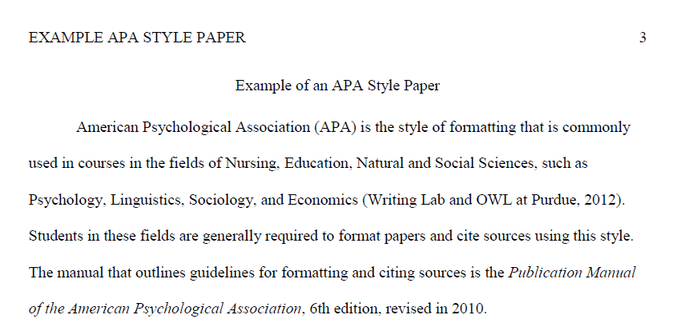
Example of an MLAStyle Paper

Slide 11
Documenting Sources
Citing: giving credit to sources of ideas, facts, graphics, tables, etc., that are not one’s own.
Plagiarism: failure to cite, even accidently
  Using other’s work
  Using your previous work
Three types of citations for MLA format:
  Citation in Prose
  Parenthetical or in-text
  Works Cited page

Slide 12
Citation in Prose
Citation in prose is citing the author within the body of the paper.
Examples:
  Naomi Baron broke new ground on the subject.
  According to the article “Bhakti Poets,” female bhakti poets “faced overwhelming challenges through their rejection of societal norms and values.”

Slide 13
Parenthetical (In-text)
Citations
Parenthetical citing is citing sources within the body of the paper.
MLA requires the author’s/authors’ last name(s) and/or page number
  If the source is not paginated, only the name/s are required.
Examples:
  (Baron)
  (“Bhakti Poets”)
  (Baron 194)

Slide 14
Parenthetical Citations
One author
  (Baron 194)
Two authors
  (Lemery and Auerbach 4-5)
Three or more
  (Nickerson et al. 135)
    “et al.” is used for every use of the citation.

Slide 15
Parenthetical Citations
If no author is identified, use the first few words of the title in place of the author.
If no date is provided, use "n.d." in place of the date.
Example:
  Changes in Americans' views of gender status differences have been documented (“Gender and Society,” n.d.).

Slide 16
Parenthetical Citations
Parenthetical citations in MLA 9th ed. are to be in the following format: (Last name page number)
  Zombies eat brains (Smith 87).
  Or
  According to Smith, zombies eat brains (87).
What appears within the sentence does not appear in the parenthetical citation.

Slide 17
Parenthetical Citations
Use “and” if the authors’ names are in the sentence.
  Others, like Jay Lemery and Paul Auerbach, note that doctors have not yet adequately explained the effects climate change will have on human health (4-5).
Use the ampersand (&) if their names are in the parenthetical citation.
  Others note that doctors have not yet adequately explained the effects climate change will have on human health (Lemery & Auerbach 4-5).

Slide 18
Works Cited Page
Cited sources in the body of paper need to be listed on the Works Cited page.
The Works Cited page:
  a bibliographical list of all sources used in the body of the paper
  goes on a separate page of its own, even if there is space left after the closing paragraph
  numbered as part of the entire paper as the last page of the document

Slide 19
Formatting the Works Cited Page
Maintain page numbers, margins, and spacing.
Label and center the top of paper with the heading:
  Works Cited (multiple sources)
  Work Cited (for one source)
Alphabetize sources by the first element in the entry.
  There is a button in Microsoft Word for this function (the “Sort” tool) in the Paragraph settings above the Paint Can tool.
    In the dialogue box, choose sort by “Paragraphs” and set the type to “Text.”
      “Text” only sorts by letters, so sources that begin with punctuation have to be moved manually.

Slide 20
Formatting the Works Cited Page
Use hanging indents for each entry.
  First line of each entry is flush left against margin.
  Second and subsequent lines are indented one-half inch, a.k.a. hanging indent
  To do this, highlight your sources, right-click, choose “Paragraph…,” go to “Indentation,” find “Special,” and set it to “Hanging.”

Slide 21
Works Cited Page
If listing by the author’s name
  author’s name is inverted (last name, first initial, middle initial)
  Example: Berry, T. J.
If a work has more than one author
  Invert all the authors’ names.
  Follow with a comma; insert the & before name of last author.
  Example: Berry, T. J., Format, O. K., & Modern, M.

Slide 22
Basic Structure For Citing Works
Formatting depends on the type of source.
All basic formats begin with
  author’s last name and first initials
  title
  publisher
  publication date
  location

Slide 23
Citing: Book
Author’s last name, first and middle initial. Title of book. Publisher’s name, year
Last Name 4
Work Cited
Mantel, Hilary. Wolf Hall. Picador, 2010.

Slide 24
Citing: Website
Author’s last name, first name. “Article title.” Name of Website. Date Published, URL
Author’s last name, first name. “Article title.” Name of Website. Retrieved Date from URL
The retrieved from date is only needed when there is no published date for ALL electronic sources.
Last Name 4
Work Cited
Deresiewicz, William. “The Death of the Artist—and the Birth of the Creative Entrepreneur.” The Atlantic, 28 Dec. 2014, theatlantic.com/magazine/archive/2015/01/ the-death-of-the-artist-and-the-birth-of-thecreative-entrepreneur/383497/.

Slide 25
Citing: Journal Article Accessed Online
Author(s) last name, first and middle initials. “Title of article.” Name of Journal,
vol. , no. , date published. doi link or (Retrieved from date)URL
Last name 4
Work Cited
Goldman, Anne. “Questions of Transport: Reading Primo Levi Reading Dante.” The Georgia Review, vol. 64, no. 1, spring 2010, pp. 69-88. JSTOR, www.jstor.org/stable/41403188.

Slide 26
Citing: eBook
Author’s last name, first and middle initial. Title of book. E-book, publisher , published year.
Last Name 4
Work Cited
Silva, Paul J. How to Write a Lot: A Practical Guide to Productive Academic Writing. E-book, American Psychological Association, 2007.

Slide 27
  Student Resources
For more APA resources, visit the Writing Center’s website:
  Google “APSU Writing Resources.”
Check out the many resources available to you online!
  https://owl.purdue.edu/owl/research_and_citation/mla_style/mla_formatting_and_style_guide/mla_formatting_and_style_guide.html
  https://style.mla.org/

Slide 28
Any questions?

