Slide 1
APA 7th Edition
Department of Language & Literature
Created by APSU Writing Center

Slide 2
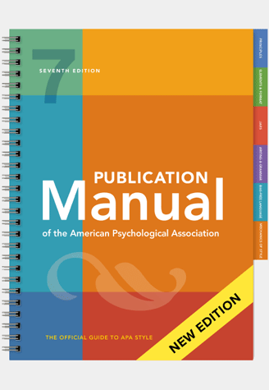
American Psychological Association (APA)
Used in many disciplines
Nursing
Sociology
Education
Psychology
Social Work
Communications
Latest updated edition is the 7th edition, dated 2019
Notes:
APA style was originally developed for psychology, but it is now used in many disciplines, including education, nursing, and social work, among others.

Slide 3
General Formatting Guidelines
Margins
All margins: 1-inch
Paragraph Settings
Left-Aligned, Unjustified
Indent paragraphs ½ inch.
Double space throughout the entire paper.
Set default settings in Microsoft Word to 0 and check the box “Don’t add space between paragraphs of the same style.”
Font Type and Size
Calibri 11, Arial 11, Lucida Sans Unicode 10, Times New Roman 12, and Georgia 11.
Use one space after the end of each sentence.

Slide 4
Header
The header of every page.
Formatting:
Cannot exceed 50 characters, including spaces and punctuation. If the title is long, use a shortened title.
Type the title in all capital letters after typing “Running head” in lowercase letters.
Word “head” is not capitalized.
“Running head:” is not required for student papers.

Slide 5
Running Head and Page Numbers
Header title: flush against the upper-left margin.
Page numbers: flush against the upper-right margin.
Both should appear on every page of the document beginning with title page.

Slide 6
Example of Running Head
Running head: APA STYLE OF FORMATTING PAPERS 1

Slide 7
Title Page
Title page includes five elements:
Running head
Page number
Title (12 words or less)
Author’s name
University affiliation
If required by the professor, the affiliation can be replaced with the course name and number.
An author’s note may also be included, but only if the professor requests it.

Slide 8
Heading
Horizontally center the title between the left and right margins.
Position it vertically in top third of the page.
Follow with your name and university affiliation.
Double-space these three lines.

Slide 9
The Title
Concisely state main idea of the paper.
Use no more than 12 words.
It may be written on two lines if title too long.
If your title is too long, shorten it.
Title Page Title: Specific Classroom Techniques for Left-handed Students in a High School Art Course
Header Title: CLASSROOM TECHNIQUES FOR LEFT-HANDED STUDENTS

Slide 10
Title Page Example
Running head: APA STYLE OF FORMATTING PAPERS 1
APA Style of Formatting Papers
Tiberius P. Herman
Austin Peay State University

Slide 11
The Body Of The Paper
The header after page one should no longer contain “Running head:”.
After inserting the header in Word, select the option “Different First Page.”
For your first page of content, the running head should have the title in all capital letters, and the page number will begin with 2. You will have to type this into the second page header.

Slide 12
Example Header For Page 2 and Forward
APA STYLE OF FORMATTING PAPERS 2

Slide 13
The Body
Title
Center the paper’s full title (in uppercase and lowercase letters) on the first line below the running head on page 2 only.
Pagination
Body of the paper begins on a new page (page 2).
Maintain the running head on subsequent pages.

Slide 14
The Abstract
An abstract is a summary of the essay/research.
Should include a brief description of the problem being investigated, the methods used, the results, and their implications.
Includes keywords which identify the content covered and discussed.
Function like hashtags

Slide 15
Abstract Format
Only appears on the second page.
Center the word “Abstract” at the top of the page.
One paragraph
No indent needed
Must be 150-250 words
Ends with keywords (optional)

Slide 16
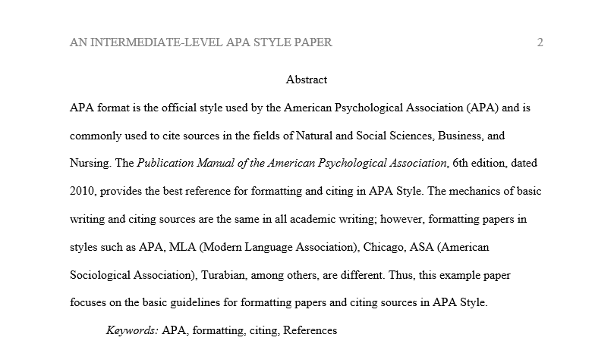
Abstract Example

Slide 17
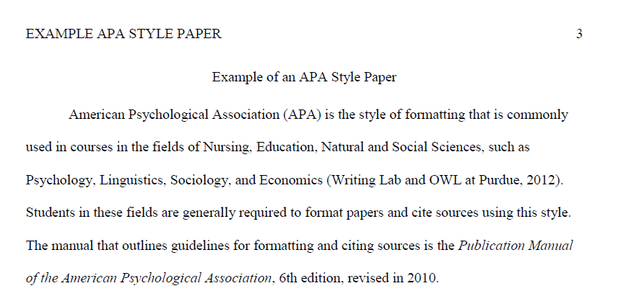
Example of an APA Style Paper

Slide 18
Documenting Sources
Citing: giving credit to sources of ideas, facts, graphics, tables, etc., that are not one’s own.
Plagiarism: failure to cite, even accidently
Using other’s work
Using your previous work
Two types of citations for APA format:
Parenthetical or in-text
References page

Slide 19
Parenthetical (In-text) Citations
Parenthetical citing is citing sources within the body of the paper.
APA requires the author’s/authors’ last name(s), year of publication, and the page number.
If the source is not paginated, only the name/s and the year of publication are required.
Examples
(Adams, 1979, p. 42)
(Prefect, 2004)
Adams (1979) presented the answer to “life, the universe, and everything” (p. 42).

Slide 20
Parenthetical Citations
One author
(Smith, 2018, p. 33)
Two authors
(Zhou & Lopez, 2019, pp. 65-66)
Three or more
(Miller et al., 2017)
“et al.” is used for every use of the citation.

Slide 21
Parenthetical Citations
If no author is identified, use the first few words of the title in place of the author.
If no date is provided, use "n.d." in place of the date.
Example:
Changes in Americans' views of gender status differences have been documented (“Gender and Society,” n.d.).

Slide 22
Parenthetical Citations
Parenthetical citations in APA 7th ed. are to be in the following format: (Last name, year published, page number)
Zombies eat brains (Smith, 2012, p. 87) Or
According to Smith (2012), zombies eat brains (p. 87).
What appears within the sentence does not appear in the parenthetical citation.

Slide 23
Parenthetical Citations
Use “and” if the authors’ names are in the sentence.
Lewis and Johnson’s (2006) study concluded, “Students often had difficulty using APA style, especially while citing sources for the first time” (p. 64).
Use the ampersand (&) if their names are in the parenthetical citation.
The educators’ study concluded, “Students often had difficulty using APA style, especially while citing sources for the first time” (Lewis & Johnson, 2006, p. 64).

Slide 24
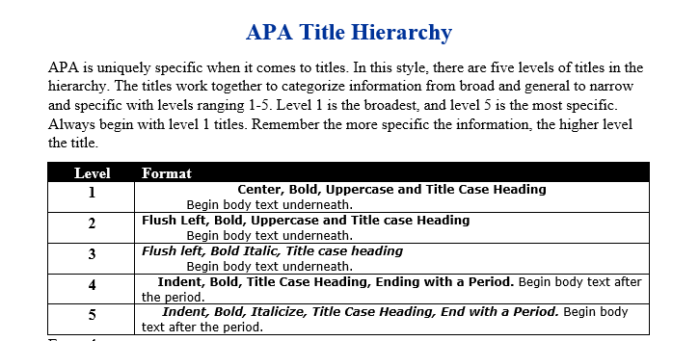
Headings

Slide 25
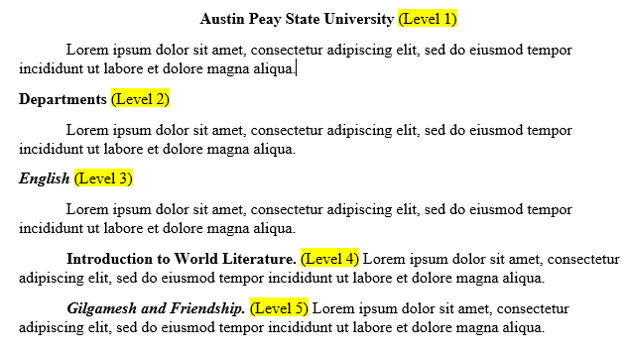
Headings Examples

Slide 26
References Page
Cited sources in the body of paper need to be listed on the References page.
The References page:
a bibliographical list of all sources used in the body of the paper
goes on a separate page of its own, even if there is space left after the closing paragraph
numbered as part of the entire paper as the last page of the document

Slide 27
Formatting the References Page
Maintain running head, page numbers, margins, and spacing.
Label and center the top of paper with the heading:
References (multiple sources)
Reference (for one source)
Alphabetize sources by the first element in the entry.
There is a button in Microsoft Word for this function (the “Sort” tool) in the Paragraph settings above the Paint Can tool.
In the dialogue box, choose sort by “Paragraphs” and set the type to “Text.”
“Text” only sorts by letters, so sources that begin with punctuation have to be moved manually.

Slide 28
Formatting the References Page
Use hanging indents for each entry.
First line of each entry is flush left against margin.
Second and subsequent lines are indented one-half inch.
To do this, highlight your sources, right-click, choose “Paragraph…,” go to “Indentation,” find “Special,” and set it to “Hanging.”

Slide 29
References Page
If listing by the author’s name
author’s name is inverted (last name, first initial, middle initial)
Example: Berry, T. J.
If a work has more than one author
Invert all of the authors’ names.
Follow with a comma; insert the & before name of last author.
Example: Berry, T. J., Format, O. K., & Modern, M.

Slide 30
Basic Structure For Referencing Sources
Formatting depends on the type of source.
All basic formats begin with
author’s last name and first initials
date of publication in parentheses
title

Slide 31
Citing: Book
Author’s last name, first and middle initial. (year). Title of book. Publisher’s name.
APA STYLE OF FORMATTING 4
Reference
Modern, J. (2011). APA is better than MLA. Longman.

Slide 32
Citing: Website
Author’s last name, first initial. (Publication date). Article title. Name of Website. URL
Author’s last name, first initial. (Publication date). Article title. Name of Website. Retrieved Date from URL
The retrieved from date is only needed when there is no published date for ALL electronic sources.
APA STYLE OF FORMATTING 4
References
Schierholz, C. (2015). NASA releases plan outlining next steps in journey to Mars. NASA.
https://www.nasa.gov/press-release/nasa-releases-plan-outlining-next-steps-in-the-journey-
to-mars
Hur, J. (n.d.). History of mobile cell phones: The first cell phone to present time. BeBusinessed. Retrieved
January 23, 2020 from https://bebusinessed.com/history/history-cell-phones/

Slide 33
Citing: Journal Article Accessed Online
Author(s) last name, first and middle initials. (year of publication). Title of article. Name of Journal, Volume(Issue Number), page range. doi link or (Retrieved from date)URL
APA REFERENCE EXAMPLES 4
References
Brownlie, D. (2007). Toward effective poster presentations: An annotated bibliography. European Journal of Marketing, 41, 1245-1283. https://doi.org/10.1108/03090560710821161
Smyth, A. M., Parker, A. L., & Pease, D. L. (2002). A study of enjoyment of peas. Journal of Abnormal Eating, 8(3), 120-125. Retrieved November 12, 2018 from http://www.articlehomepage.com/full/url/

Slide 34
Citing: eBook
Author’s last name, first and middle initial. (year). Title of book. Publisher’s name. Website name. URL.
APA STYLE OF FORMATTING 4
Reference
Carroll, L. (1917). Alice’s adventures in Wonderland. MacMillan & Co. Google Play Books. https://play.google.com/books/reader?id=Y7sOAAAAIAAJ&pg=GBS.PP11.w.1.0.0.1

Slide 35
Student Resources
For more APA resources, visit the Writing Center’s website:
Google “APSU Writing Resources.”
Check out the many resources available to you online!
APA Blog

Slide 36
Any questions?

