Slide 1
Degree Works
Version 5.0.4

Slide 2
Agenda
01
Process Button
02
Substitutions and Waivers
03
Common Errors

Slide 3
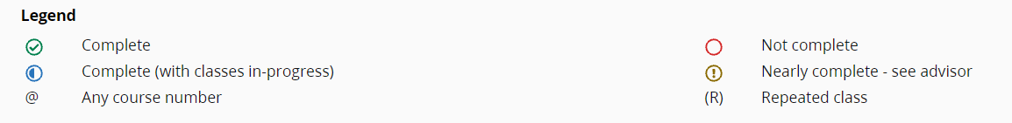

Legend
Add Exception

Slide 4
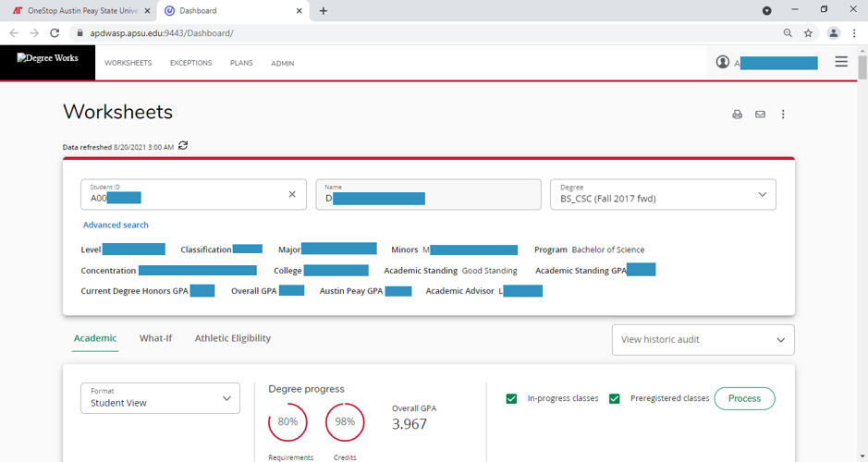
Please ensure data refreshed date is current. If not, select the “refresh” icon.

Slide 5

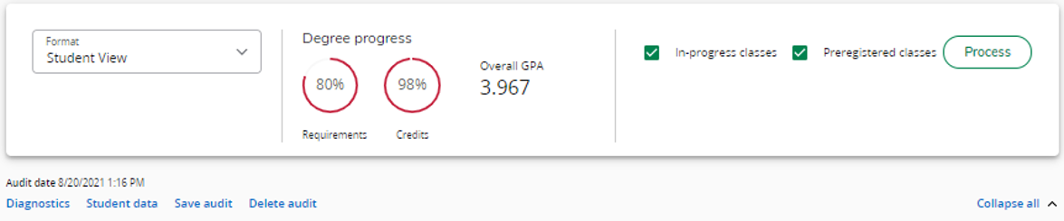
Process Button
To ensure that data is presented correctly, Advisor must click on
Check Audit date to ensure audit details are up to date

Slide 6
Substitutions and Waivers

Slide 7
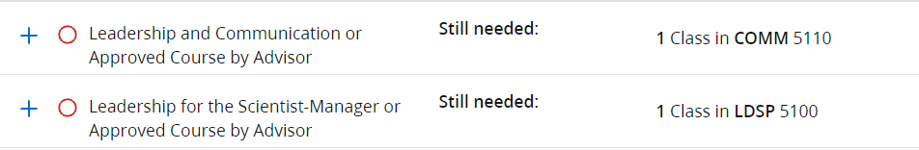
Getting to the Exception page
Click on the Exceptions link at the top of the Audit page to Access Substitutions and Waivers form
Scroll down to the item that requires the exception
Click + next to said item

Slide 8
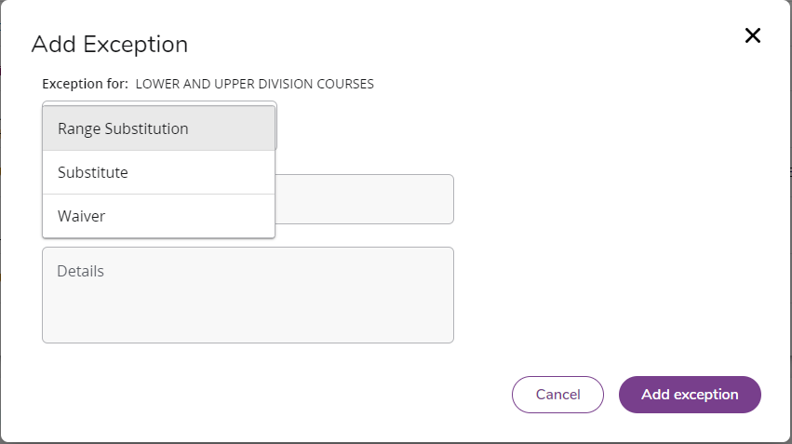
Add Exception
Select Exception Type:
Waiver: Complete requirement
Substitution: Replace course requirement
Range Substitution: Replace course range requirement

Slide 9
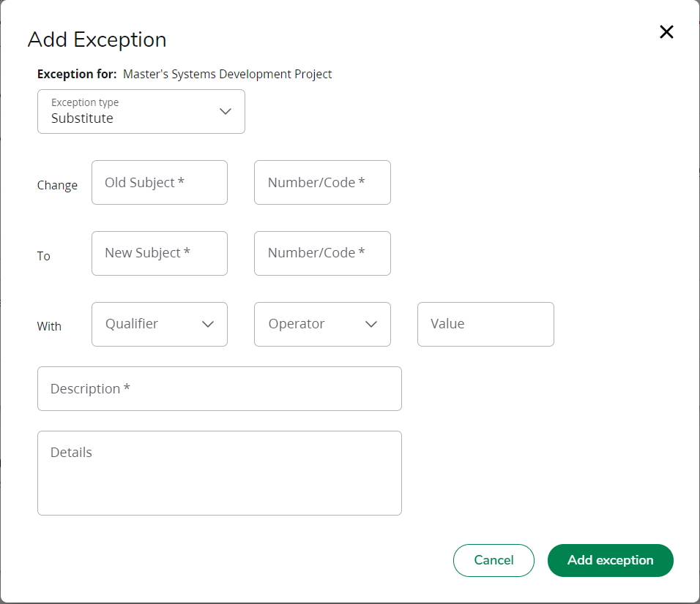
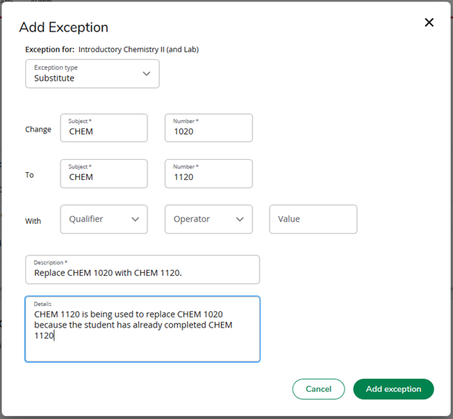
Substitution Form
These are used for transferred course substitutions only

Slide 10
Example 1a: Substitutions for non-transferred courses
Sub the requirement CHEM 1020 with CHEM 1120
CHEM 1120 taken at APSU
CHEM 1020 not yet taken

Slide 11
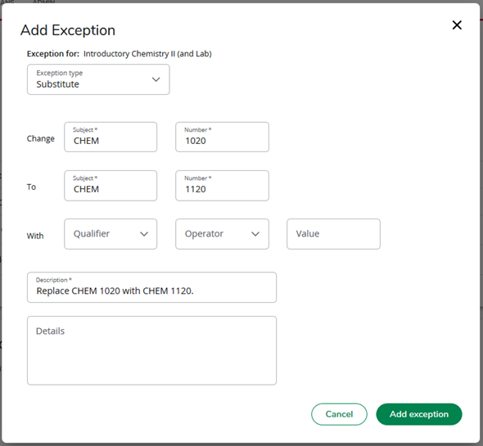
Step 1:
In Change: Input Original Course REQUIREMENT

Slide 12
Step 2:
In To: Input new course REQUIREMENT

Slide 13
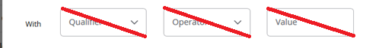
NOTE:
For non-transfer course: leave the With section blank

Slide 14


Step 3:
Description IS NOT to type comments
Description MUST be in the format below
Type: Replace original course requirement with new course requirement

Slide 15

Step 4:
Details box is for optional comments.
(However, adding comment is recommended, especially for unusual cases. Department chairs may reject a substitution/waiver if there is not adequate information explaining the reason for the substitution/waiver)
Step 5:
Click

Slide 16
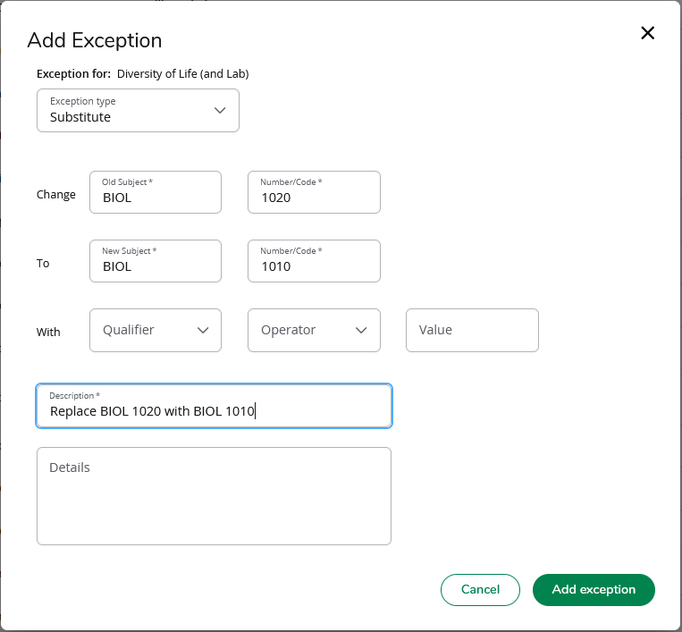
Example 1b: Substitutions for courses with labs
Click on the + next to the requirement to substitute the course
Fill out the form to substitute for the lecture course as instructed in Example 1

Slide 17
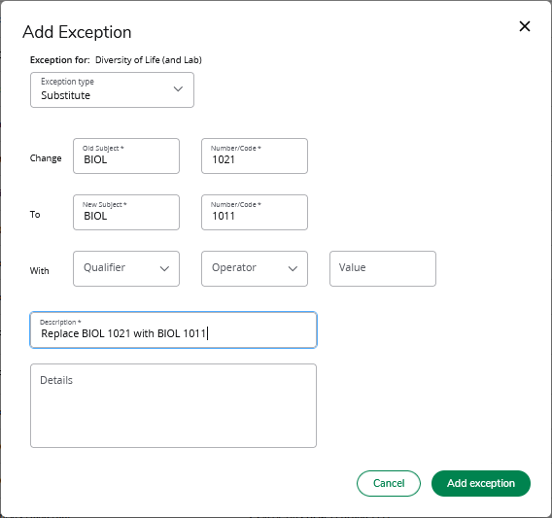
Click on the + next to the requirement to substitute the lab
Fill out the form to substitute the lab course as instructed in Example 1a

Slide 18
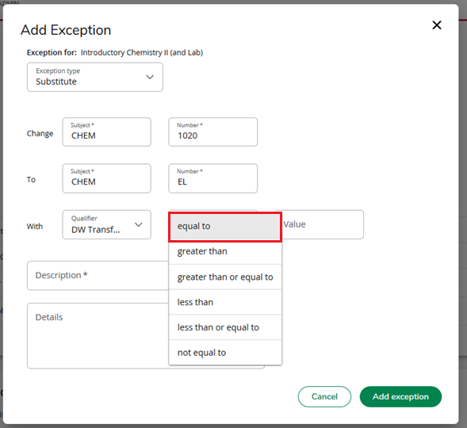
Example 1c: Substitutions for transferred courses
Step 1 & 2:
Sub the requirement CHEM 1020 with CHEM EL
CHEM1234 is the transferred Course NUMBER (original course number from the transferring institution)
CHEM EL is the transferred Course NAME (course name as it appears on APSU’s audit)
CHEM EL is transferred
CHEM EL already taken
CHEM 1020 not yet taken (required APSU course)
Follow Step 1&2 from Example 1

Slide 19
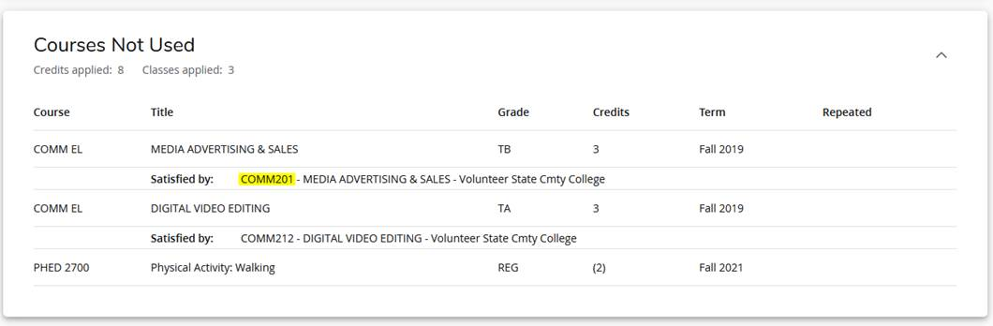
How to find Transferred Course Number
Will need for substitution using transferred course
WORKSHEETS => Scroll down to said transferred course
Course Number can be found next to “Satisfied by”:
CHEM EL
INTRO TO CHEMISTRY
CHEM1234 - INTRO TO CHEMISTRY

Slide 20
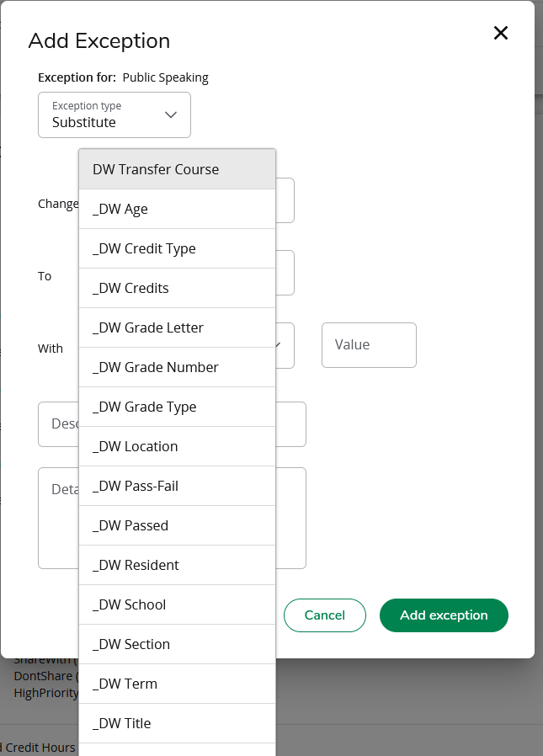
Step 3.1:
In With:
Click on Qualifier
Choose DW Transfer Course
Must choose DW Transfer Course. Any other Selection will result in an Error

Slide 21
Step 3.2:
Must choose “Equal to”. Any other Selection will result in an Error
In “With”:
Click on “Operator”
Choose “equal to”

Slide 22
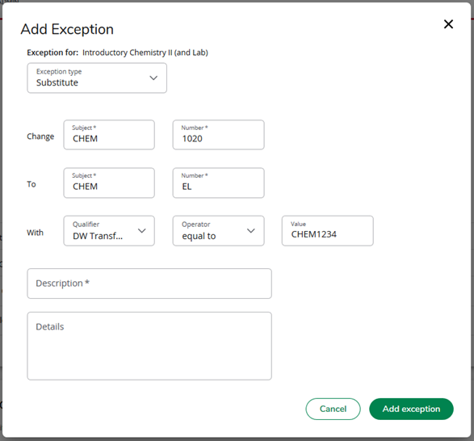
Step 3.3:
Must type course NUMBER and NOT the course NAME ad it appear on the audit.
In “With”:
Click on “Value”
Type the new Course’s EXACT course NUMBER (Refer to slide 19 for further instruction)

Slide 23
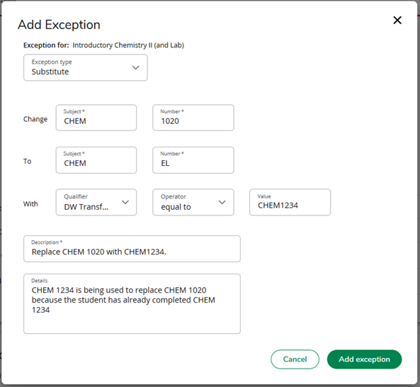
Step 4:
Follow Steps to complete Descriptions and Details as said in Example 1a (Slide 14 & 15)
Must have no space between letters and numbers.
This information can be found using the instructions on slide 17
Must be in
the format: Replace old requirement with the value in the “Value” block in the “With” section

Slide 24
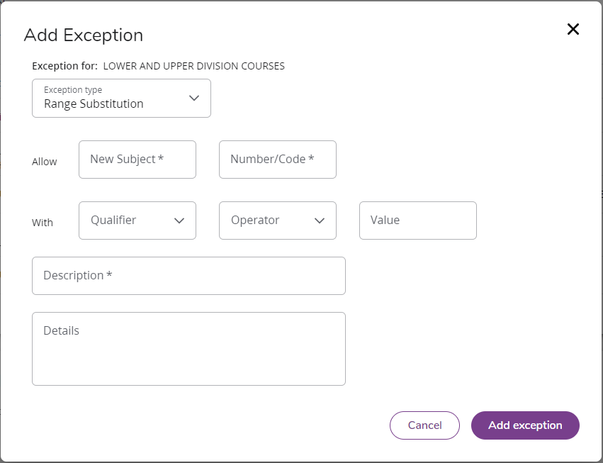
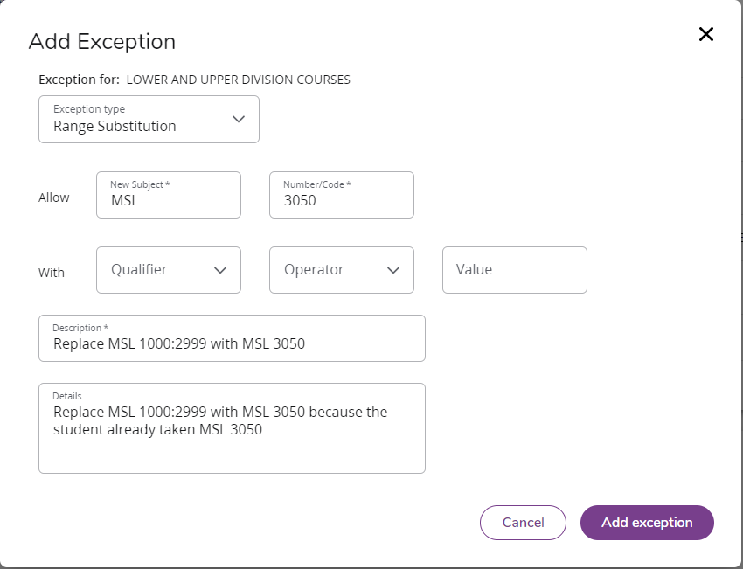
Range Substitution Form
These are used for transferred course substitutions only

Slide 25
Example 2a: Explanation (Substitution for a range using a non-transfer course)
Sub the requirement MSL 1000:2999 with MSL 3050
MSL 3050 is already taken at APSU

Slide 26
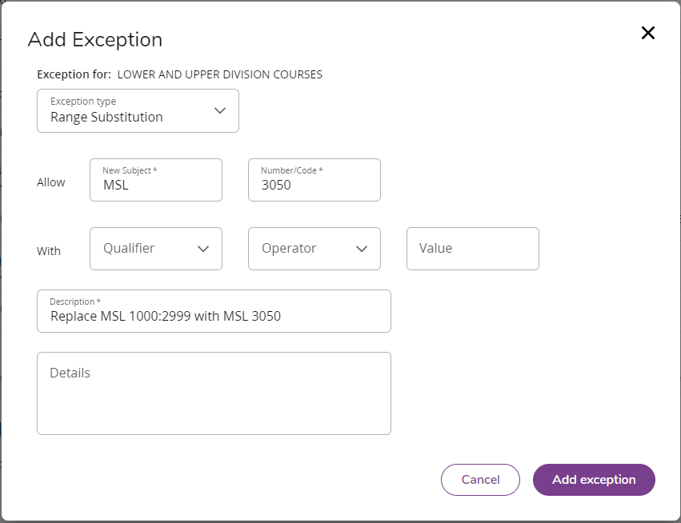
Step 1:
In Allow: Input the new course requirement

Slide 27
NOTE:
For non-transfer course: leave the With section blank

Slide 28
Step 2:
Description IS NOT to type comments
Description MUST be in the format below
Type: Replace <original course range requirement> with <new course requirement>

Slide 29
Step 3:
Details box is for optional comments.
(However, adding comment is recommended, especially for unusual cases. Department chairs may reject a substitution/waiver if there is not adequate information explaining the reason for the substitution/waiver)
Step 4:
Click

Slide 30
Example 2b: Explanation (Substitution for a range using a transferred course)
Sub the requirement MSL 1000:2999 with MSL EL
MSL EL is the course NAME
MSL103 is the course NUMBER

Slide 31
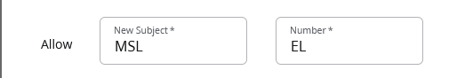
Step 1:
In Allow: Input the new course requirement

Slide 32
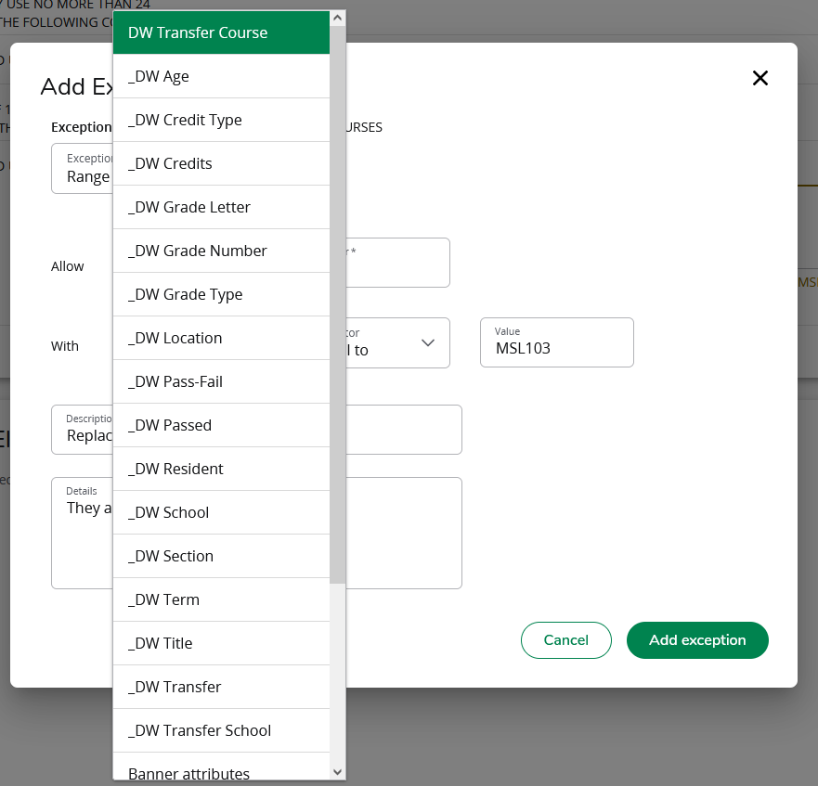
Step 2.1:
In With:
Click on Qualifier
Choose DW Transfer Course
Must choose DW Transfer Course. Any other Selection will result in an Error

Slide 33
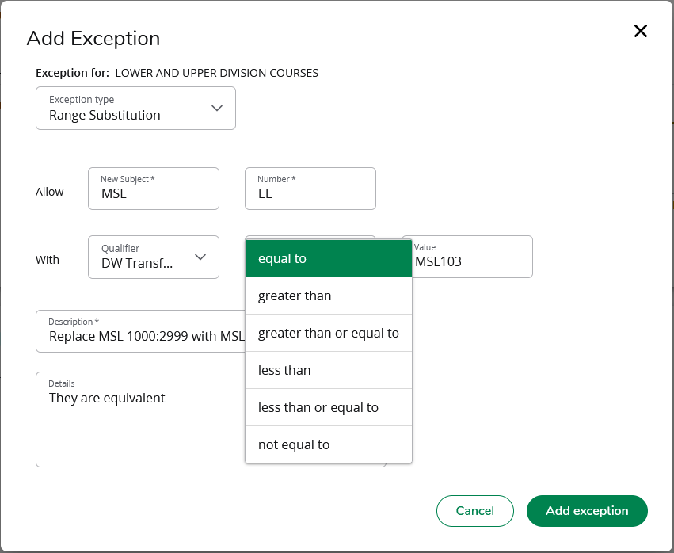
Step 2.2:
Must choose “Equal to”. Any other Selection will result in an Error
In “With”:
Click on “Operator”
Choose “equal to”

Slide 34
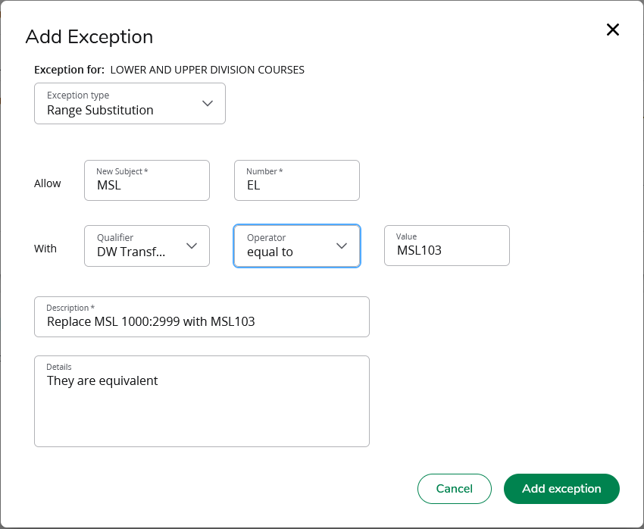
Step 2.3:
Must type course NUMBER and NOT the course NAME ad it appear on the audit.
In “With”:
Click on “Value”
Type the new Course’s EXACT course NUMBER (Refer to slide 19 for further instruction)

Slide 35
Step 3:
Follow Steps to complete Descriptions and Details as said in Example 1a (Slide 14 & 15)
Must have no space between letters and numbers.
This information can be found using the instructions on slide 19
Must be in
the format: Replace old requirement with the value in the “Value” block in the “With” section

Slide 36
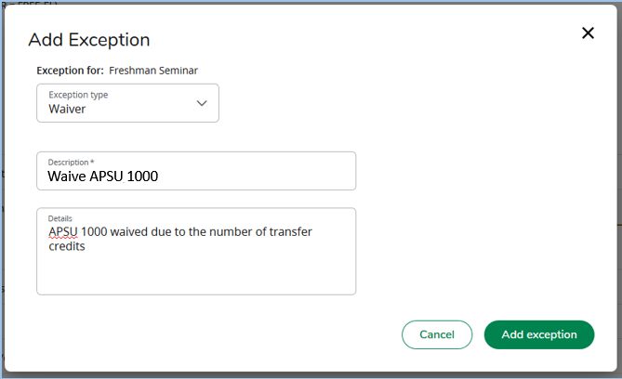
Example 3 Explanation (Waive Requirement)
Step 1:
Step 2:
Waive APSU 1000 Requirement
In Description, type:
Waive course requirement
In Details:Type optional (but very much recommended) further comments

Slide 37
Common Errors

Slide 38
Substitute or Waive Errors
While at the WorkSheet
Please contact us as soon as first Error is encountered before trying again
Was the wrong + clicked?
Typo
Adding Exception for already used class
Having spaces in the course NUMBER
Is the WorkSheet refreshed?
Is the “Process” Button pressed?

Slide 39

Thank you for listening!
Questions?
Contact Us:
degree-works@apsu.edu
Sherry Comperry - Degree Works Coordinator
Joe Waltz - Degree Works Technician
Quynh Tran - Degree Works Technician
Curtis Compton - Degree Works GA

