Slide 1


Remote Testing & Alternative Assessments
Amor Moran
Director, Distance Education
moranl@apsu.edu
Amanda Wornhoff, Ed.D.
Director, Institutional Effectiveness and Assessment
wornhoffa@apsu.edu
July 2020

Slide 2

In this series
Selecting assessments
Alternatives to (proctored) testing
Best practices for assessments in a remote learning environment
Resources for remotely proctored tests

Slide 3
Learning outcomes
After viewing this series, we hope you will:
Reflect on your options for assessing students in your courses
Consider alternatives to remotely proctored tests, where appropriate
Understand the resources available to you for testing and alternative assessments in D2L and other instructional technologies
Know the current options and procedures for remote proctoring at APSU (updates since spring 2020)

Slide 4
Selecting Assessments
Reflect on your options for assessing students in your courses this fall

Slide 5
Assessment Types*
In-person, proctored test
Synchronous
Not possible in remote learning
Online, remotely proctored test
Synchronous or asynchronous
Usually timed
Online, unproctored test
Asynchronous
Timed or untimed
Higher-order learning and/or open-book
i.e., Beyond recall
Alternative assessments
Applied project/assignment
Analysis/Synthesis
Reflection/Metacognition
*Not an exhaustive list!

Slide 6
Considerations
Course learning outcomes
What do you want students to be able to know or do after taking this course?
How will students demonstrate their progress toward course learning outcomes?
Purpose of assessments
What do you hope to learn from the assessments in this course?
What do you hope students learn or gain from the assessments in this course?
Technology, technology, technology
Class size
Time
External or internal mandates (e.g. accreditation)

Slide 7
Remote Proctoring
Benefits
Challenges
Most “secure”
Nothing is 100% secure
Clearly conveys focus on academic integrity
Technology barriers
Web cam
Stable internet
Third party logins or software (not Zoom)
Intrusive surveillance on students in their homes
Costly (not Zoom)

Slide 8
Un-proctored tests (including “open book” or “take home” tests, lower-stakes quizzes)
Benefits
Challenges
Fewer technology requirements
Open-book tests often focus on higher-order learning
Quizzing can help assess learning throughout the semester
Less secure than proctored exams
Not suitable for high-stakes recall of information, particularly as required by external agencies
May require more design or grading time

Slide 9
Alternative Assessments
Benefits
Challenges
Allow students to demonstrate learning in a variety of formats (especially when combined with tests/quizzes)
Can help students apply or synthesize knowledge in specific contexts
Often provide opportunities for more in-depth assessment of student learning
May require more design and grading time
Students may be less familiar with these types of assessments
If new to you, will take time to "calibrate" a new assignment

Slide 10
Varied assessments
Applied projects/ assignments
Testing
Analysis/synthesis
Reflection/ metacognition
Teaching
Learning
Assessment

Slide 11
Best Practices for Assessments
Be transparent
Purpose – Why this assessment? What outcomes does it serve?
Task - What will students be asked to do? When? How?
Criteria – How will students be graded? What are the specific criteria?
Communicate clearly and frequently
Before – Design carefully, prepare students, provide examples/practice
During – Reiterate expectations, take and respond to questions, be prepared for challenges
After – Follow-up with students, ask them to reflect
Applicable to any assessments, but particularly critical in the remote learning environment.
Transparency in Learning and Teaching (TILT) Framework
https://tilthighered.com/

Slide 12
Best Practices for Assessments
Vary assessment methods
Multiple ways to demonstrate learning
Assessments designed for learning (not only for evaluation)
Low-stakes or scaffolded assessments building to major assessments
Engage students in academic integrity
Provide information and resources
Directly address integrity in selection and design of assessments
Create opportunities for reflection or discussion, even if briefly
Applicable to any assessments, but particularly critical in the remote learning environment.
Notes:
Plagiarism exercises from Cornell University: https://plagiarism.arts.cornell.edu/tutorial/exercises.cfm

Slide 13
Remote Testing & Alternative Assessments
Amor Moran
Director, Distance Education
moranl@apsu.edu
Amanda Wornhoff, Ed.D.
Director, Institutional Effectiveness and Assessment
wornhoffa@apsu.edu
July 2020

Slide 14
In this series
Selecting assessments
Alternatives to (proctored) testing
Best practices for assessments in a remote learning environment
Resources for remotely proctored tests

Slide 15
Learning outcomes
After viewing this series, we hope you will:
Reflect on your options for assessing students in your courses
Consider alternatives to remotely proctored tests, where appropriate
Understand the resources available to you for testing and alternative assessments in D2L and other instructional technologies
Know the current options and procedures for remote proctoring at APSU (updates since spring 2020)

Slide 16
Alternative assessments
Consider alternatives to remotely proctored tests, where appropriate
Understand the resources available to you for testing and alternative assessments in D2L and other instructional technologies

Slide 17

Alternative Assessments
Alternative assessments can be combined with testing.
This approach gives students multiple ways to demonstrate learning and instructors multiple ways to assess learning throughout the course.
Notes:
Significant overlap across assessment types
Consider selecting a combination of assessment types
Take high-stakes weight off exams

Slide 18
Varied Assessments
Applied projects/ assignments
Testing
Analysis/synthesis
Reflection/ metacognition
Teaching
Learning
Assessment

Slide 19
Quizzing
Quizzes can be used in lieu of, or in conjunction with, higher-stakes testing
In D2L, quizzes can
Be timed or untimed
Randomize questions
Include an upload of handwritten or typed work to accompany answers
Be averaged into the gradebook
Quizzes can also be used to assess student learning of key concepts or to ask them to reflect on their own learning

Slide 20
Open-book tests
Open-book tests allow students to use course materials and other resources during the test.
Open-book tests often include questions that require interpretation, application, or critical thinking.
Apply knowledge to case-based or problem-based scenarios
Interpret quantitative or qualitative data
Identify examples of key concepts
Grapple specifically with content from course materials, lectures, discussions
Notes:
Additional resources for open-book tests
Tips for Creating Open-book Exams – IU Bloomington: https://blogs.iu.edu/citl/2020/03/27/open-book-exams/#.XxXfGShKhQA
Rutgers SAS – Special advice for open-book assessments in quantitative courses: https://sasoue.rutgers.edu/teaching-learning/remote-exams-assessment#special-advice-for-open-book-assessment-in-quantitative-courses
University of Newcastle – Guide for Academics: Open-book exams: https://www.newcastle.edu.au/__data/assets/pdf_file/0006/268980/Open-Book-Exams.pdf
How to Write Better Tests – Bloomington Testing and Evaluation Service: https://austinpeay-my.sharepoint.com/:b:/g/personal/wornhoffa_apsu_edu/ESR7OQuUN_9Om1cif7t5EzIBQ8y4JeLVqQCVckWoSsNZrQ?e=j1671j

Slide 21
Open-book tests: Considerations
Questions should be as clear and unambiguous as possible
This can be tricky since these types of questions can be more subjective.
Open-ended questions require more grading time
A mix of multiple choice, open-ended, and other question formats may be best for open book exams
Open-book tests typically have less questions then closed-book tests
Students may tend to underprepare
This can be mitigated with clear expectations and tips on preparation

Slide 22
Open-book tests: Tips
Keep the time tight, within reason
Strive for a balance of urgency and inclusiveness
Make the questions tough
Include higher-order questions that can't be easily Googled
Add options for "showing their work" and/or reflection on responses
Recognize collaboration
Can some collaboration be allowed (or even encouraged)?
Acknowledge you know students have access to information
Provide examples of the types of of things you'll ask that can't be easily Googled or copied from course materials.
Adapted from "Why Open-book Tests Deserve a Place in Your Courses" - Matt Farrell and Shannon Maheu, Faculty Focus
https://www.facultyfocus.com/articles/educational-assessment/why-open-book-tests-deserve-a-place-in-your-courses/

Slide 23
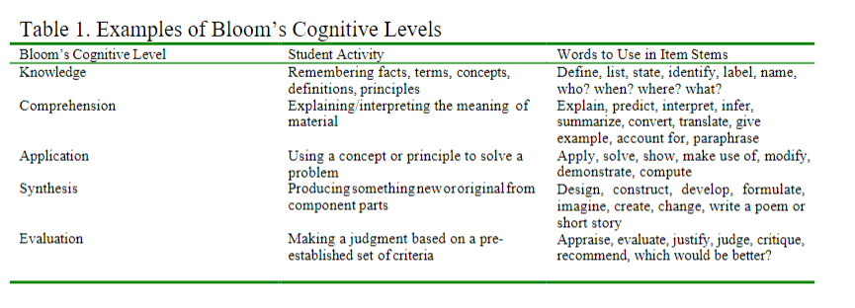
(Re)writing test questions
From "How to Write Better Tests" - Bloomington Evaluation and Test Service (BEST) available here: https://iu.app.box.com/s/aevsahmonow0i4iikzpajckyxnx3yc78

Slide 24
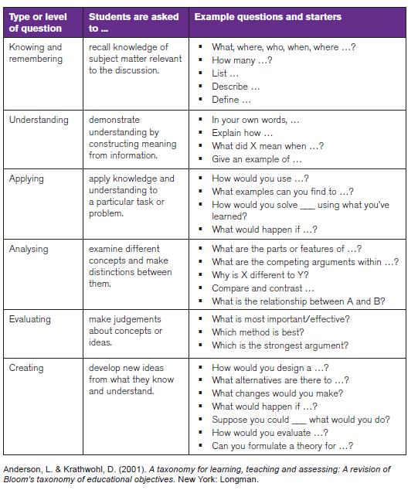
(Re)writing test questions
From "A Guide for Academics – Open Book Exams" - University of Newcastle Australia CTL
https://www.newcastle.edu.au/__data/assets/pdf_file/0006/268980/Open-Book-Exams.pdf

Slide 25
Analysis/Synthesis
Assignment example | Instructional technology resources
Case study Analysis paper Presentation Test/quiz | D2L Discussion Board D2L Writing Assignment D2L Quiz
Review or critique Apply course concepts to article, event, performance, experience Traditional paper or other media | D2L Assignment (multimedia available)
Debate Live debate Asynchronous discussion Recorded videos Dialogue paper | Zoom D2L Discussion Board D2L Writing Assignment
Notes:
Utilizing case studies for assessment can give students a chance to demonstrate their learning in a course by analyzing a scenario (real or imagined) and applying knowledge and skills to describe, define, evaluate, predict, or solve issues present in the scenario.
Case studies can be used for a stand-alone assessment, wherein students write or present their analysis, individually or in groups. Or, a case study could be the basis of one or more questions in an exam.
Many disciplines, like business and education, regularly use case study teaching. However, this method could be used in many different disciplines.
Case study resources
Illinois CITL – The Case Method: https://citl.illinois.edu/citl-101/teaching-learning/resources/teaching-strategies/the-case-method Brief overview of teaching with case studies, including references.
National Center for Case Study Teaching in Science (University at Buffalo Libraries) https://sciencecases.lib.buffalo.edu/collection/ Searchable database of case studies for educators. Search by subject, topic, education level, and more. Resources for and assessment of the use of case studies in the teaching of science.
Vanderbilt Center for Teaching: https://cft.vanderbilt.edu/guides-sub-pages/case-studies/ One-page guide on teaching with case studies.

Slide 26
Application
Assignment example | Instructional technology resources
Product or proposal for an external audience (real or imagined) Brochure Website Funding proposal Policy brief Fact sheet or FAQ | D2L Assignment
Problem-solving assignment Apply course learning to a problem, design a solution “Solve for everything” scenarios | D2L Assignment
Professional/research presentation | Zoom Yuja
Notes:
Problem-based learning allows students to demonstrate their learning by applying knowledge in specific context to solve a problem. PBL is often designed as a collaborative learning experience, with students working in teams. However, it can be designed as an individual assessment. Problem-based questions can also form the basis of an exam.
PBL Clearinghouse (University of Delaware): http://www1.udel.edu/pblc/index.html
Database of problems and assignments created by faculty in a variety of disciplines.

Slide 27
Reflection/Metacognition
Assignment example | Instructional technology resources
Narrated/annotated problem-solving | Students can upload files "showing their work" when testing in D2L
Exam or project wrapper | D2L Assignment (multimedia available) Qualtrics Google form
Course portfolio | D2L ePortfolio
Notes:
Exam wrappers (or assignment wrappers) give students a chance to reflect on how they plan for, study for, and complete an exam or assignment. These short reflective exercises can give instructors insights into how students study, where they struggle or succeed in preparing for or completing an exam or assignment.
Exam/assignment wrappers are typically a low-stakes accompaniment to a test or major assignment. It is recommended, though, that you make them required and/or make them worth a few points, even if for extra credit, to incentivize students to complete them and take them seriously.
APA example – concise pre/post wrapper that could be adapted for other disciplines: https://www.apa.org/ed/precollege/topss/teaching-resources/exam-wrapper.pdf
CMU Eberly Center, includes math and science examples: https://www.cmu.edu/teaching/designteach/teach/examwrappers/
Teaching Naked (definition and templates): http://teachingnaked.com/cognitive-wrappers/
Teaching Naked provides a concise definition of wrappers, as well as detailed templates for faculty and students (that would be shortened based on your selections).
Illinois CITL (90 sec video): https://mediaspace.illinois.edu/media/Exam+Wrappers+-+A+Better+Way+for+Students+to+Prepare+for+Exams/1_fokszlhn

Slide 28
Assessment redesign
Before
After
Midterm exam 20%
Final exam 30%
Quizzes 15%
Case study 15%
Open-book final 20%
Research paper 25%
Midterm exam 15%
Final exam 20%
Annotated bibliography 10%
Midterm exam 15%
Policy brief 15%
Final presentation 15%
Homework 15%
Quizzes 10%
Problem-based assignment 10%
Midterm exam 15% (open-book, annotated)
Final exam (Zoom proctored) 20%
Homework 20%
Midterm exam 20%
Final exam 30%

Slide 29
Best Practices for Assessments
Be transparent
Communicate clearly and frequently
Vary assessment methods
Engage students in academic integrity
Applicable to any assessments, but particularly critical in the remote learning environment.
Transparency in Learning and Teaching (TILT) Framework
https://tilthighered.com/

Slide 30
References
Harper College Academy for Teaching Excellence – Online Testing and Alternative Assessments: https://harper-academy.net/wp-content/uploads/2020/04/Online-Testing-Webinar-Slides.pdf
Transparency in Learning and Teaching (TILT) Framework: https://tilthighered.com/
Plagiarism exercises from Cornell University: https://plagiarism.arts.cornell.edu/tutorial/exercises.cfm
Open-book testing
"Why Open-book Tests Deserve a Place in Your Courses" - Matt Farrell and Shannon Maheu, Faculty Focus https://www.facultyfocus.com/articles/educational-assessment/why-open-book-tests-deserve-a-place-in-your-courses/
Tips for Creating Open-book Exams – IU Bloomington: https://blogs.iu.edu/citl/2020/03/27/open-book-exams/#.XxXfGShKhQA
Rutgers SAS – Special advice for open-book assessments in quantitative courses: https://sasoue.rutgers.edu/teaching-learning/remote-exams-assessment#special-advice-for-open-book-assessment-in-quantitative-courses
University of Newcastle – Guide for Academics: Open-book exams: https://www.newcastle.edu.au/__data/assets/pdf_file/0006/268980/Open-Book-Exams.pdf
How to Write Better Tests – Bloomington Testing and Evaluation Service: https://austinpeay-my.sharepoint.com/:b:/g/personal/wornhoffa_apsu_edu/ESR7OQuUN_9Om1cif7t5EzIBQ8y4JeLVqQCVckWoSsNZrQ?e=j1671j
This series curates, draws upon, and adapts from these sources.

Slide 31
References
Exam wrappers
APA example – concise pre/post wrapper that could be adapted for other disciplines: https://www.apa.org/ed/precollege/topss/teaching-resources/exam-wrapper.pdf
CMU Eberly Center, includes math and science examples: https://www.cmu.edu/teaching/designteach/teach/examwrappers/
Teaching Naked (definition and templates): http://teachingnaked.com/cognitive-wrappers/
Illinois CITL (90 sec video): https://mediaspace.illinois.edu/media/Exam+Wrappers+-+A+Better+Way+for+Students+to+Prepare+for+Exams/1_fokszlhn
Case Studies
Illinois CITL – The Case Method: https://citl.illinois.edu/citl-101/teaching-learning/resources/teaching-strategies/the-case-method
National Center for Case Study Teaching in Science (University at Buffalo Libraries) https://sciencecases.lib.buffalo.edu/collection/
Vanderbilt Center for Teaching: https://cft.vanderbilt.edu/guides-sub-pages/case-studies/
Problem-based Learning
PBL Clearinghouse (University of Delaware): http://www1.udel.edu/pblc/index.html
This series curates, draws upon, and adapts from these sources.

Slide 32
Remote Testing & Alternative Assessments
Amor Moran
Director, Distance Education
moranl@apsu.edu
Amanda Wornhoff, Ed.D.
Director, Institutional Effectiveness and Assessment
wornhoffa@apsu.edu
July 2020

Slide 33
In this series
Selecting assessments
Alternatives to (proctored) testing
Best practices for assessments in a remote learning environment
Resources for remotely proctored tests

Slide 34
Learning outcomes
After viewing this series, we hope you will:
Reflect on your options for assessing students in your courses
Consider alternatives to remotely proctored tests, where appropriate
Understand the resources available to you for testing and alternative assessments in D2L and other instructional technologies
Know the current options and procedures for remote proctoring at APSU (updates since spring 2020)

Slide 35
Remote Testing Resources
Know the current options and procedures for remote proctoring at APSU (updates since spring 2020)

Slide 36
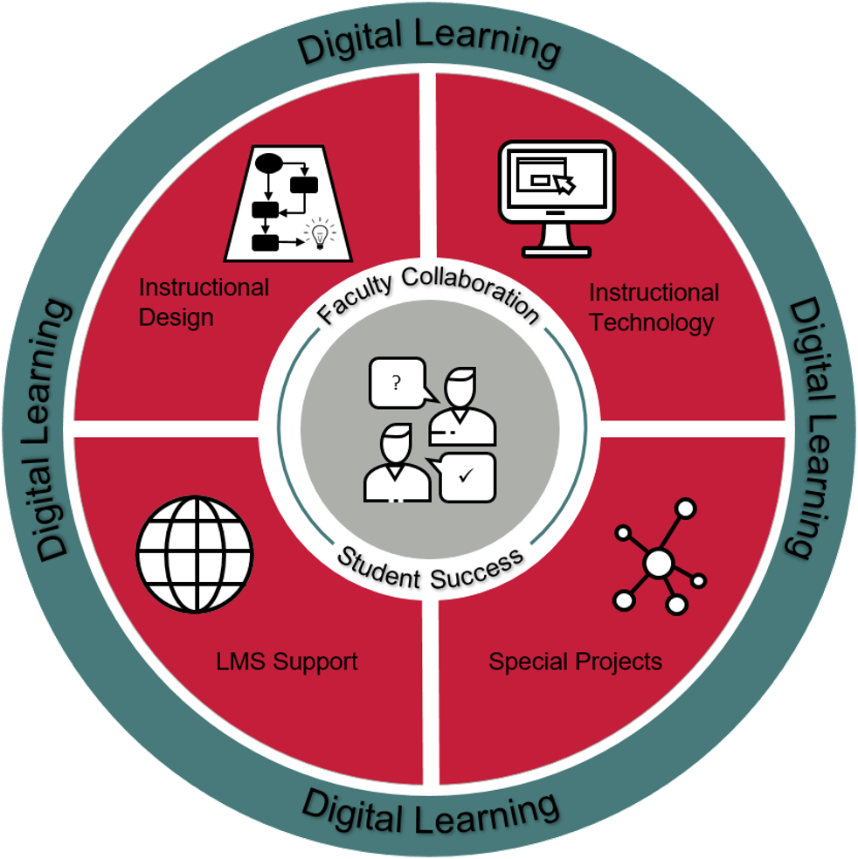
Distance Education
Instructional Design
Support Assessment Development
Support Alignment Checks
Support development in D2L
Instructional Technologies
D2L
Zoom
Examity
Honorlock
LMS Support
D2L functions and all integrated technologies
Quizzing questions
Gradebook integrations

Slide 37


D2L
D2L Quiz Tool
The Quizzes tool allows instructors to test students’ mastery of course materials using quizzes with multiple choice questions, short answer questions, matching questions, and more.
D2L is APSU's Learning Management System (LMS).
Shuffle questions
Establish time limits
Pull analytics
Set attempt limitations
Sync to gradebook
Notes:
The Quizzes tool enables you to create and manage points-measured assessments. As part of your quantifiable assessment procedures, you can use quizzes to help evaluate users' learning progress and learning outcomes. Create and manage quiz questions from the Question Library or the Quizzes tool, and organize quizzes into categories to make it easier to find assessments with similar or related content. Use the quiz preview option to test the accuracy of content and grading before you release a quiz. In a preview, you can answer the questions, view allowed hints, submit the quiz, auto-grade answers, read feedback, and view report results.
Once you receive completed quizzes from learners, you can view quiz statistics such as grade distribution, grade average, question statistics, and user statistics on the Statistics page.
https://documentation.brightspace.com/EN/le/quizzes/instructor/creating_quizzes_intro.htm
https://www.apsu.edu/online/technology/files/d2lbasictasksinstructortable.pdf

Slide 38
Considerations for online proctoring
Foster a culture of academic integrity
Openly discuss expectations
Provide examples of desired and unacceptable behavior
Evaluate if remote proctoring is necessary & feasible
Will my students have access to the technology they need?
Is my assessment designed for remote proctoring?
Is this a high stakes exam?
Prepare your students for online proctoring
Make sure they look at the student resources for the technology they are using
Have them look at the privacy policies & FAQs
Provide clear instructions on what is allowed/not allowed during the session
Be aware of accomodations

Slide 39
Zoom
Proctor your own exam
Record the session
Ensure the settings are checked for "record gallery view with shared screen"
Discuss ground rules
Reliable internet connection
Preferred location with minimal distractions
Procedures of unexpected interruptions
Hadware/software requirements
Expectations for the students' zoom configuration
Required items
How to ask questions
Identity verfication considerations
Be mindful
Zoom Web Conferencing
Notes:
Be mindful of what is said or expected of students
When using third party service the responsibility is on them, with Zoom it's on the instructor, be mindful of what you are asking your students to do
If need suggestions- contact us or department chairs, more flexible and less secure, understand that if choosing this option, you take on much of the responisbility but it is not the same as being in the room with students
On the other hand, it might be more comfortable for students, because it is more like taking an exam in class for them

Slide 40
Honorlock
Moving online due to COVID-19?
On demand automated proctoring, proctors conduct "live pop ins" when students trigger an intervention with suspicious activity
Requires a Chrome plug-in
Fee per student per exam, reserve for higher stakes assessments
Honorlock online proctoring
Notes:
https://www.apsu.edu/online/technology/honorlock.php
https://youtu.be/2en08gMYFp0

Slide 41
Examity
Is your course normally scheduled online?
If new to using Examity, please contact Distance Education Support
Fee per student per exam. Limit use of Examity for high stakes exams
Midterms & finals
Multiple exam levels
The experience will be different for the student depending on the exam level
Review the DE Examity website prior to using the technology
Examity online proctoring
Notes:
https://www.apsu.edu/online/technology/online-proctoring.php

