Slide 1

APSU Return-to-campus (RTC)
Student employee training
Presenters: Office of Human Resources

Slide 2
Agenda
COVID-19 RTC Plan Overview
Workplace Expectations
Health & Safety Practices
Mental and Emotional Wellbeing
Student Employee Responsibility

Slide 3
APSU’s Commitment to safety:
We are in this together
APSU is committed to providing faculty, staff, students, and visitors a safe environment despite the COVID-19 pandemic. As such, APSU will monitor-- to the extent possible-- on-campus activities to ensure the safety and well-being of individuals as APSU opens the campus responsibly.

Slide 4
New workplace guidelines
New! COVID-19 RTC and Face-Covering Guidelines
All APSU student employees are expected to fully comply with the guidelines and protocols outlined in this training and located on RTC website
Any student who violates these guidelines will be referred to the Dean of Students Office for appropriate disciplinary action, pursuant to 1:013 Student Code of Conduct.

Slide 5
New covid-19 RTC Guidelines
All Student Employees:
  Must take personal responsibility in following the recommended CDC COVID-19 guidelines.
  Must be free of any COVID-19 related symptoms to be on campus
  Must conduct symptom monitoring daily before reporting to work
  Must truthfully respond to any prescreening questions, as defined by the State of Tennessee or CDC guidelines, before arrival to campus.
  Displaying any COVID-19 symptoms will be asked to leave campus immediately and seek medical care and/or COVID-19 testing as soon as reasonably possible.
  Displaying symptoms will be required to self-quarantine as outlined in the CDC guidelines and will return to work according to CDC guidelines.
  Those who have been within six (6) feet or less for ten (10) minutes or more of an individual who tests positive for COVID-19 or has been in direct contact with infectious secretions of a positive COVID-19 case must follow the mandatory CDC recommended quarantine period and seek COVID-19 testing.
  Must practice social distancing to the greatest extent possible by maintaining a distance of at least a six (6) feet between individuals.
  Must utilize remote meetings as much as possible to reduce physical interaction.
Notes:
Received guidelines on 6/8 which detailed out what you see on this slide.
We just want to reinforce a few bullets:
Emphasis on employee responsibility
Symptom monitoring daily
Truthfully respond
Social Distancing
Remote meetings

Slide 6

Personal safety practices

Slide 7
New Face-coverings guidelines
Effective immediately and until further notice all persons on Austin Peay State University property will be required to wear a cloth or surgical-style mask or face covering following the guidelines of the Centers for Disease Control (CDC).
Required mask wearing is one way that Austin Peay State University can slow or stop the spread of the Coronavirus.
Areas of required mask wearing include, but are not limited to, campus buildings, common areas in dormitories, restrooms, dining services and other shared spaces.
Face coverings are not required in outdoor areas, but are highly recommended.
All participants in a classroom setting must wear a face covering as referenced above.
Vendors and visitors who do not have masks will be offered a paper mask to wear while on campus grounds.
Disposable masks will be provided, if needed. Disposable masks may only be worn for one day and then must be placed in the trash.
Notes:
Your own face masks are acceptable.
We encourage you to wear masks you may already have. However, if it is a disposable mask, please only wear for one day at a time.
Highly recommended outdoors
Vendors/visitors – should encourage try to schedule appointments ahead of time
Disposable masks will be available in each department

Slide 8
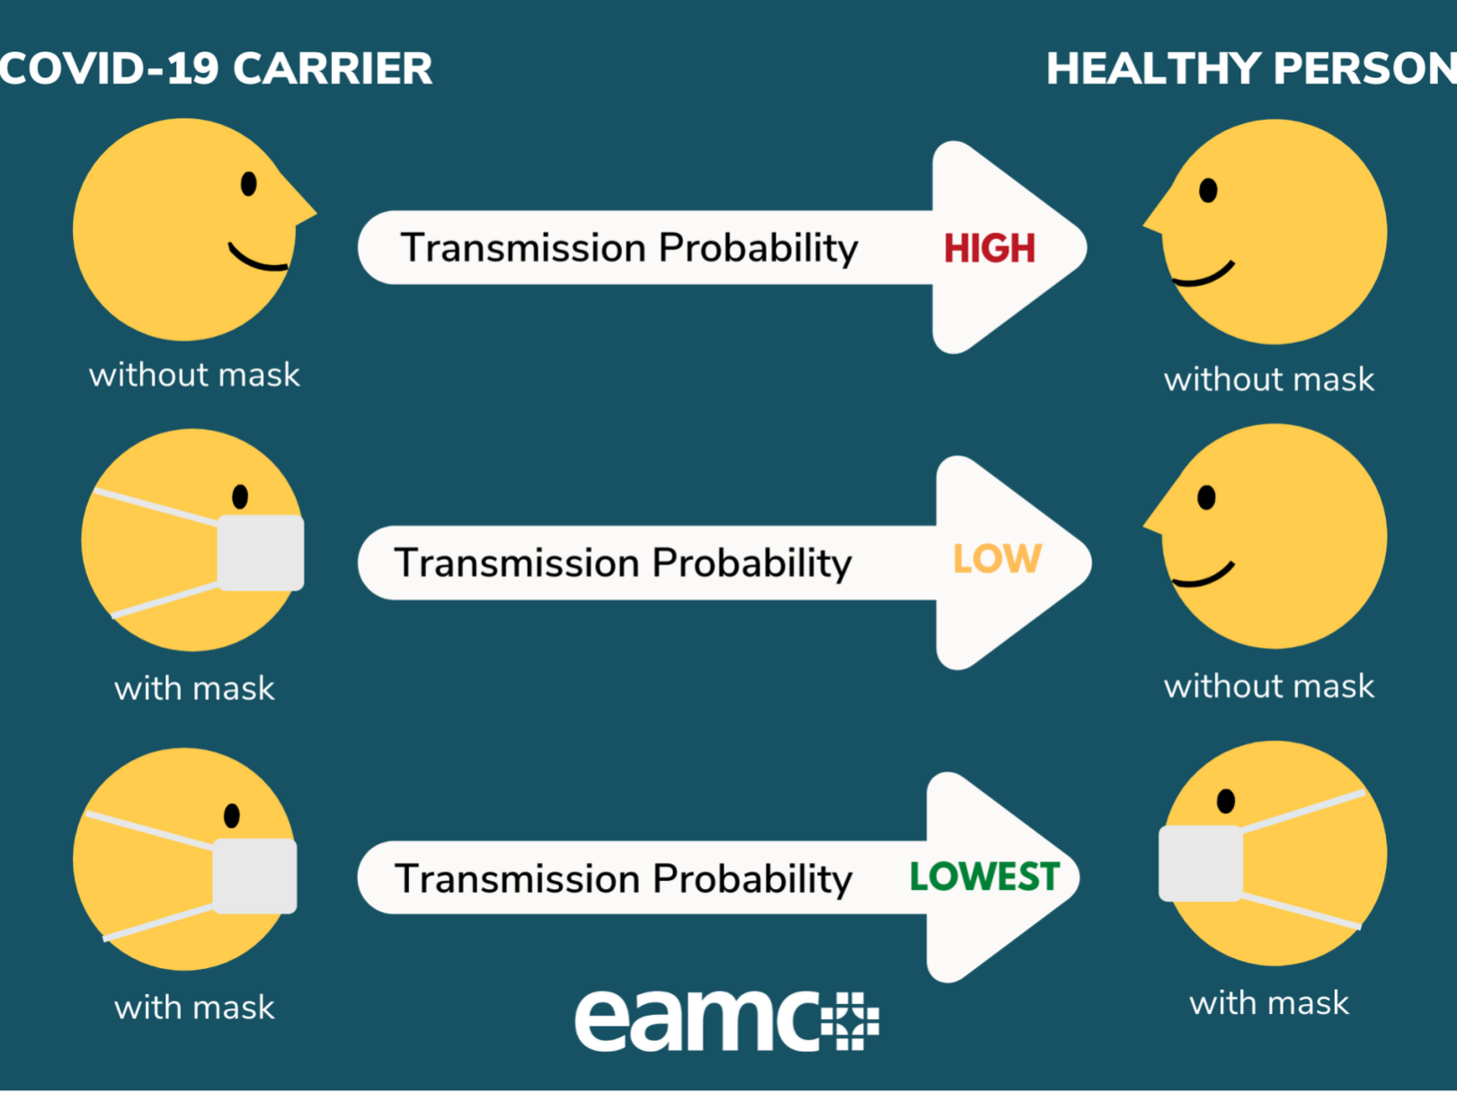
Notes:
Required mask wearing is one way that Austin Peay State University can slow or stop the spread of the Coronavirus.

Slide 9
Personal Safety Practices
Wash your hands often with soap and water for at least 20 seconds especially after you have been in a public place, or after blowing your nose, coughing, sneezing, or touching your face.
If soap and water are not readily available, use a hand sanitizer that contains at least 60% alcohol. Cover all surfaces of your hands and rub them together until they feel dry. Avoid touching your eyes, nose, and mouth, and wash your hands after touching your face.
Disinfection of shared work spaces: additional care should be taken to wipe down commonly used surfaces ( e.g. microwaves, refrigerators, phones, copiers, printers, computers, A/V and other electrical equipment, coffee makers, desks and tables, light switches, door knobs, etc.).
Social Distancing: Stay at least 6 feet (about 2 arms’ length) from other people at all times, do not gather in groups, stay out of crowded places and avoid mass gatherings, and communicate with colleagues via email, instant message, telephone or technology rather than face-to-face.
Coughing/Sneezing Hygiene: If you are in a private setting and do not have on your cloth face covering, remember to always cover your mouth and nose with a tissue when you cough or sneeze or use the inside of your elbow. Throw used tissues away and wash hand with soap and water for 20 seconds or use hand sanitizer as described above.
Notes:
Shared work spaces disinfected after each use!
There will be hand sanitizing stations placed throughout the campus at building entrances and in common areas.
Departments can request disinfectant spray by contacting physical plant.

Slide 10
Student employee guidance
Daily self-monitoring of symptoms per COVID-19 guidelines
APSU Zero-tolerance for coming to work sick
If you are not feeling well contact your manager/supervisor immediately
Offices will be open with reduced staffing using combination of telework/alternating days.
Practice social distancing at all times
Continue to utilize technology for meetings as much as possible to reduce physical interaction.
Contact HR if you need support
Health Services and Student Counseling Center
Notes:
The university will continue to emphasize the importance of daily self-screens, social distancing, handwashing, staying home when sick, and use of cloth face coverings. As we reopen campus, be ready to adjust plans based on COVID-19 case data as needed. This paced and flexible approach supports our vision for fall and beyond.

Slide 11
Next Steps – acknowledgement
New! When you log into Self-Service in OneStop, you will be prompted to a one-time acknowledgement of COVID-19 Guidelines. Available on June 15, 2020
New! Daily affirmation of COVID-19 Guidelines and APSU Policy 4:029:Acceptable Use of Information Technology

Slide 12
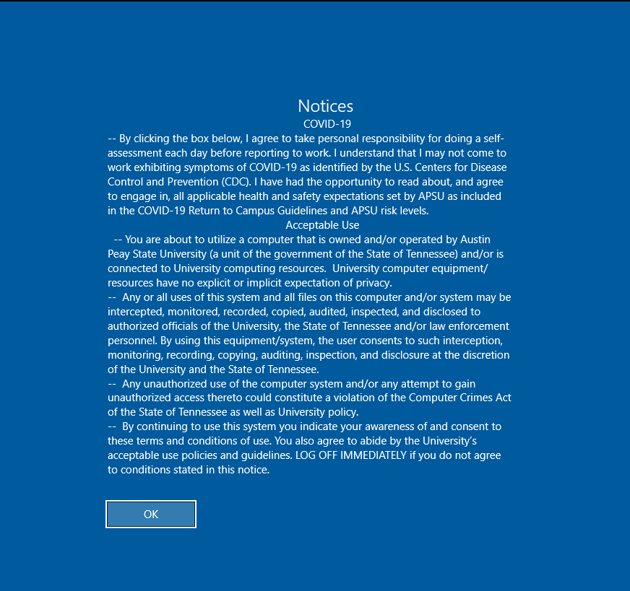

Slide 13
Please contact HR if you have any questions:
HR@apsu.edu
(931) 221-7177

