Slide 1
Lab 11
Survey of Embryonic Development

Slide 2
Lab 11
Hormonal controls of the menstrual (ovarian and uterine) cycles
Fertilization, implantation, and early development
Final lab practical this time next week

Slide 3
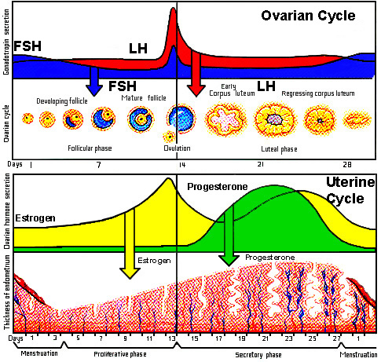

Slide 4
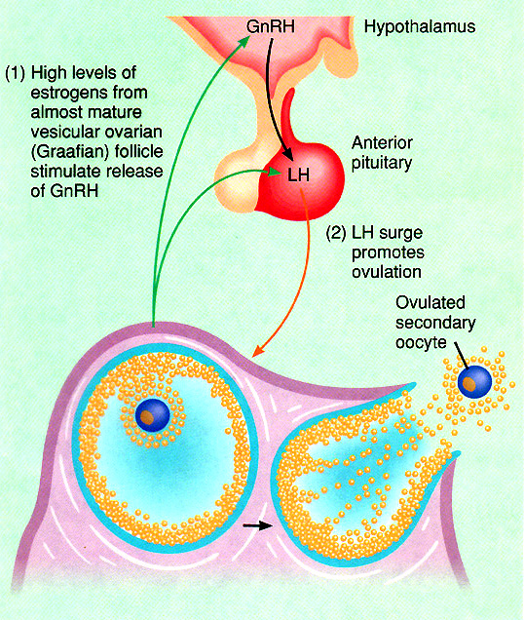
Ovulation

Slide 5
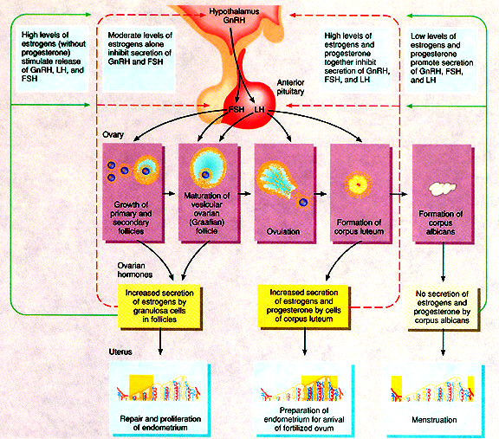
Ovarian and Menstrual Cycle Regulation

Slide 6
Fertilization
The Five Steps in Sperm Entry
Chemotaxis
Acrosome Reaction
Sperm-Egg Binding
Plasma Membrane Fusion
Block to Polyspermy

Slide 7
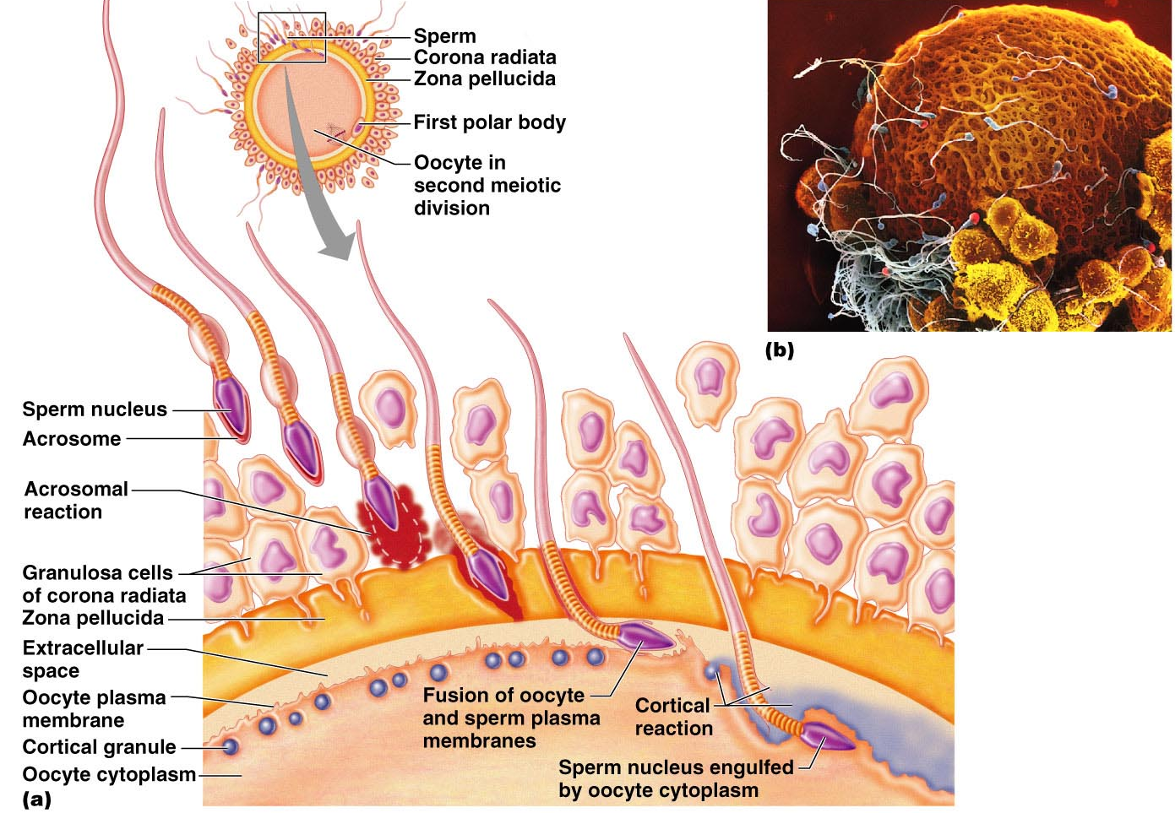
Sperm penetration and the cortical reaction

Slide 8
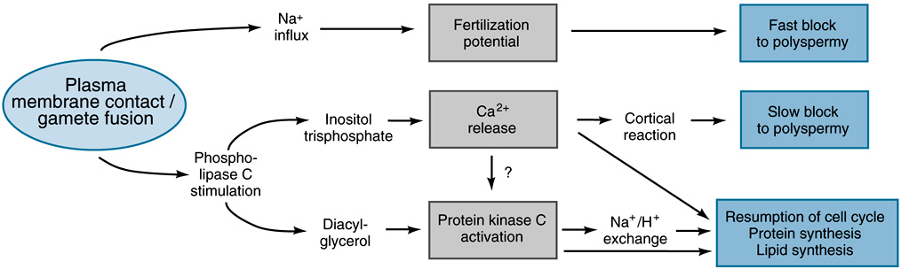
The Events which Occur in the Egg with Gamete Contact & Fusion

Slide 9
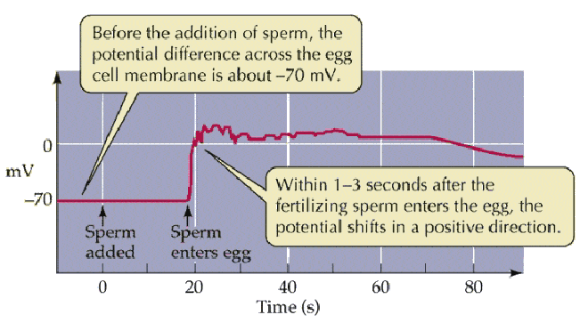
The Change in Membrane Potential in Egg is the Fast Block to Polyspermy

Slide 10
The Events which Occur in the Egg with Gamete Contact & Fusion

Slide 11
Sperm penetration and the cortical reaction

Slide 12
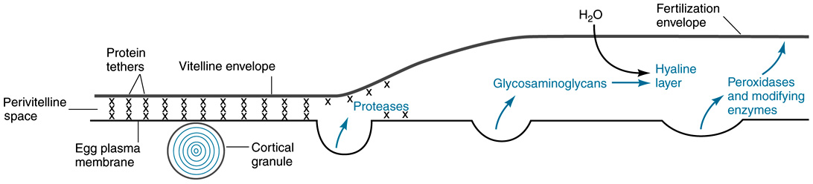
The Cortical Reactions Raise the Fertilization Envelope & Provide the Slow Block to Polyspermy

Slide 13
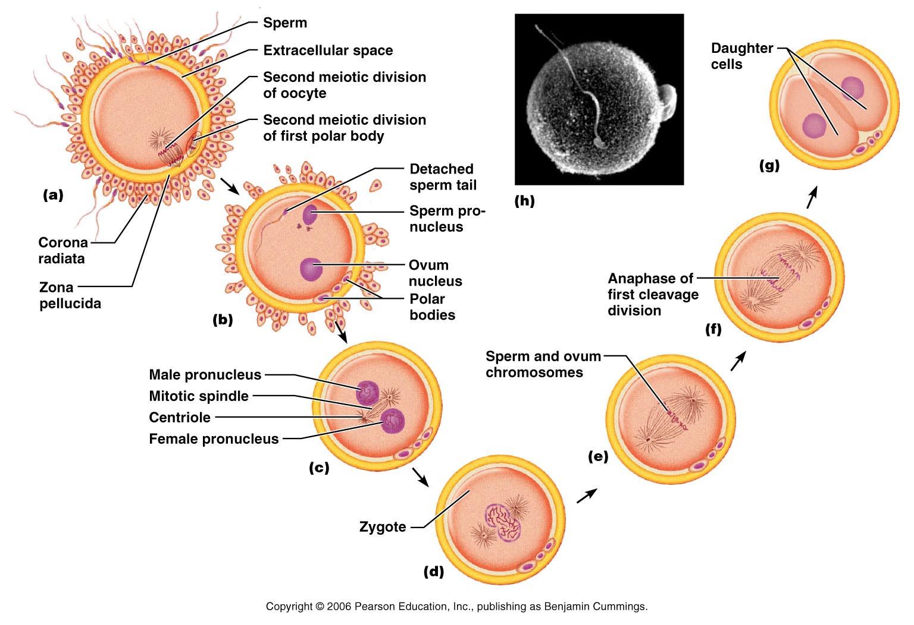
Zygote Formation

Slide 14
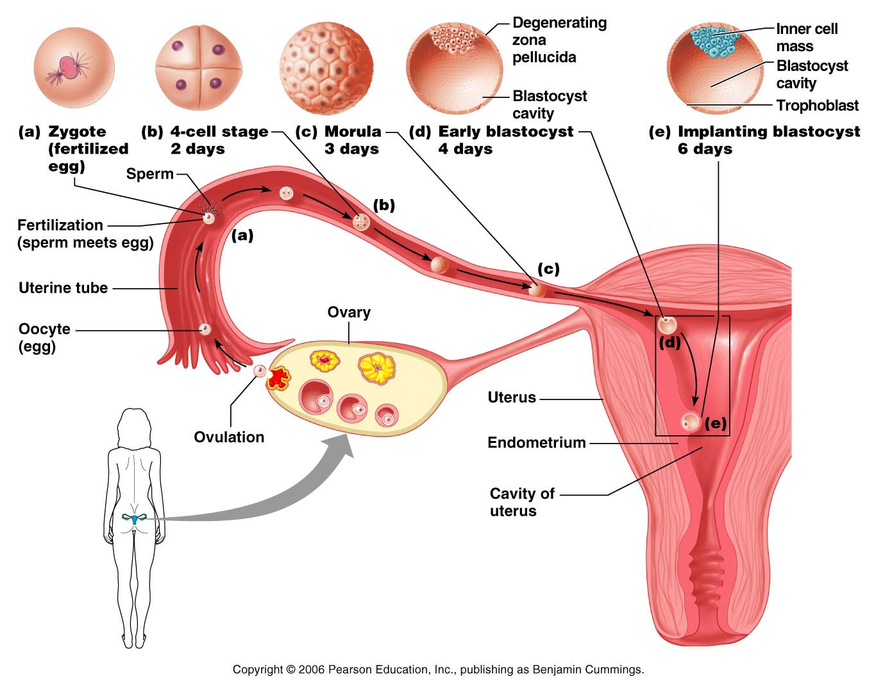
Figure 29.4 Cleavage is a rapid series of mitotic divisions that begins with the zygote and ends with the blastocyst
Cleavage and Implantation

Slide 15
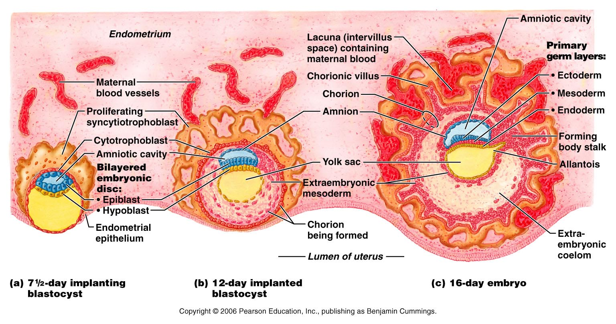
Events of placentation, early embryonic development and formation of the embryonic membranes
hCG = human Chorionic Gonadotropin
signals placenta formation after implantation

Slide 16
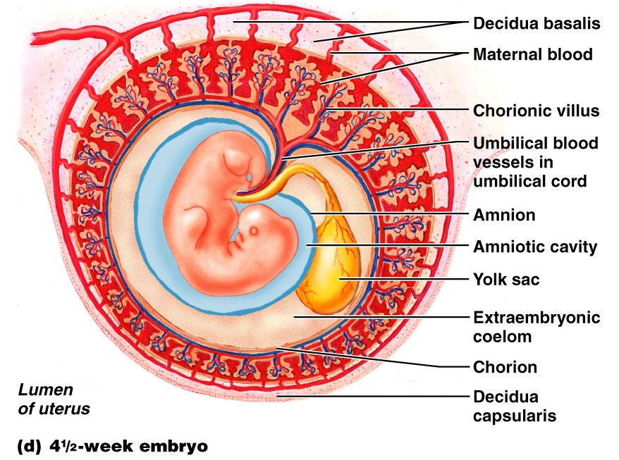
Events of placentation, early embryonic development and formation of the embryonic membranes

Slide 17
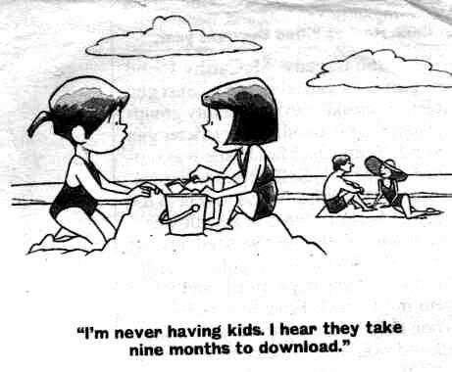

Slide 18
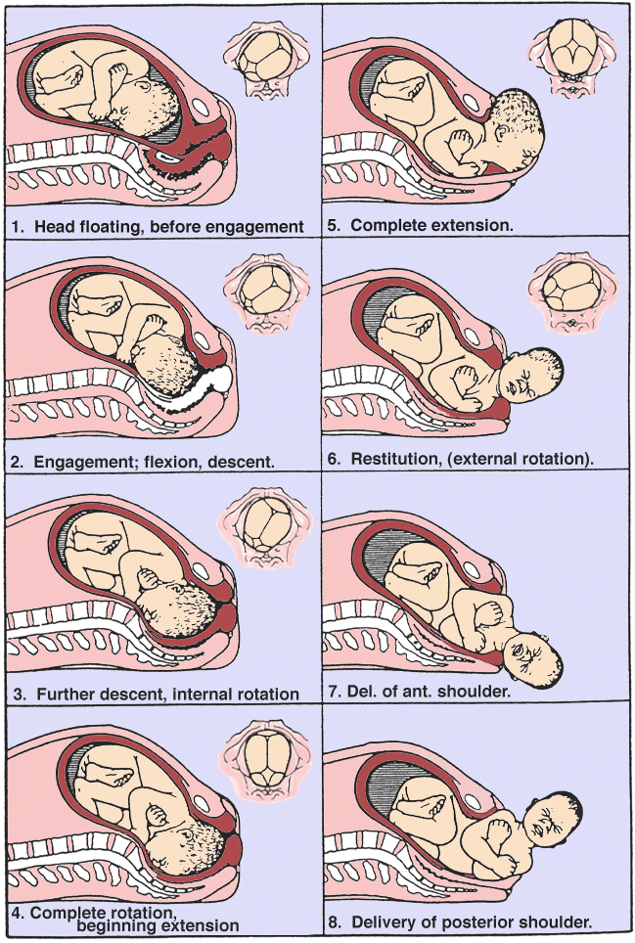
Labor and Delivery
ANS stimulation and positive feedback from the fetal movements
Oxytocin and local prostaglandins
Placenta discharge = “afterbirth”
Uterine contractions to reduce post-partum hemorrhage

Slide 19
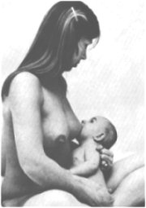
Labor and Delivery; Lactation
Estrogens and progesterone assist prolactin in readying breast for colostrum and milk production
Oxytocin stimulation from positive feedback from the infant suckling

Slide 20
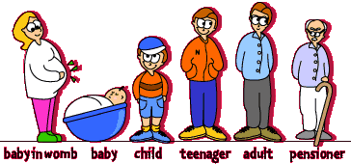
When and Where Will It All End?

Slide 21
Homework
Complete Assignment 11 on MasteringAandP.

Slide 22
End Lab 11

Slide 23
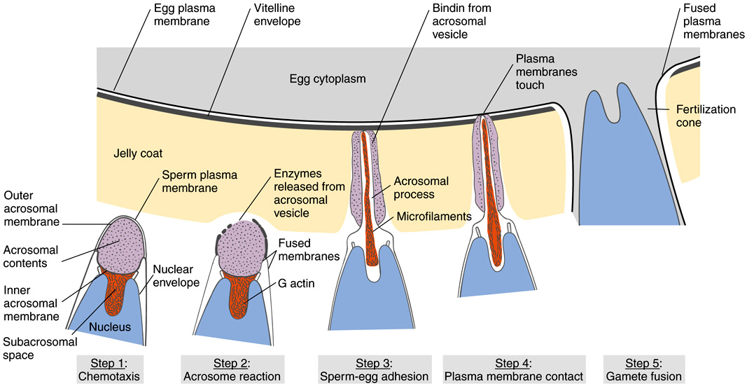
Fertilization (NOT MAMMALIAN!)

Slide 24
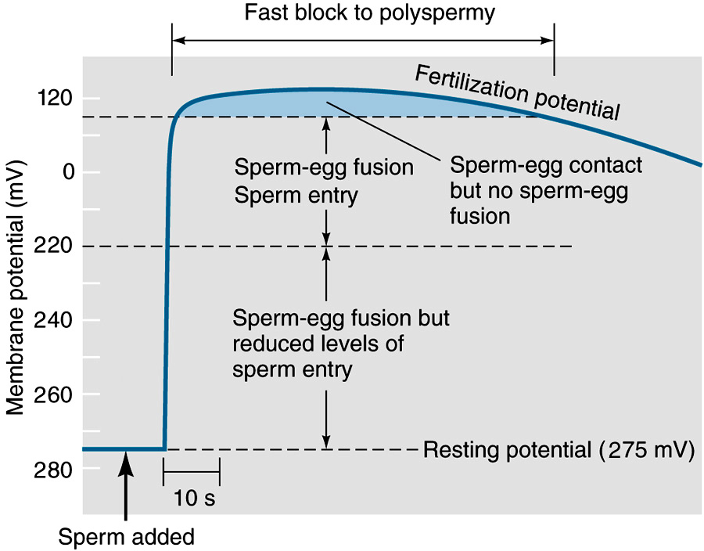
The Change in Membrane Potential in Egg is the Fast Block to Polyspermy

