Slide 1
Lab 10
The Histology of the Reproductive System

Slide 2
Lab 10 Objectives
Examine male and female reproductive organ models
Examine slides of ovary (#68, #69), testis (#65), penis (#67), uterine tube (#77), and uterus (#71)
Understand meiosis and gametogenesis

Slide 3
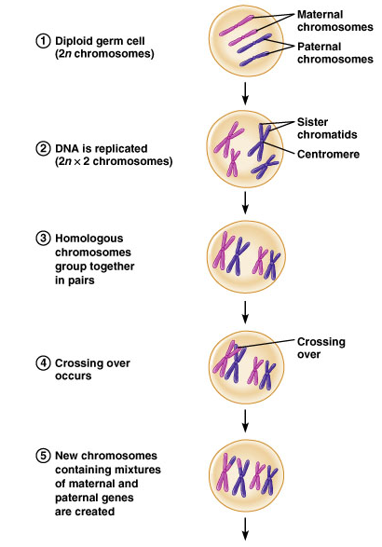
Meiosis
46 chromosomes
46 chromosomes ( 2 copies of each)
Germann & Stanfield, 2005

Slide 4
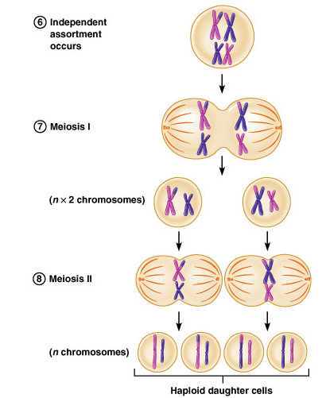
Meiosis
23 chromosomes (2 copies of each)
23 chromosomes (1 of each)
Germann & Stanfield, 2005

Slide 5
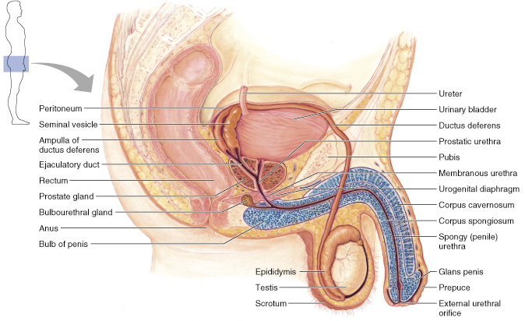
Male Reproductive System

Slide 6
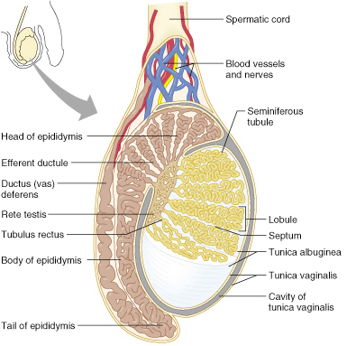
Male Reproductive Duct System

Slide 7
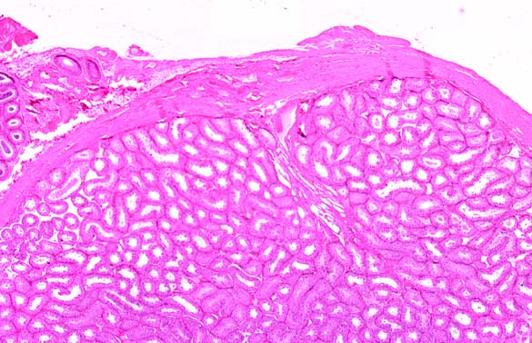
Epididymus and Testis – Low Power

Slide 8
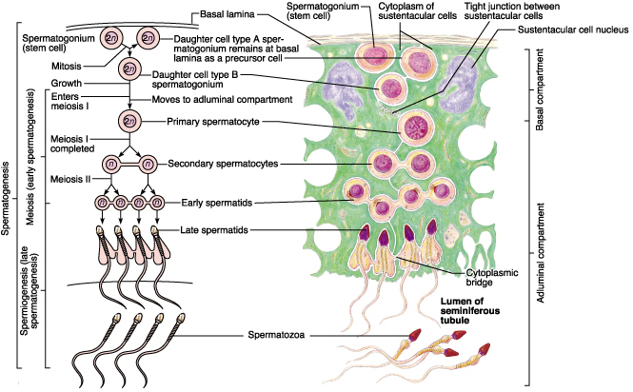
Seminiferous Tubule

Slide 9
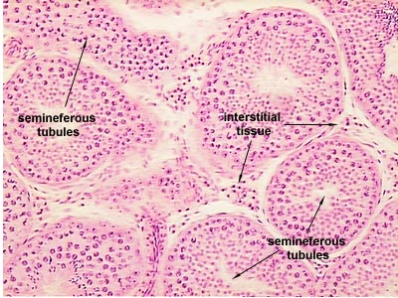

Slide 10
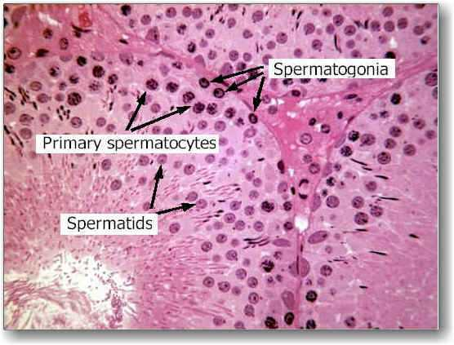

Slide 11
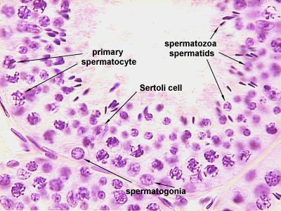

Slide 12
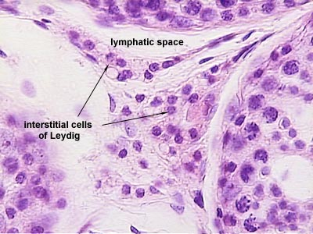

Slide 13
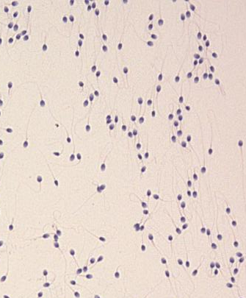
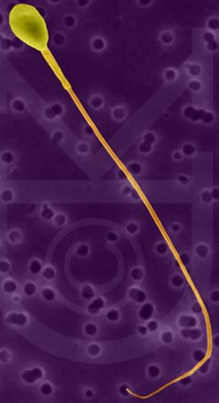
Spermatozoans

Slide 14
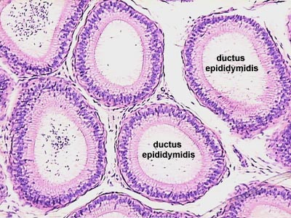

Slide 15
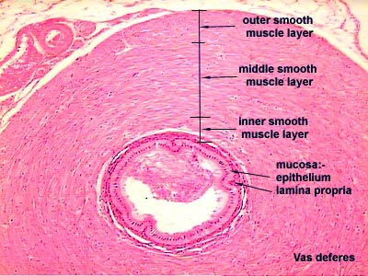

Slide 16
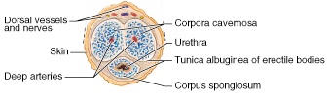
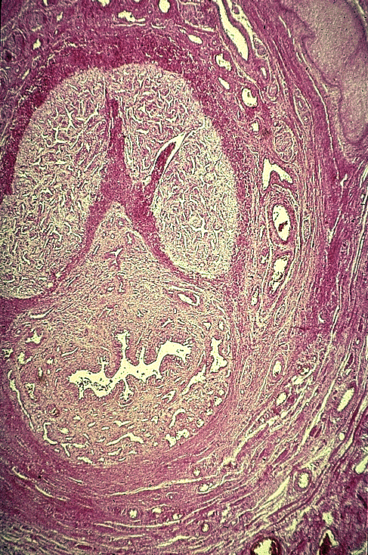
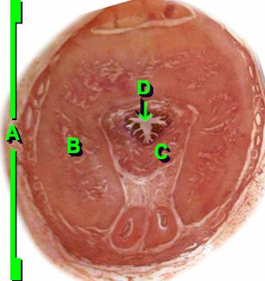
Cross Section of the Penis
B
D
C
B
C
D

Slide 17
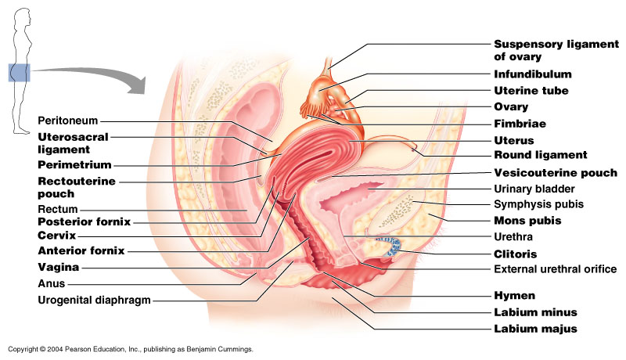
Female Reproductive Tract

Slide 18
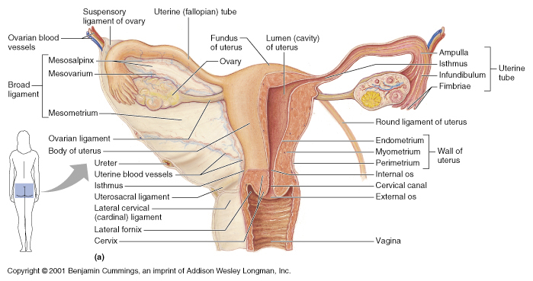
Female Reproductive Tract

Slide 19
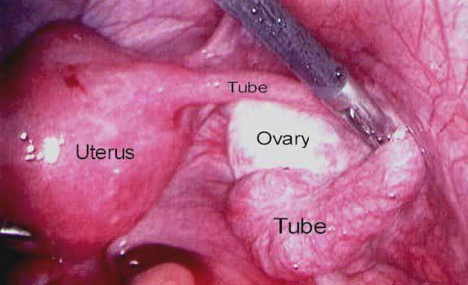
Female Reproductive Tract

Slide 20
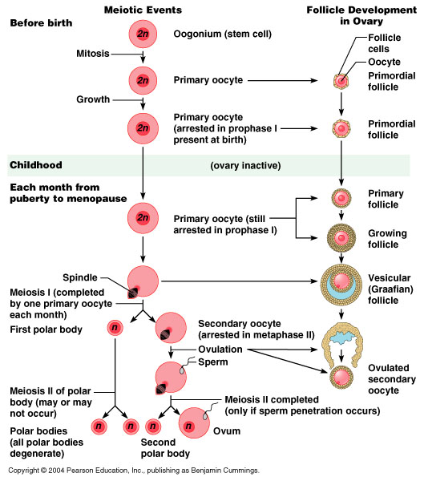

Slide 21
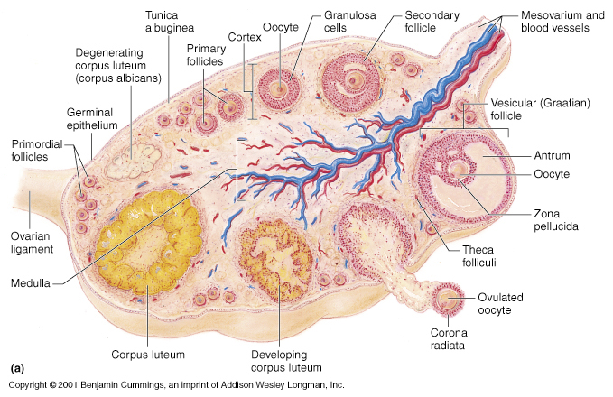
Ovarian Cycle

Slide 22
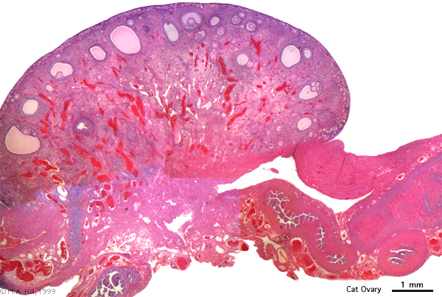
Ovary & Uterine Tube

Slide 23
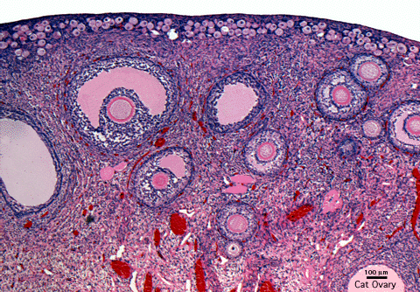
Ovarian Follicles

Slide 24
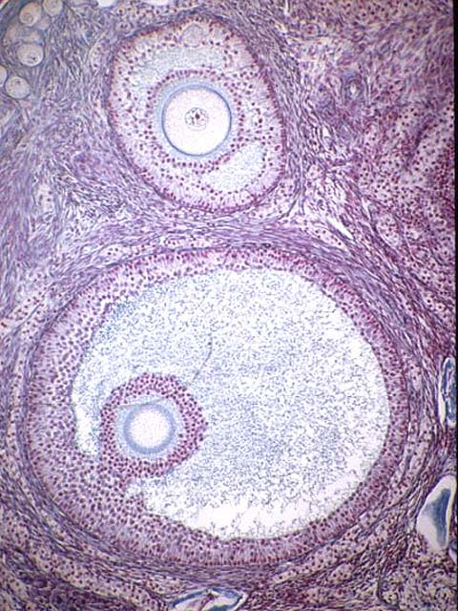
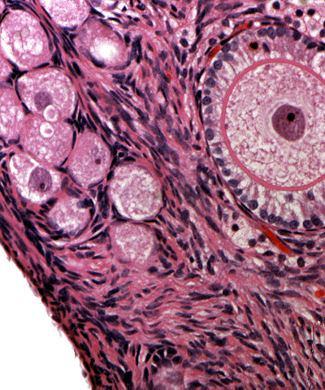
Follicles

Slide 25
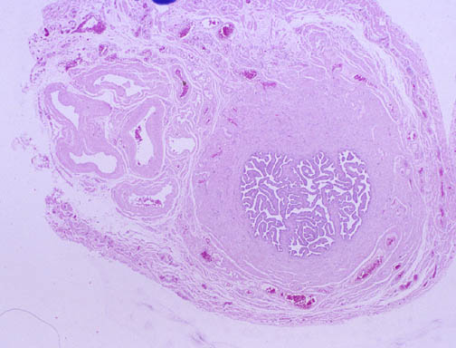
Uterine Tube

Slide 26
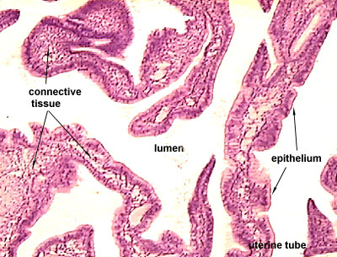

Slide 27
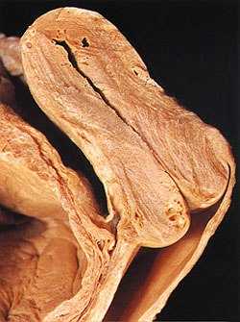
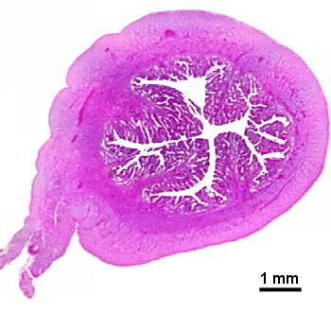
Uterus

Slide 28
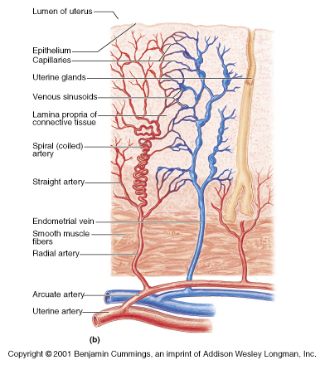
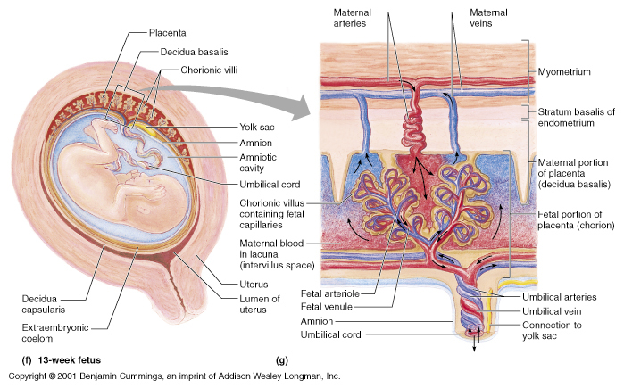
Uterine Wall

Slide 29
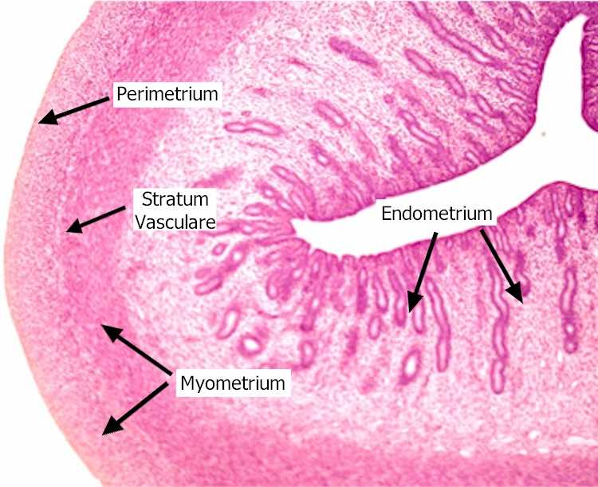
Uterine Wall

Slide 30
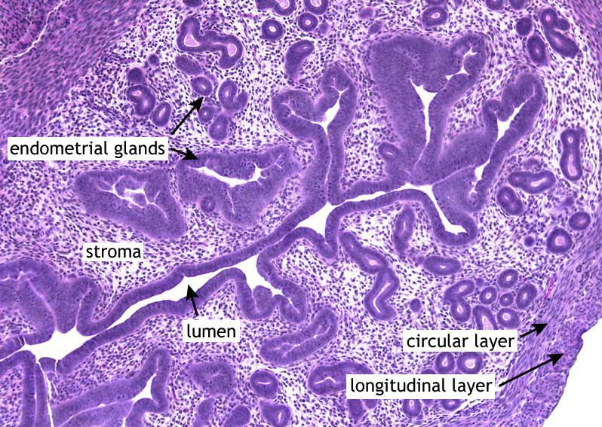

Slide 31
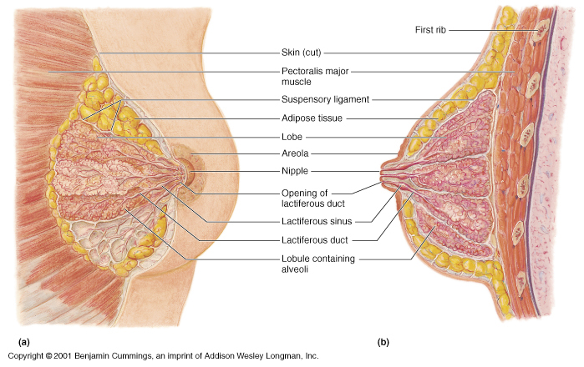
Mammary Gland

Slide 32
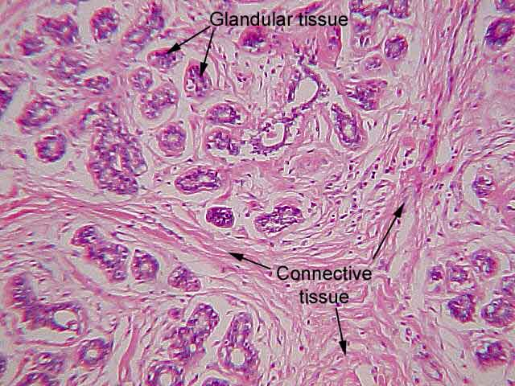
Inactive Breast

Slide 33
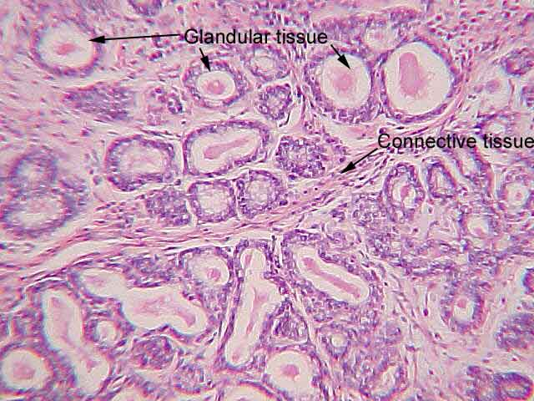
Early Gland Development

Slide 34
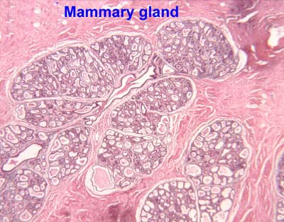
Active

Slide 35
Homework
Complete Assignment 10 on MasteringAandP.

Slide 36
End Lab 10

