Slide 1
Lab 8
Digestion

Slide 2
Lab 8: Digestion
Histology
  Parotid gland, esophagus, stomach, duodenum, jejunum, ileum, colon, liver, pancreas
  Alimentary canal histological layers
Models of the digestive system
PhysioEx: Chemical and Physical Processes of Digestion
  Learn to understand and interpret data tables + simulated test tube results for salivary amylase
  Learn about the major digestive enzymes and their substrates
  Examine the effect of heating, cooling, and pH on enzyme activity
  Use indicators of enzyme activity (IKI, Benedict’s, etc.)

Slide 3
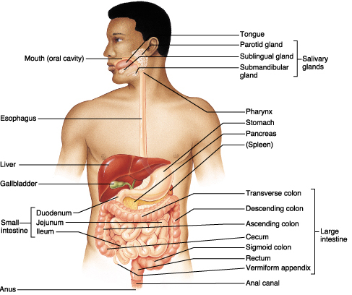
General Structure
Digestive organs divided into 2 main groups
  GI (alimentary) tract
  Accessory structures
    cheeks, teeth, tongue, salivary glands
    liver, gallbladder, pancreas

Slide 4
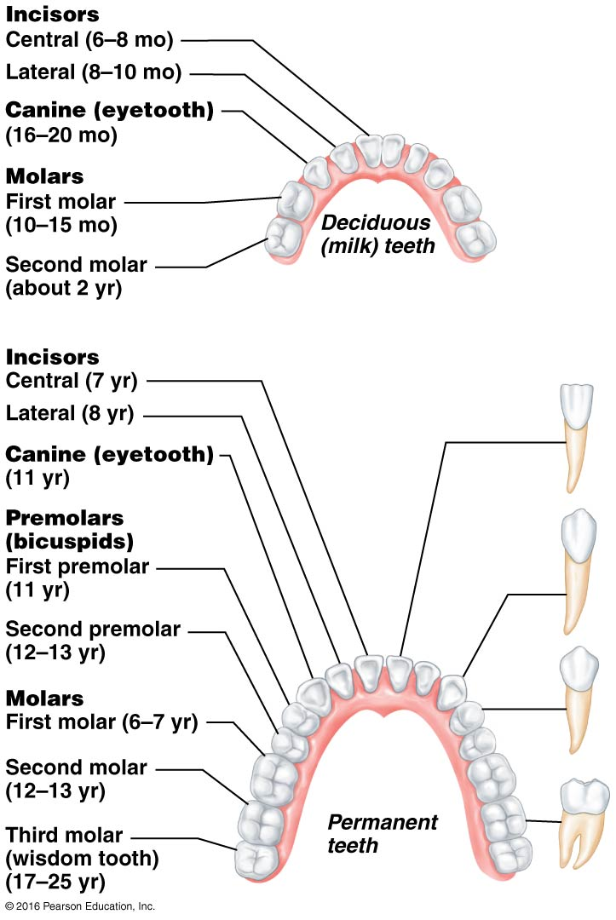
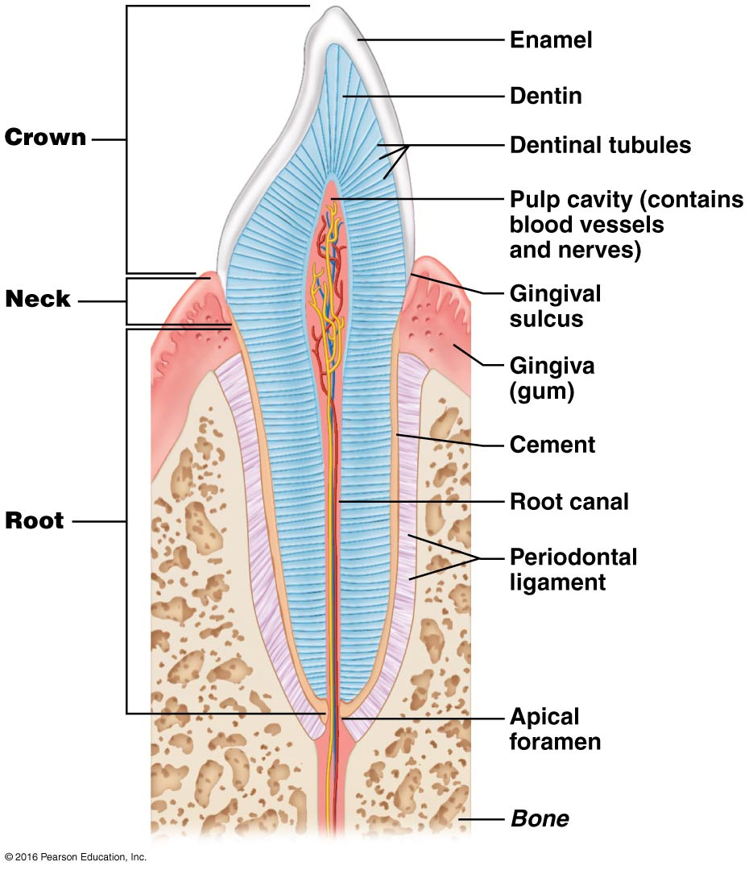
Teeth

Slide 5
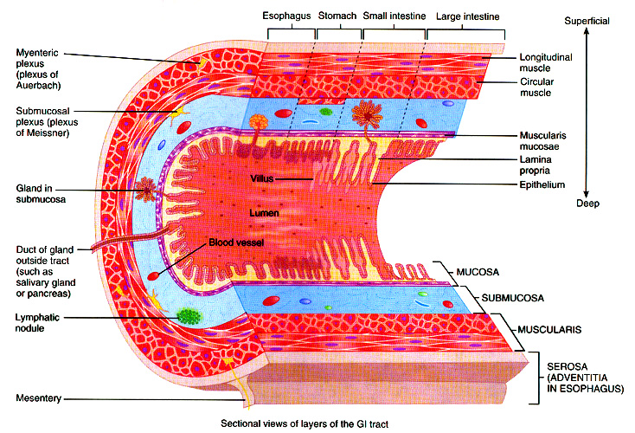
General Organization of GI Tract

Slide 6
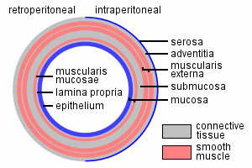
Histology of the GI Tract
#55: salivary glands
#56: esophagus
#57: stomach
#58: small intestine – duodenum
#59: small intestine - jejunum
#60: small intestine – ileum
#54: liver
#39: pancreas
#61: large intestine

Slide 7
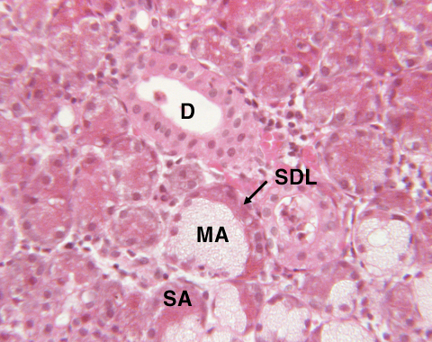
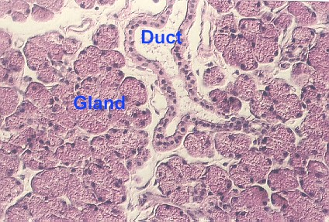
Salivary Glands
MA = mucous acinus; SA = serous acinus;
ducts lined by simple cuboidal epithelium

Slide 8
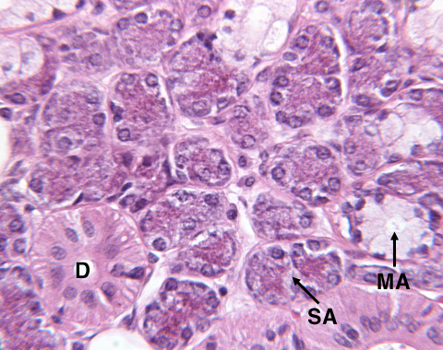
Parotid Salivary Gland

Slide 9
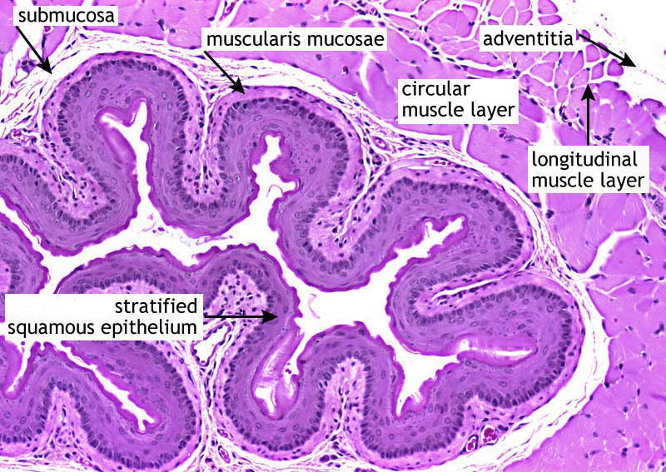
Esophagus

Slide 10
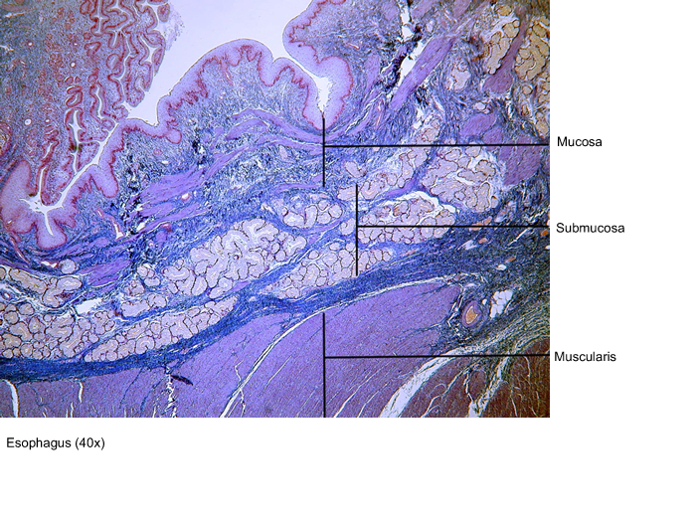
Esophagus

Slide 11
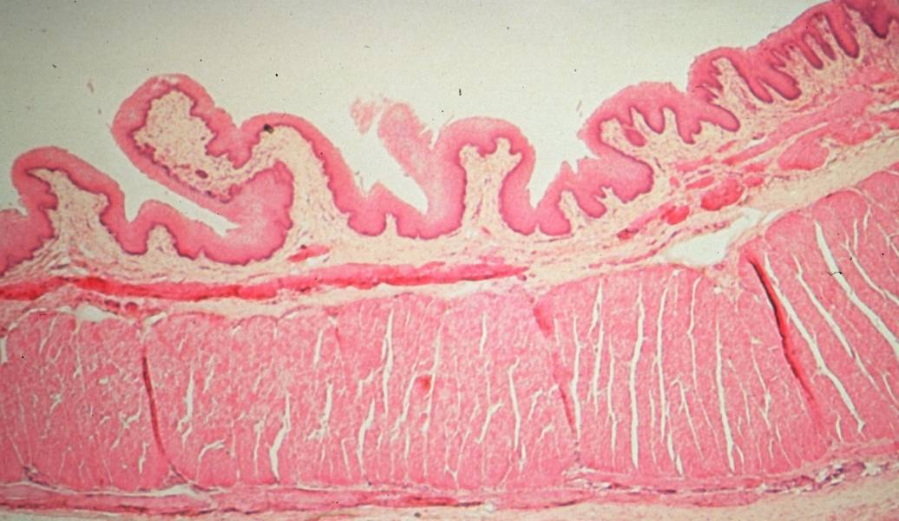
Esophagus – 4 tissue layers

Slide 12
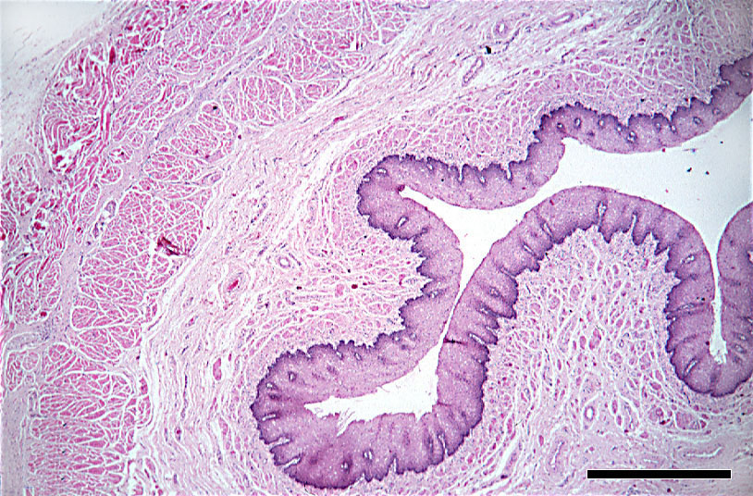
Esophagus

Slide 13
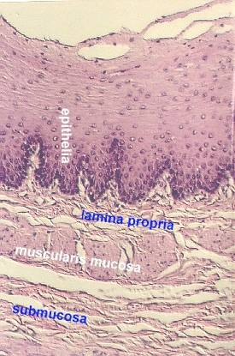
Esophagus

Slide 14
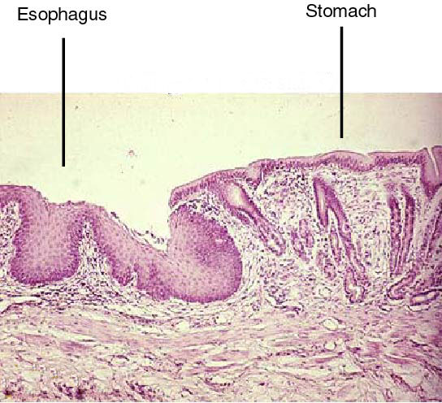
Transition Zone
Simple columnar
Stratified squamous

Slide 15
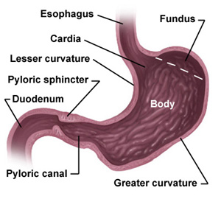
Stomach

Slide 16
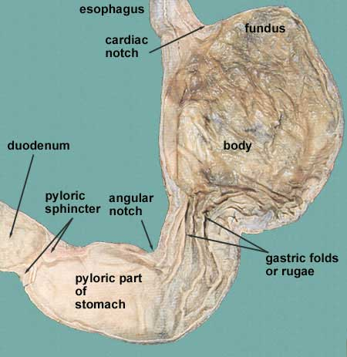
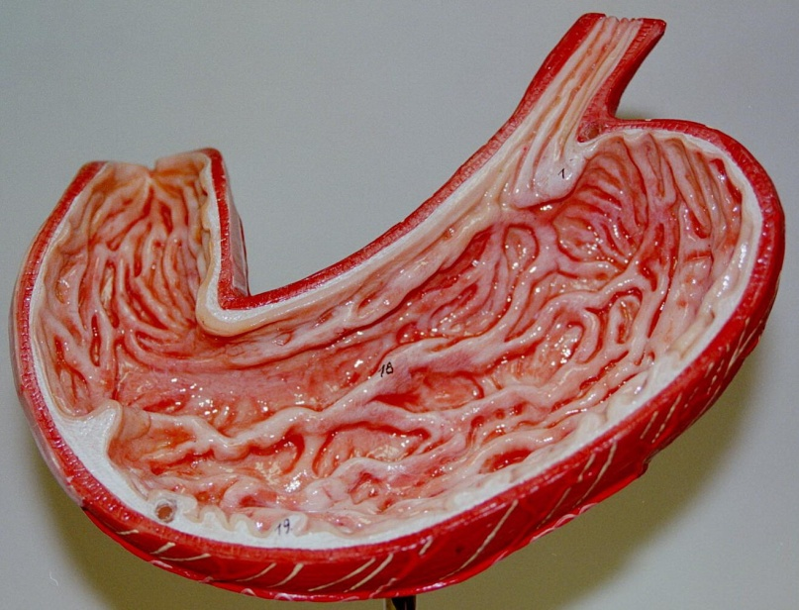
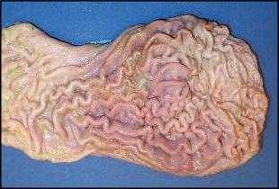
The interior wall of the stomach consists of a series of folds, called rugae.

Slide 17
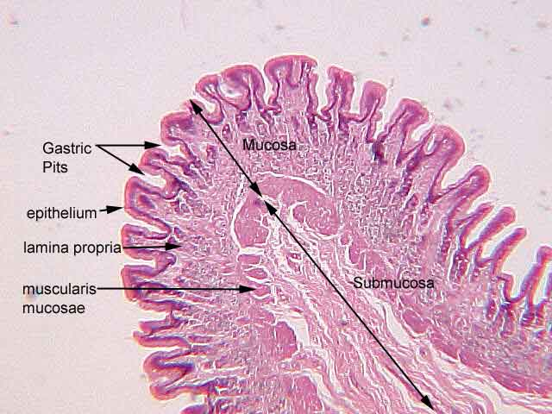
Detail of Rugae

Slide 18
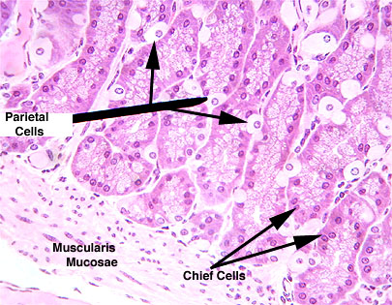
Fundus: gastric glands

Slide 19
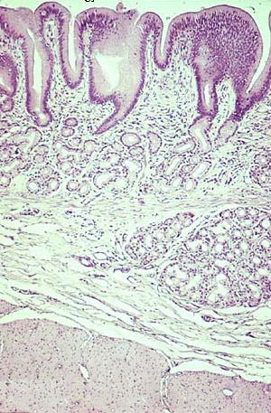
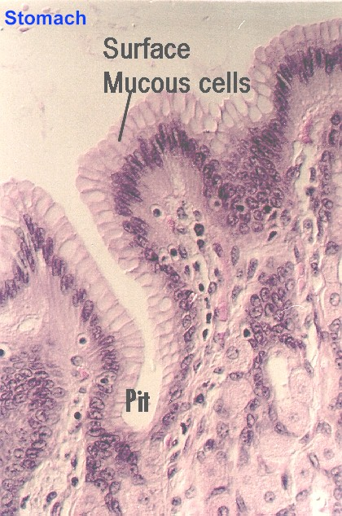
Gastric Glands

Slide 20
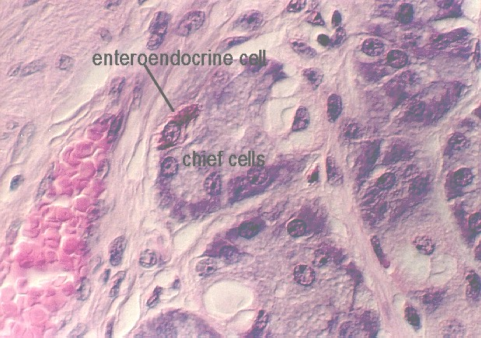
G Cells produce Gastrin

Slide 21
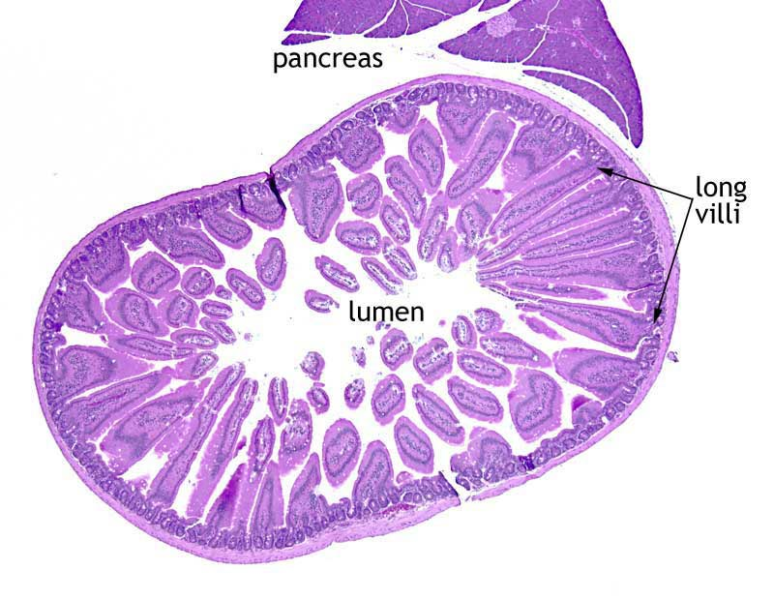
Duodenum

Slide 22
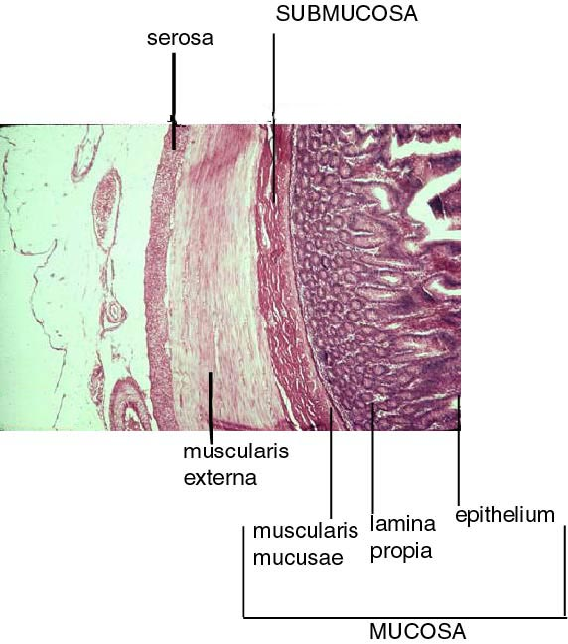
Duodenum

Slide 23
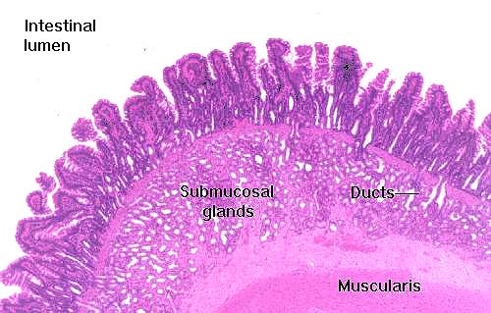
Villi (multicellular)

Slide 24
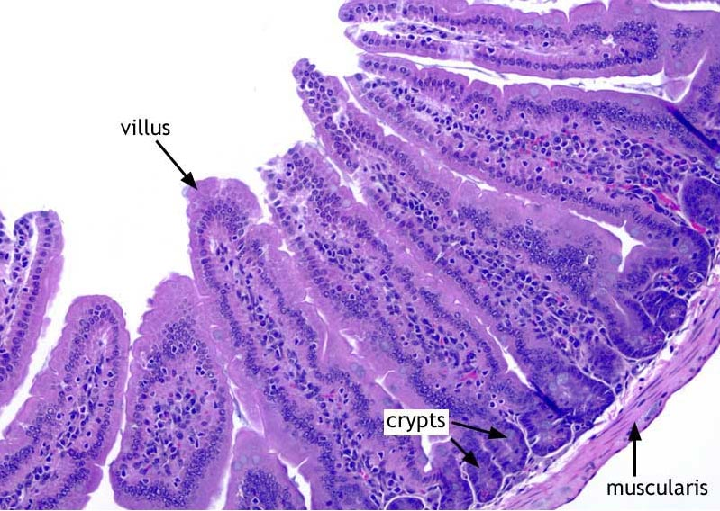
Duodenum

Slide 25
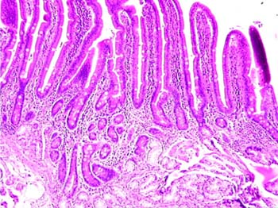
Villi and Intestinal Crypts

Slide 26
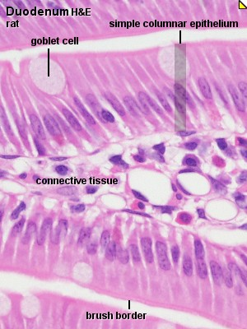
Duodenum

Slide 27
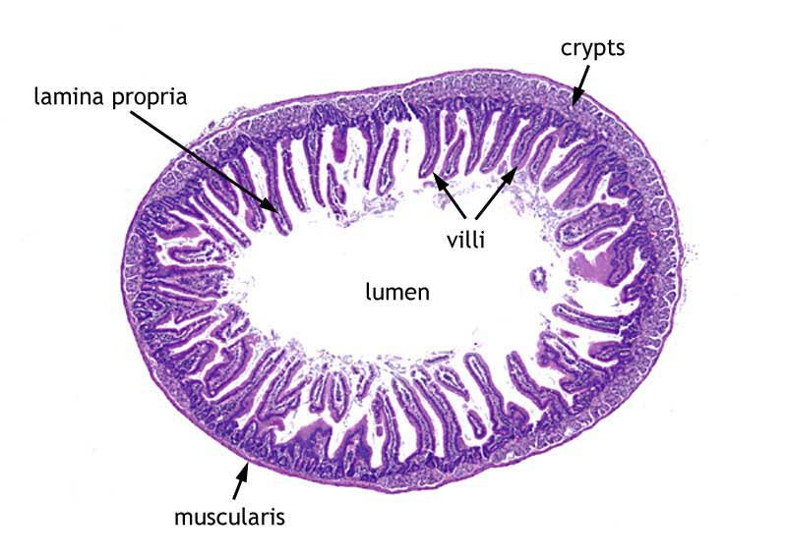
Jejunum

Slide 28
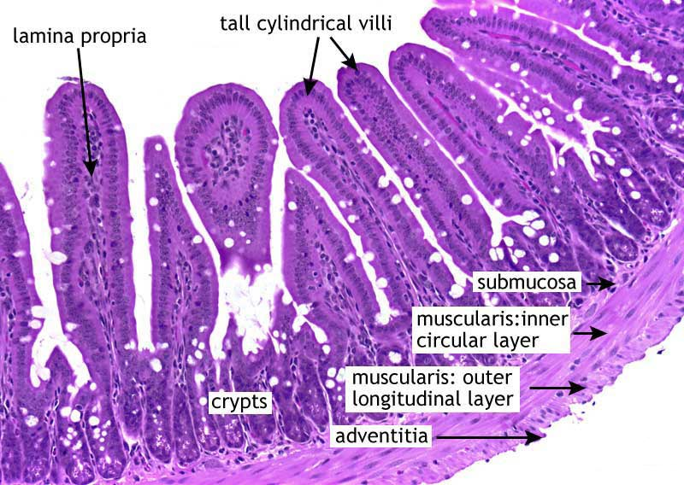
Jejunum

Slide 29
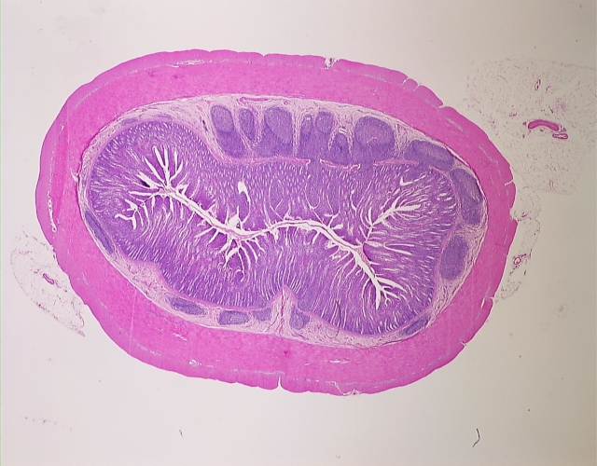
Ileum with MALT =
Mucosal Associated Lymphatic Tissue

Slide 30
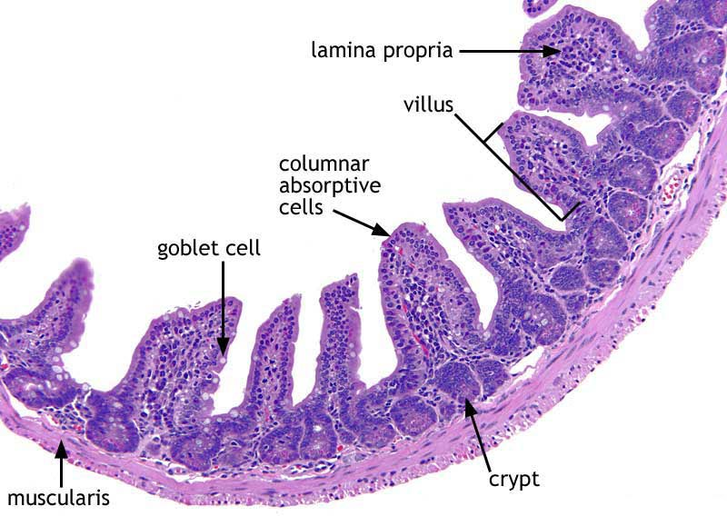
Ileum

Slide 31
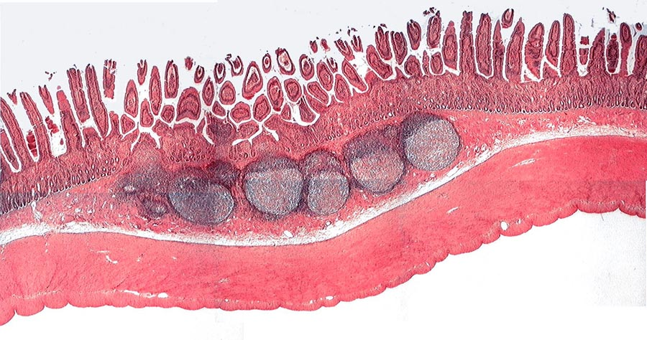
Ileum with Peyer’s Patches = aggregated lymphatic nodules

Slide 32
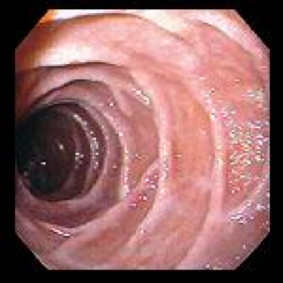
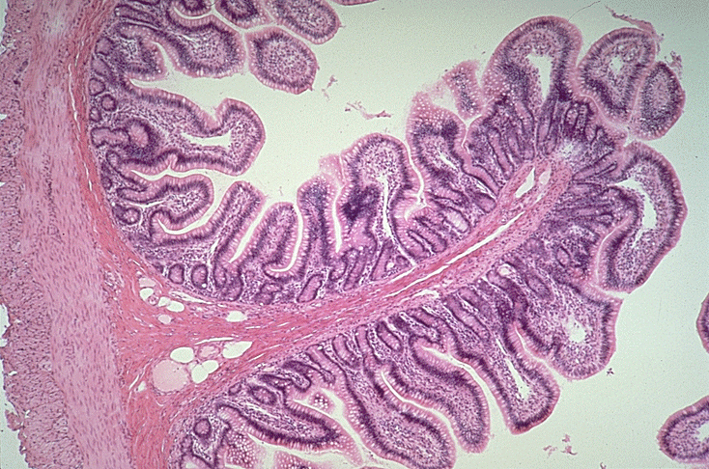
Ileum and Plicae Circularies
Lacteal

Slide 33
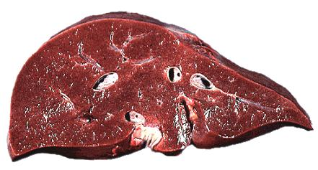
Liver in cross section

Slide 34
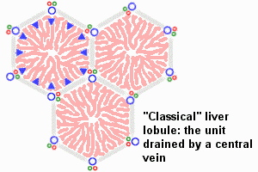

Slide 35
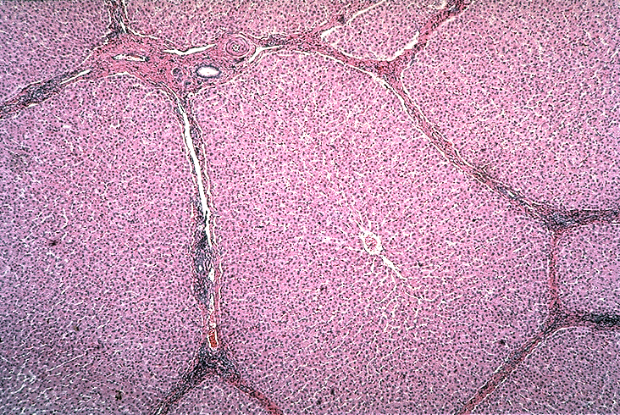
Liver Lobules

Slide 36
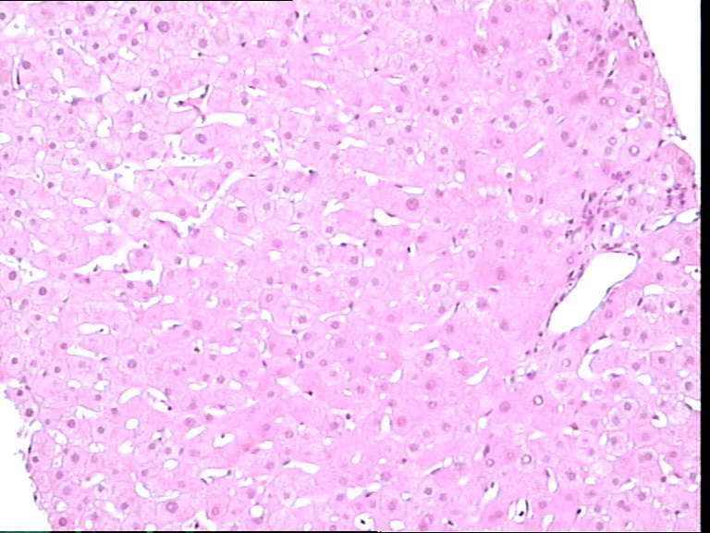
Liver Parenchyma

Slide 37
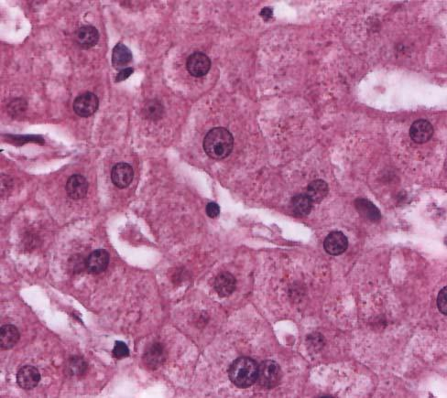
Hepatocytes

Slide 38
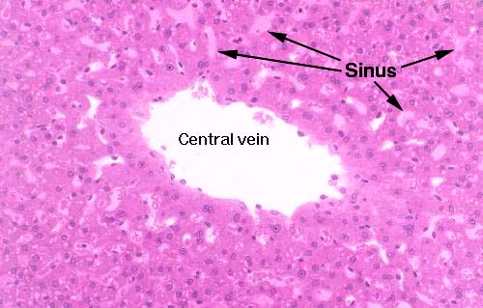
Liver Lobule

Slide 39
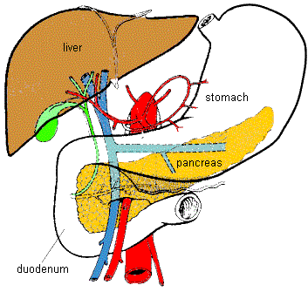
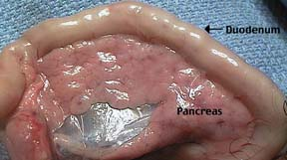
Pancreas

Slide 40
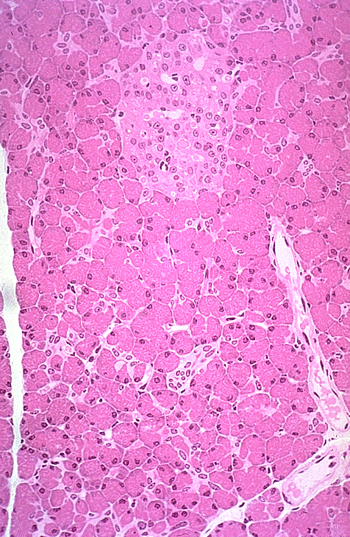
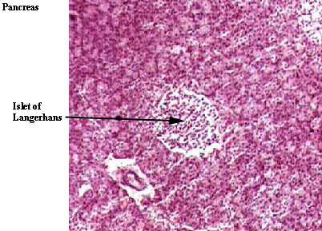
Pancreas
Exocrine: acinar cells
Endocrine: islet cells

Slide 41
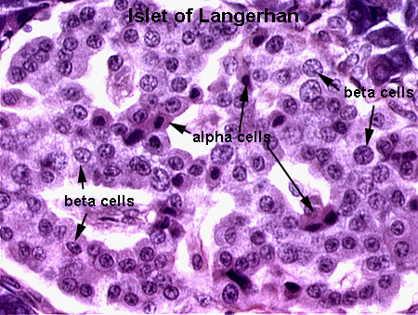

Slide 42
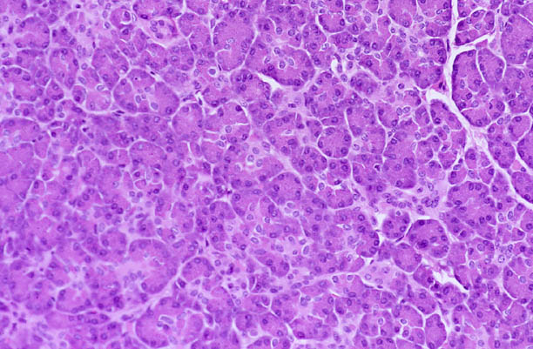
Pancreas
Acinar Cells

Slide 43
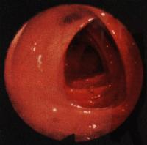
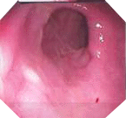

Large Intestine
(Colon)

Slide 44

Appendix

Slide 45

Appendix

Slide 46

Colon

Slide 47


Colon

Slide 48


Glands in Colon

Slide 49


Glands in Colon
colon polyp

Slide 50
PhysioEx 39B
Experiment 1: Starch Digestion

Slide 51


Starch Digestion by Amylase
Starch is a polymer composed of repeating units of glucose.
Amylase breaks starch into smaller subunits such as maltose.
Maltose

Slide 52


Slide 53

Load 7 tubes

Slide 54

Fill 7 tubes,
use droppers

Slide 55

Boil tube 1,
Incubate tubes

Slide 56

Transfer liquid
to new tubes

Slide 57

Add IKI reagent
Add Benedict’s reagent and incubate

Slide 58
Record data
Print data table and answer questions as directed in your Lab manual

Slide 59


End Lab 8
Please bring a full bladder to lab next week for urinalysis!

