Slide 1
The Respiratory System & Ventilation
Lab 7

Slide 2
Lab 7 Activities
Biopac L08-Respiratory Cycle 1: Pneumography
PhysioEx Respiratory System Mechanics (computer simulations of spirometry)

Slide 3
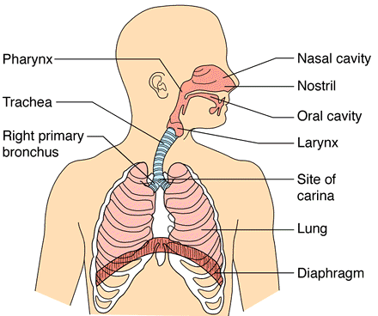
Respiratory System Structure

Slide 4
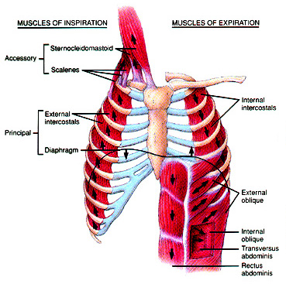
Respiratory System Muscles
Muscles of inspiration
diaphragm
external intercostals
Muscles of expiration
internal intercostals
abdominals

Slide 5
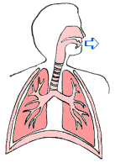
Pulmonary Ventilation: Inspiration + Expiration

Slide 6
CO₂ & Ph Levels Influence Ventilation Rate
Bicarbonate formation driven by the RBC enzyme: carbonic anhydrase
CO₂ +H₂0 ⇌ H₂CO₃⁻ ⇌ HCO₃⁻ +H⁺

Slide 7
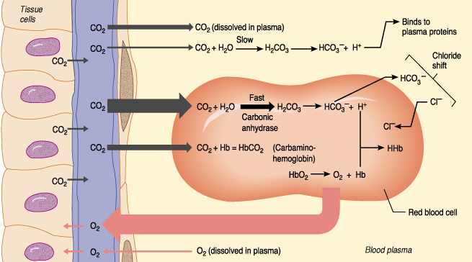
O₂ and CO₂ Transport
Gas exchange in the tissues

Slide 8
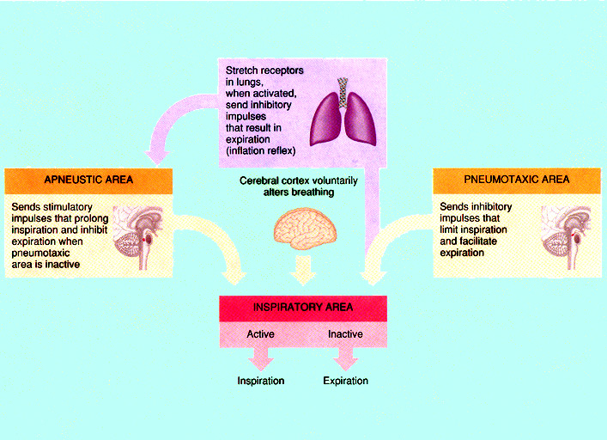
Control of Respiration

Slide 9
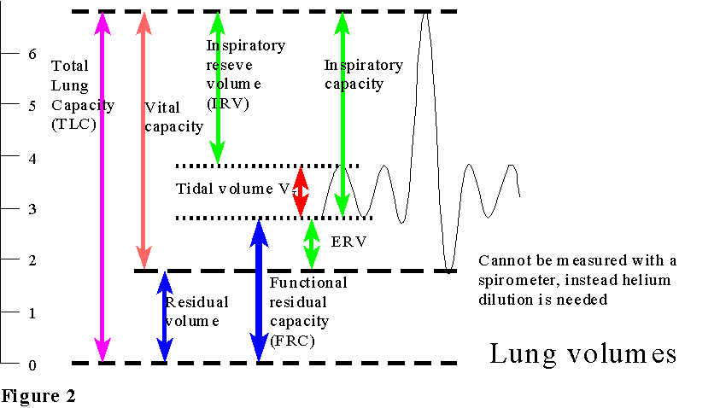
Biopac Spirometry
Residual volume

Slide 10
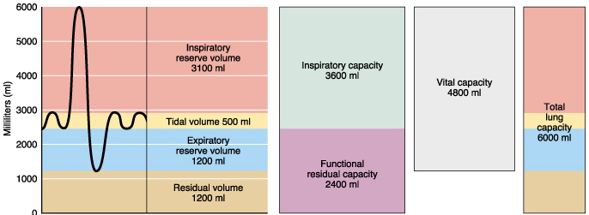
Lung Volumes and Capacities
Pulmonary volumes are measured
Pulmonary capacities are calculated

Slide 11
Biopac Set up
The respiration transducer- channel 1
The temperature transducer- channel 2
Place the respiration transducer over light clothing, around the chest, above the nipples and below the armpits.
Make sure during a maximum expiration it is still snug. Take time calibrating as it is sensitive to tension changes.

Slide 12
BioPac Collecting Pneumogram Data
Calibration: Expect lots of trial and error positioning the thermistor and pneumograph transducer
Treatment 1: normal breathing 15 seconds
Treatment 2: hyperventilation 30 seconds followed by normal breathing 30 seconds
Treatment 3: hypoventilation 30 seconds followed by normal breathing 30 seconds
Treatment 4: cough once followed by reading aloud 30 seconds

Slide 13
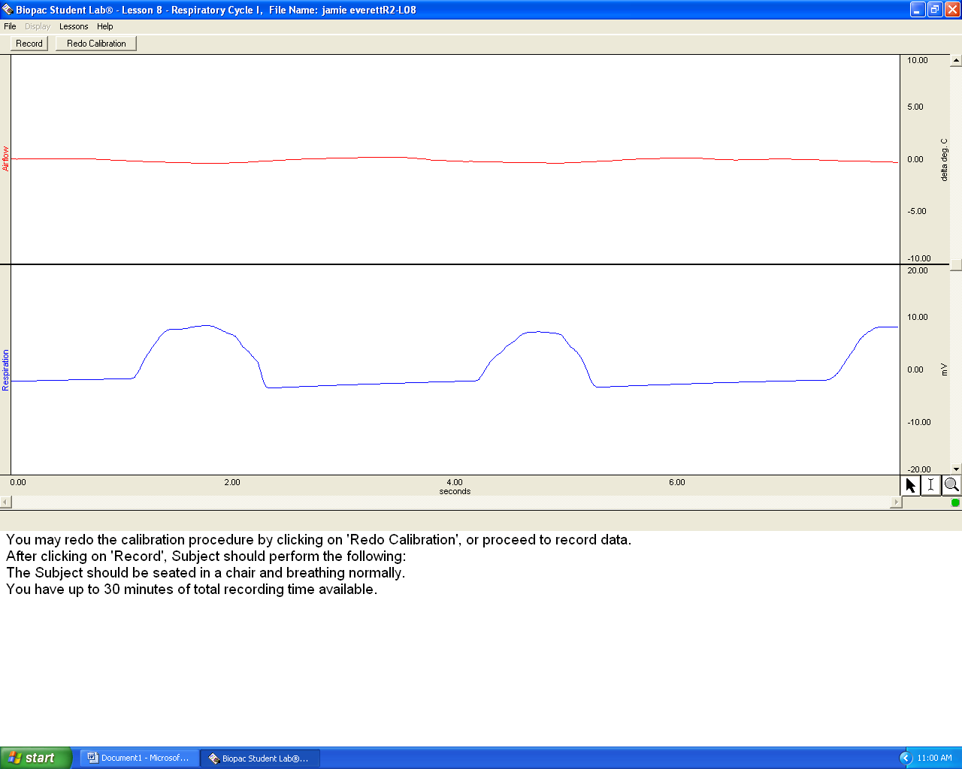
BioPac Pneumogram Calibration

Slide 14
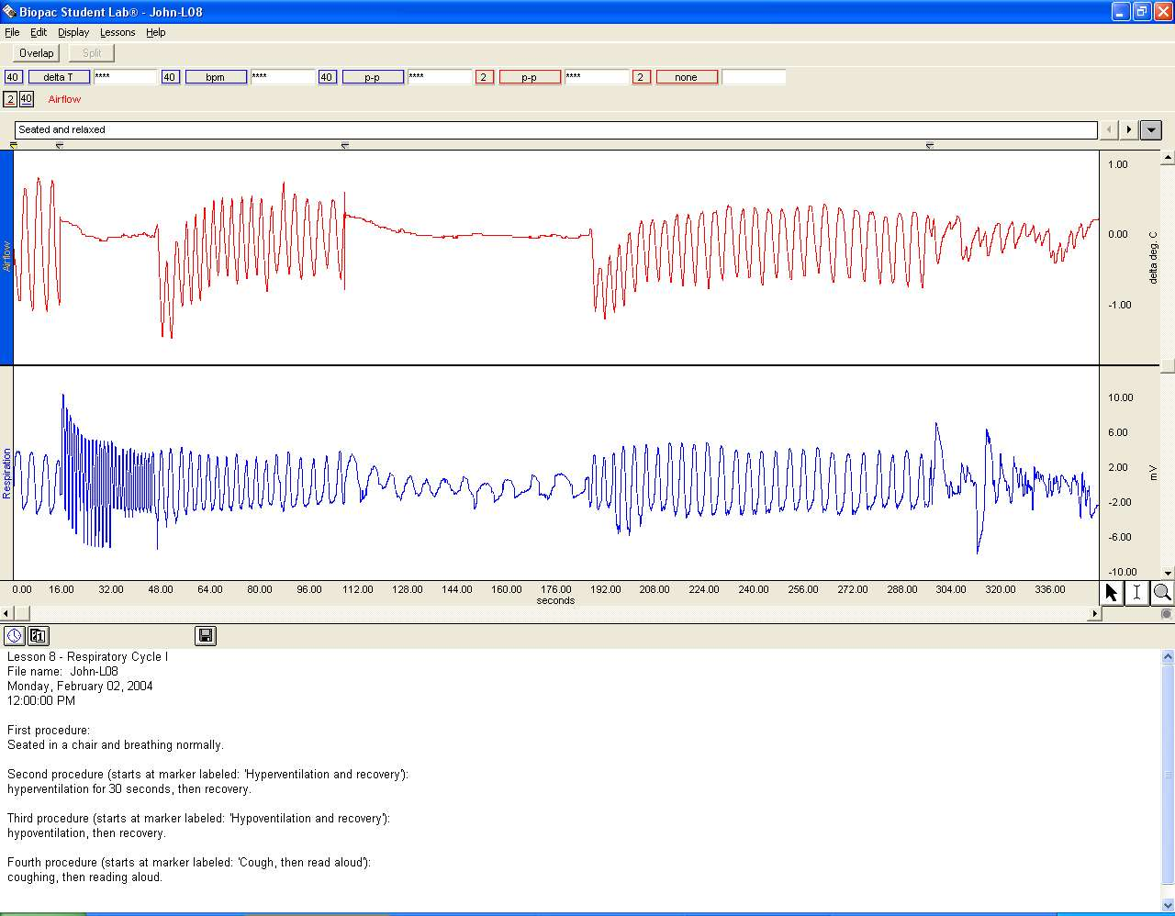
BioPac Pneumogram Example Data
hyperventilation
cough and
then read
normal breathing
Recovery
hypoventilation
Recovery

Slide 15
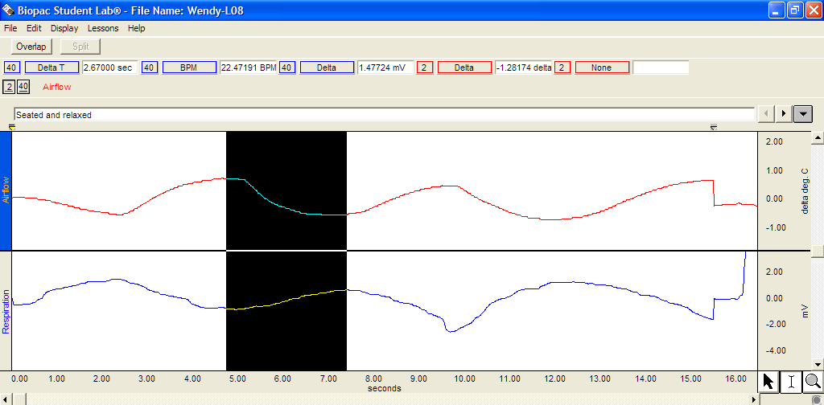
BioPac Data Analysis: Measuring Inspiration

Slide 16
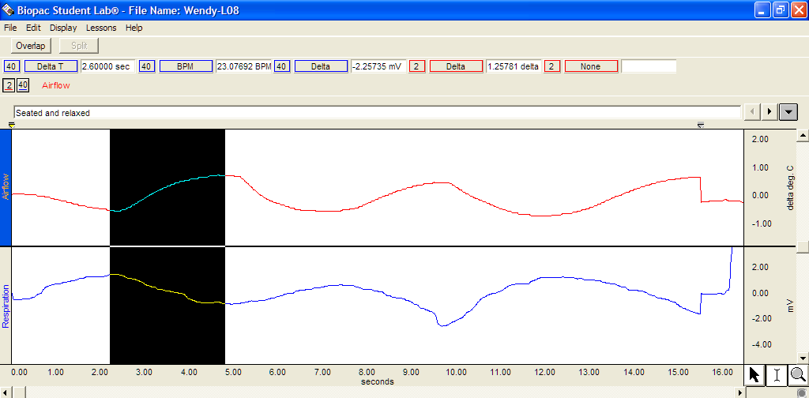
BioPac Data Analysis: Measuring Exhalation

Slide 17
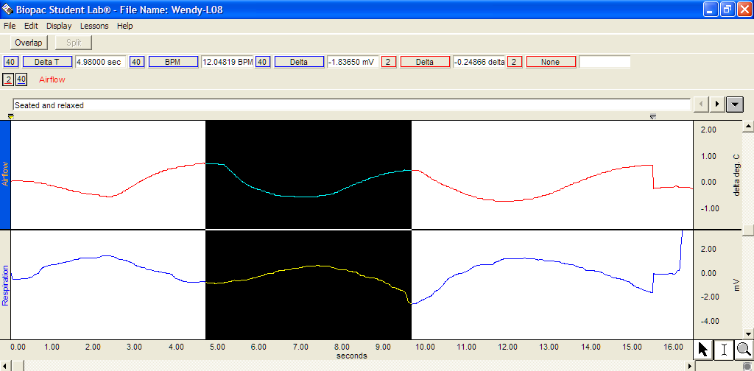
BioPac Data Analysis: Measuring Ventilation
Repeat these measurements for all the treatments!
Use the RECOVERY SECTIONS!

Slide 18
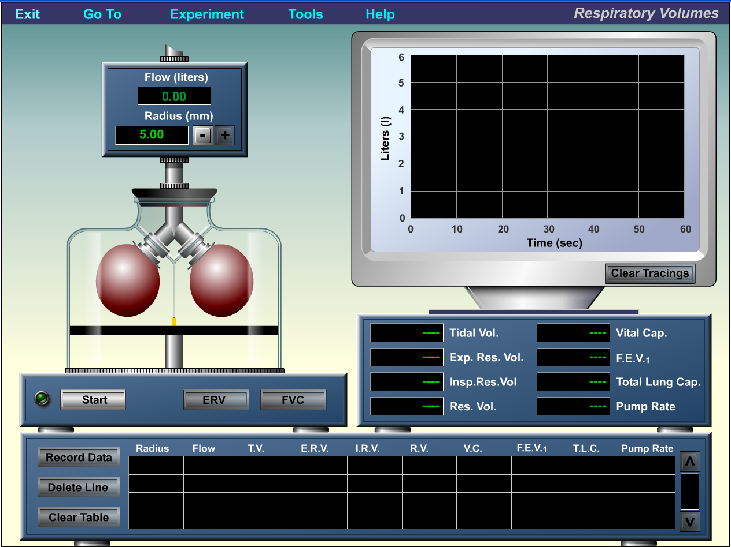
PhysioEx 7: Respiratory System Mechanics
Activity 1: Measuring Respiratory Volumes and Calculating Capacities
Record data in Table 4 on page 7-12 of lab manual.

Slide 19
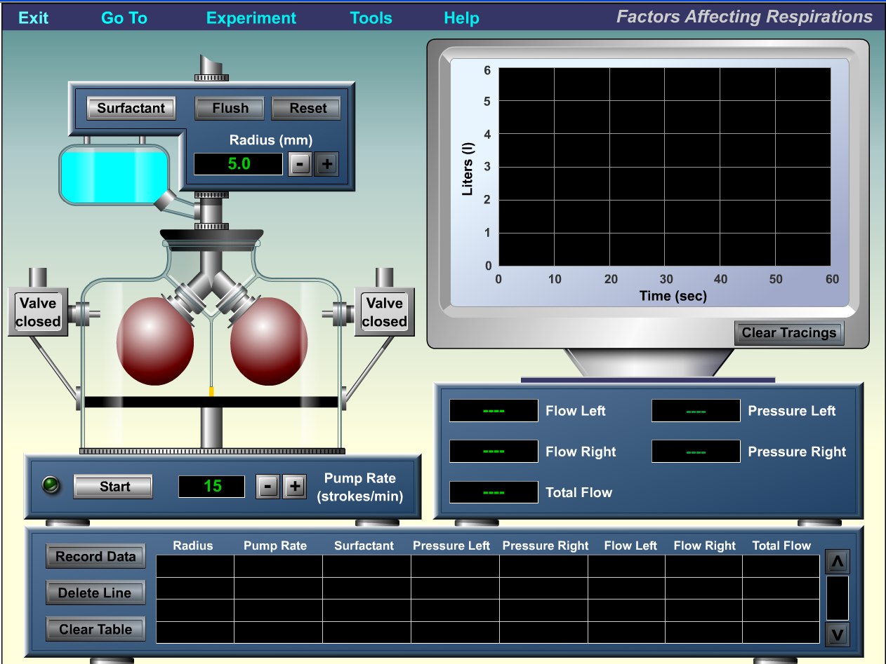
PhysioEx 7: Respiratory System Mechanics
Activity 2: Comparative Spirometry
Record data in Table 5 on page 7-13 in Lab Manual

Slide 20
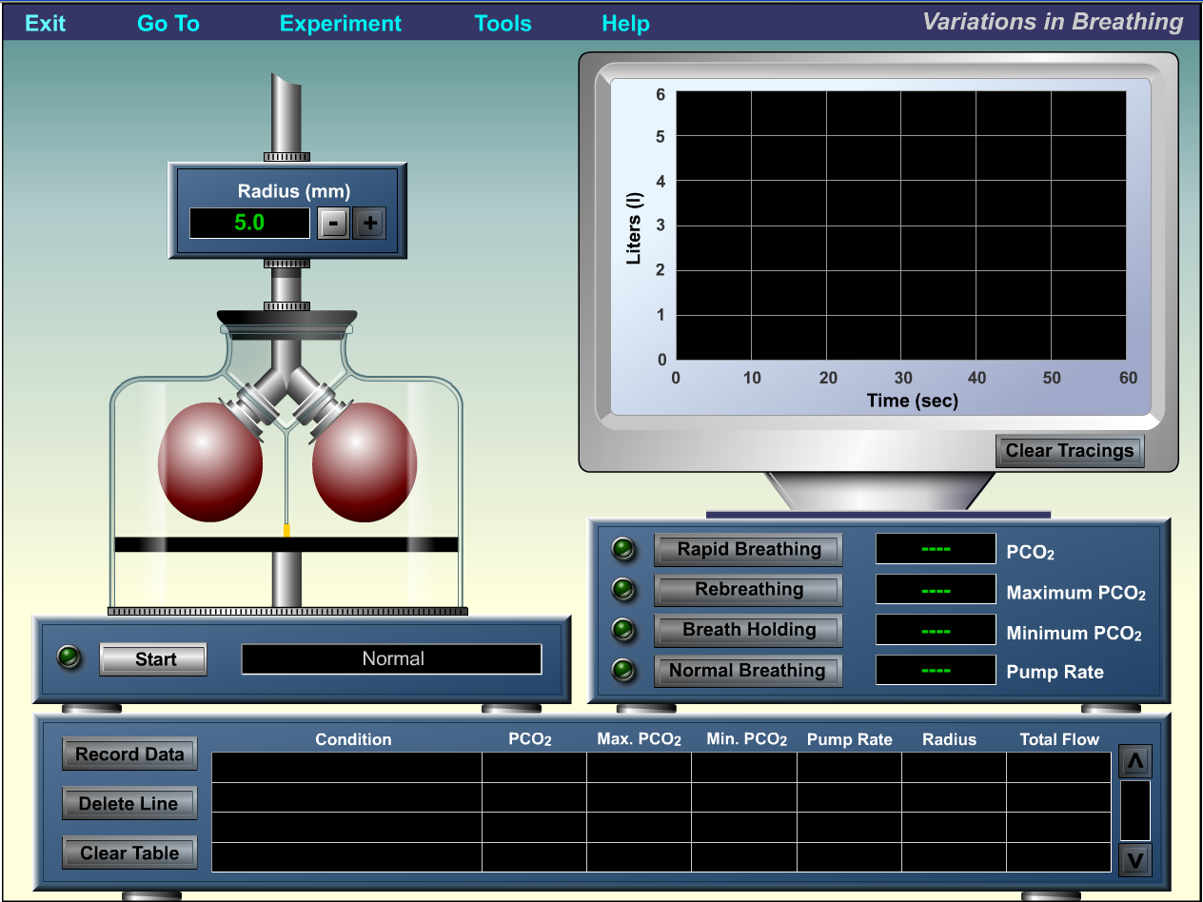
PhysioEx 7: Respiratory System Mechanics
Activity 3: Effect of Surfactant and Intrapleural Pressure on Respiration
Record data in Table 6 on page 7-13 in Lab Manual

Slide 21
What you will turn in
Pages 7-11 through 7-13.
A labeled printout of the pneumogram from Biopac. See page 7-11, question 2 for details on what to label.
MasteringAandP activity 7 is due next Friday.

Slide 22
The End
Lab 7

Slide 23
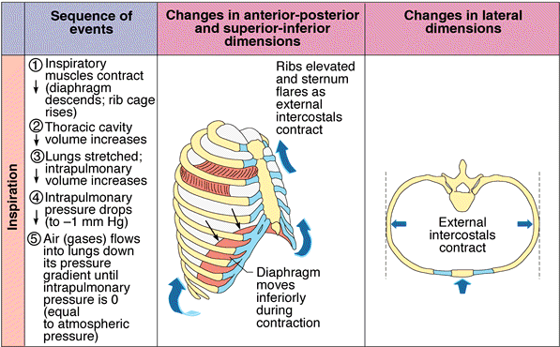
Pulmonary Inspiration - Summary

Slide 24
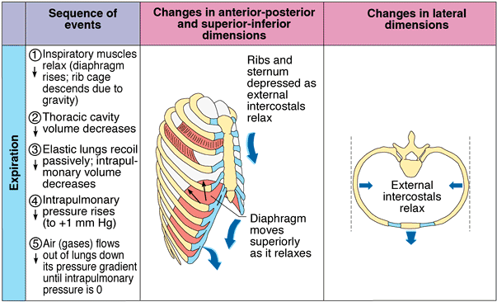
Pulmonary Expiration - Summary

