Slide 1
Lab 4 Cardiovascular Physiology

Slide 2
Lab 4: Cardiovascular Physiology
Blood Pressure and Pulse Determinations (BioPac: L016-BP-1)
Cardiovascular Dynamics (PhysioEx 5: computer simulation of vessel resistance and pump mechanics; activities 1,4,5 and 6)

Slide 3
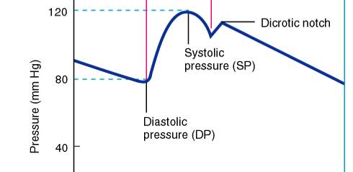
Aortic Pressure During the Cardiac Cycle
Arterial blood pressure
Systolic blood pressure = maximum pressure
Due to ejection of blood into aorta
Diastolic blood pressure = minimum pressure
Not zero due to elastic recoil and arterial muscle tone
Pulse Pressure = SBP – DBP
Mean Arterial Pressure = MAP = (SBP + 2DBP)/3

Slide 4
Korotkoff Sounds
1. You shouldn’t hear anything at rest.
2. When pressure of the cuff is elevated beyond systolic pressure, blood flow is occluded.
3. As pressure is eased off the cuff, the first audible sound of turbulent flow is when pressure is equal to systole.
4. The sounds are heard between systole and diastole. At diastole no sound is heard.

Slide 5
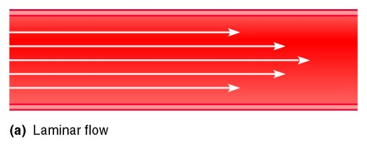

Patterns of Blood Flow During Blood Pressure Measurements
No Sound
Sounds
No Flow: No Sound

Slide 6
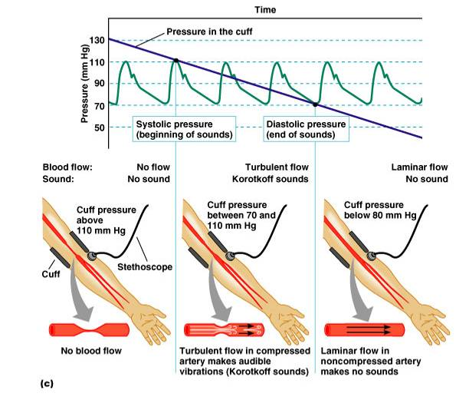
Measuring Blood Pressure

Slide 7
Blood Pressure and Pulse Determinations (BioPac: L016-BP-1)
Biopac instructs you to make 2 recordings for each treatment.
To save time, we will only do one measurement on the left arm while sitting up, one measurement on the right arm while sitting up, and one measurement from the right arm after exercise.
Follow the Lab Guide instructions carefully!
Click on Resume and Suspend to skip the second recording segment on the right arm while sitting up; then two more times to skip this third procedure (lying down) and to “fool” the program into "thinking" you have done all but the last procedure.

Slide 8
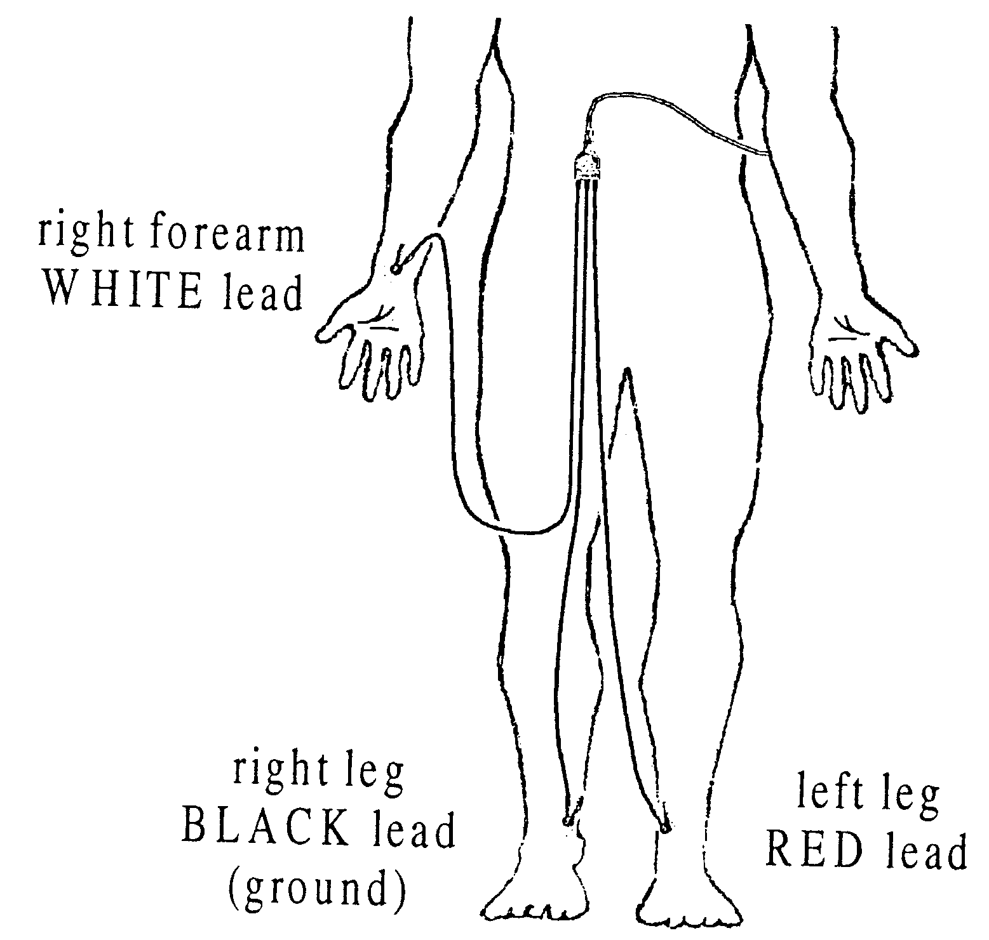
Electrode Positions
Caution: Electrode clips are fragile; place cords where they will not be stepped on, in use, or when you are through!

Slide 9
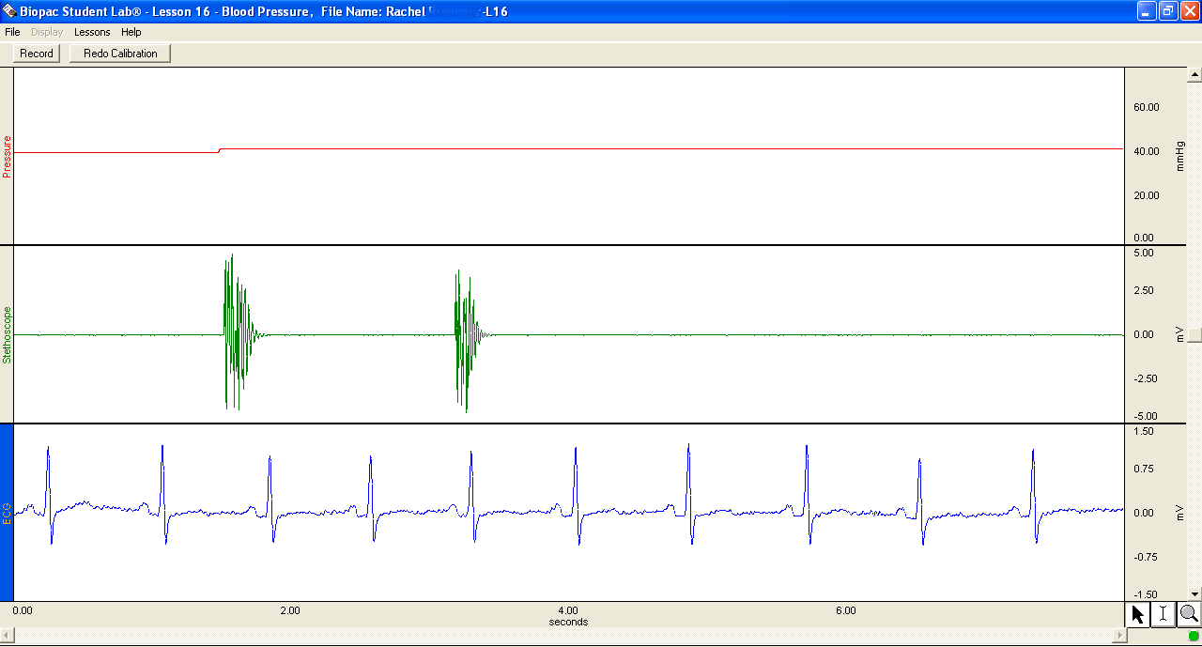
BioPac: L016-BP-1 Calibration
TAP! Stethoscope Twice

Slide 10

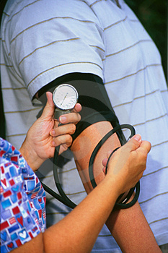
BioPac: L016-BP-1 Data Collection
Each time you take the subject’s blood pressure (for the 3 treatments):
Record both the systolic and diastolic BP values from the METER in Table 1 on page Lab 4-9 as you go.
You will need these numbers (e.g., 120/80) when you do the data analysis.

Slide 11
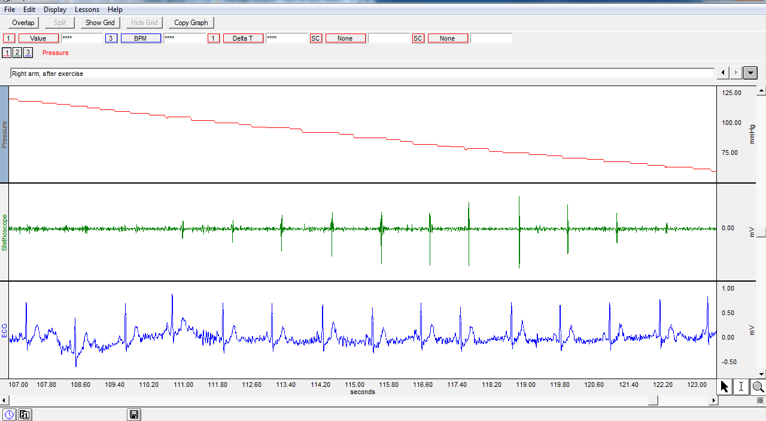
BioPac: Data Analysis
Change to:
1: MAX 1: MIN 1:P-P

Slide 12
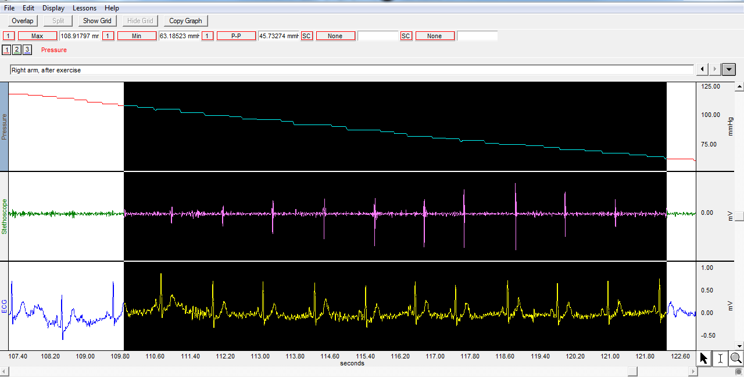
BioPac: Data Analysis
Highlight from First to Last Korotkoff sound
1:MAX Reports Systolic Pressure
1: MIN Reports Diastolic Pressure
1: P-P Reports Pulse Pressure

Slide 13
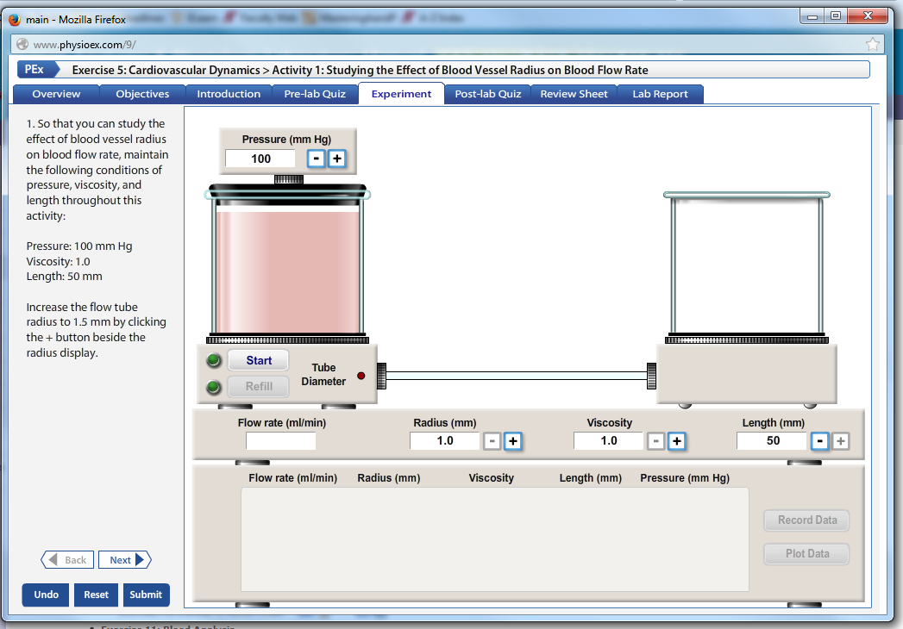
PhysioEx 5: Cardiovascular Dynamics
Activity 1 (PhysioEx activity 1): Effect of blood vessel radius on blood flow rate
Record results in Table 2 on page Lab 4-11

Slide 14
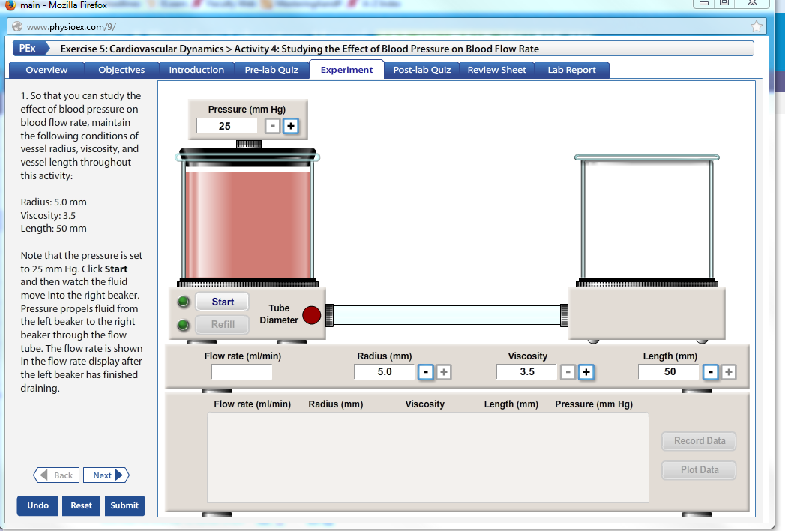
PhysioEx 5: Cardiovascular Dynamics
Activity 2 (PhysioEx Activity 4): Effect of blood pressure on blood flow rate
Record results in Table 2 on page Lab 4-11

Slide 15
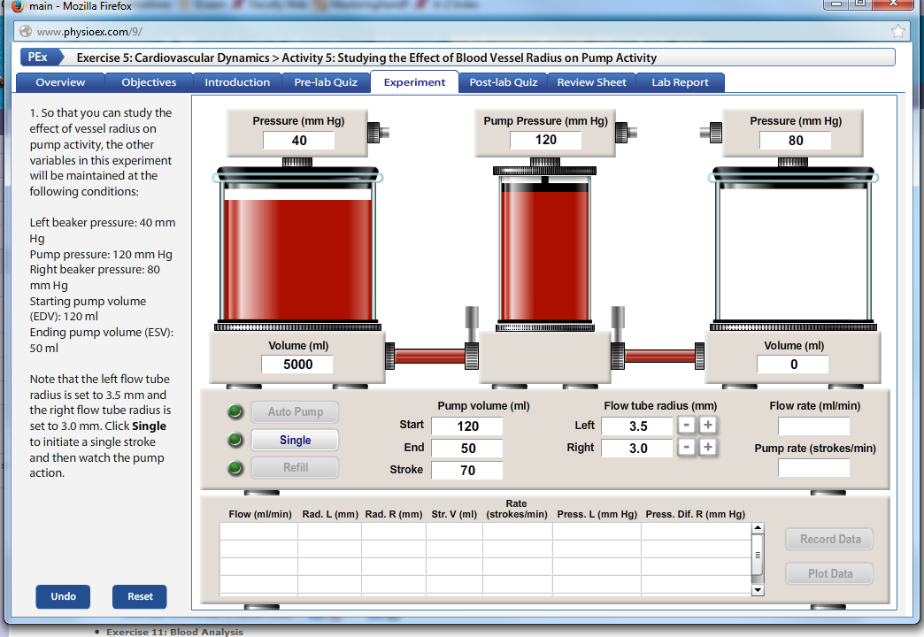
PhysioEx 5: Cardiovascular Dynamics
Activity 3 (PhysioEx Activity 5): Effect of blood vessel radius on pump activity
Record results in Table 3 on page Lab 4-11

Slide 16
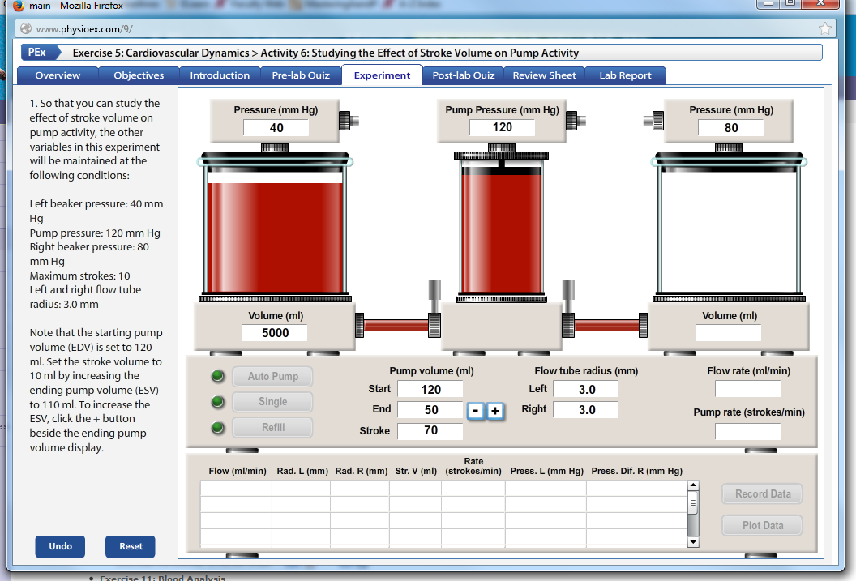
PhysioEx 5: Cardiovascular Dynamics
Activity 4 (PhysioEx Activity 6): Effect of stroke volume on pump activity
Record results in Table 3 on page Lab 4-11

Slide 17
Homework
Complete and turn in the questions on pages 4-9 to 4-12
Biopac: Be sure to include the labeled graph from Biopac!
Label P,Q,R,S and T- 5 points
Label first and last Korotkoff sounds- 2 points
Report the blood pressure measurements and pulse pressure for graph on the graph- 3 points
PhysioEx Graphs: You may use Excel, any other graphing software, or you may make the graphs by hand.
Recall that for full credit a graph should include:
An informative title
Labeled X and Y axis's that include the units
Each graph is worth 4 points
Complete Assignment 4 on MasteringAandP.

Slide 18
End Lab 4

