Slide 1
Lab 3 The Blood Vessels

Slide 2
Lab 3: Objectives
Examine:
Slide #44 of artery, vein, and capillaries; #45 of atherosclerosis
Circulatory tree and torso models
Arm blood vessels model
Vessels on heart, torso, thorax, and pelvis models
Palpate superficial pulse points/take apical pulse
Biopac L07-ECG-Pulse: ECG and pulse (including effect of cold temperature and raising arm (gravity) on pulse amplitude)
Biopac L017-HS-1 (Heart Sounds): ECG and heart (valve) sounds

Slide 3
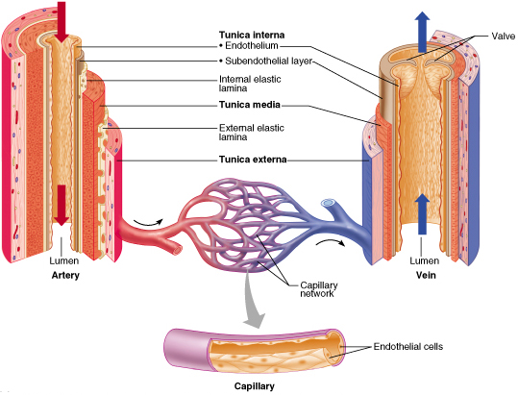
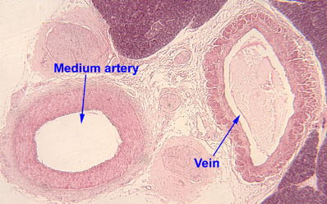
Vessel Structure
All vessels have the same basic structure
3 layers in the wall
Tunica adventitia (externa) - elastic and laminar fibers
Tunica media
thickest layer
smooth muscle fibers and elastic fibers
Tunica interna (intima)
endothelium – non-stick layer
basement membrane
internal elastic lamina
lumen = opening

Slide 4
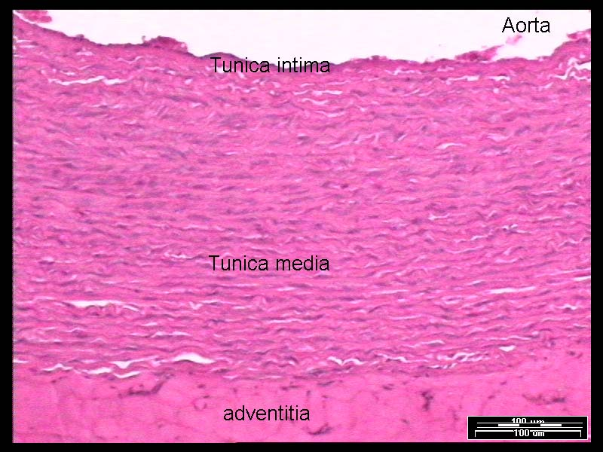
Aorta – Elastic Fibers Visible

Slide 5
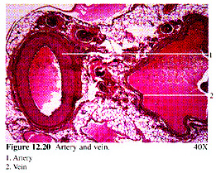
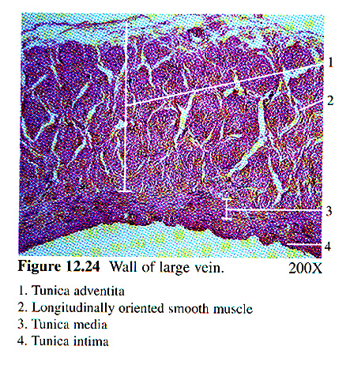
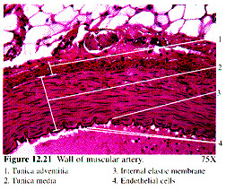
Vessel Structure - Histology
Very different morphology under light microscopy
Tunica media thickness distinguishes arteries from veins

Slide 6
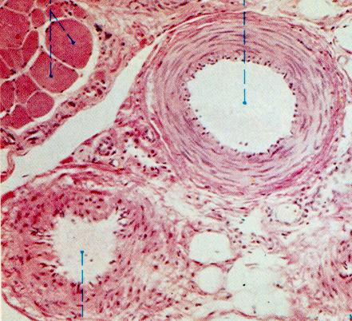
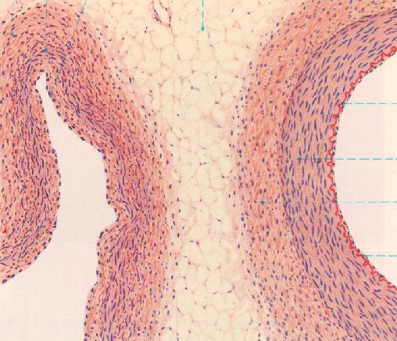
Vessel Structure - Histology
Vein Artery
Vein Artery
internal elastic lamina

Slide 7
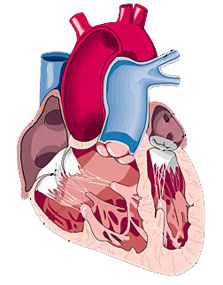
Valves of the Heart
Four named valves: tri- and bi-cuspid (mitral) valves between the atria and ventricles and semi-lunar valves between ventricles and main arteries
Valves also close the entry points to the atria
All these valves prevent back flow of the blood
Bicuspid
(Mitral)
Tricuspid
Semi-lunar

Slide 8
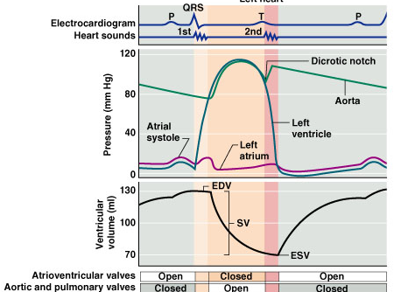
The Cardiac Cycle
Understand the relationship between electrical and mechanical events
Left ventricular
ejection
creates our
pulse

Slide 9
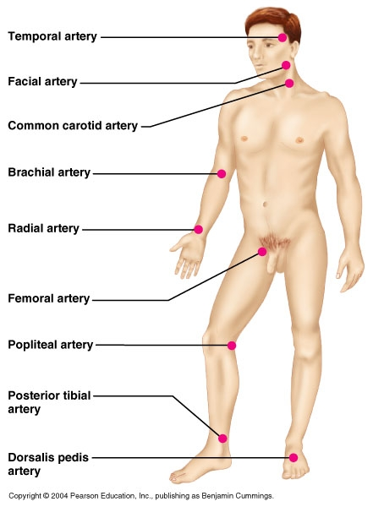
Pulse Points
Palpate the pulse in these areas, except the femoral artery.

Slide 10
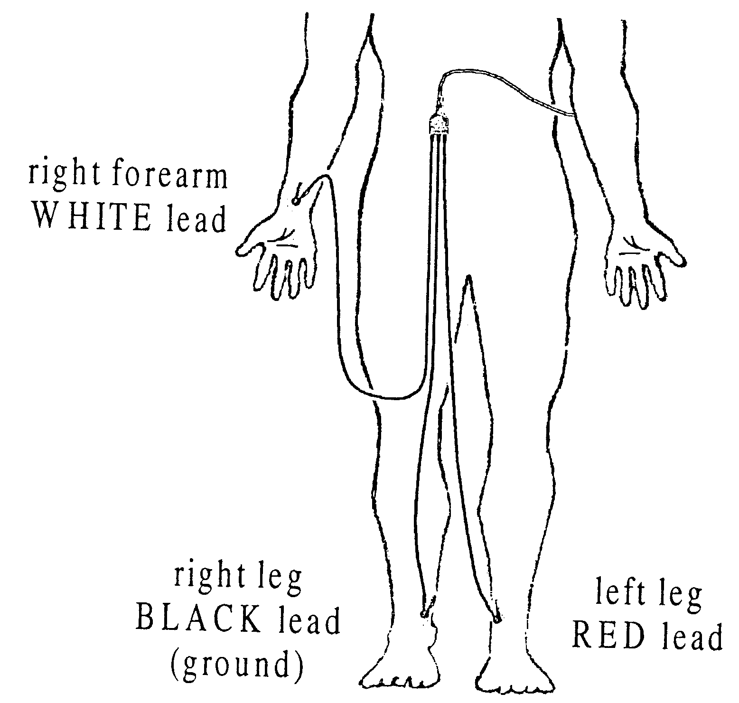
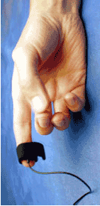
Biopac L07-ECG-Pulse:
ECG and pulse
pulse
The ECG Electrode and
pulse plethysmograph
need to be on the right!
Caution: Electrode clips are fragile; place cords where they will not be stepped on, in use, or when you are through!

Slide 11
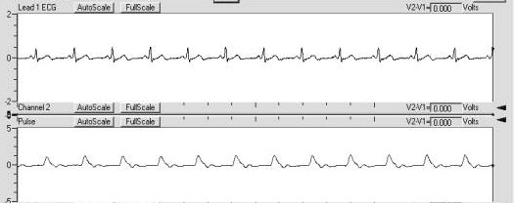
BioPac: EKG & Pulse Tracing
The heart beat is followed by the pulse pressure wave in the finger

Slide 12
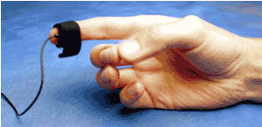
BioPac: EKG & Pulse Tracing
Calibration: be sure pulse plethysmograph is not too tight or too loose on the
RIGHT hand.
Treatment 1: seated, relaxed, click record for 15 secs.
Treatment 2: free hand (left) plunged into ice water, record for 15-30 secs. while hand is submerged. Do NOT submerge plethysmograph!!!
Treatment 3: plethysmograph hand (right) raised over head, 15 secs. Record for 15 seconds.
Click Done and analyze current data file. Set measurement channel box 1 to delta T (time) and box 2 to BPM (number of events per minute), box 3 to measure p-p in channel 1 ( height of waves in ecg) and box 4 to measure p-p on channel 40 (height of highlighted pulse waves)
Use I-beam to select regions for Table 1 on page 3-21

Slide 13
Actual pulse tracings look like this:
During what part of the ECG does ventricular ejection occur?
What does the arrow represent?

Slide 14
BioPac: EKG & Pulse Tracing
Print and label your graph to turn in according to your lab guide instructions.
Cardiac cycle duration &
QRS amplitude
R to R
Pulse duration
Peak to Peak
Peak to Trough
Pulse strength

Slide 15
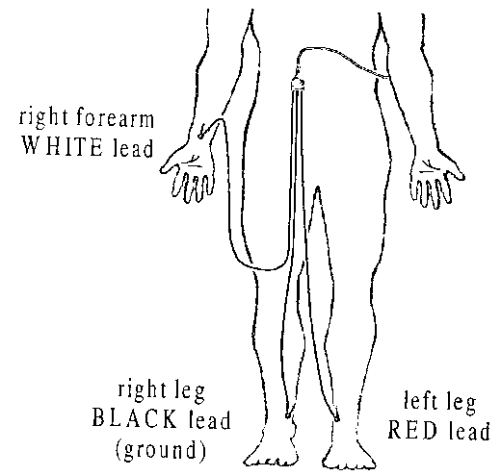
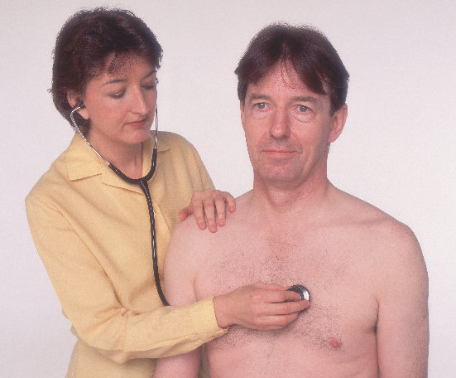
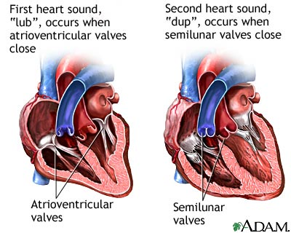
Biopac L017-HS-1 (Heart Sounds)
You must change the Biopac cable connections to the box for the heart sounds Biopac lab!
The stethoscope should be plugged in to channel 1
The ECG leads need to be plugged into channel 2

Slide 16
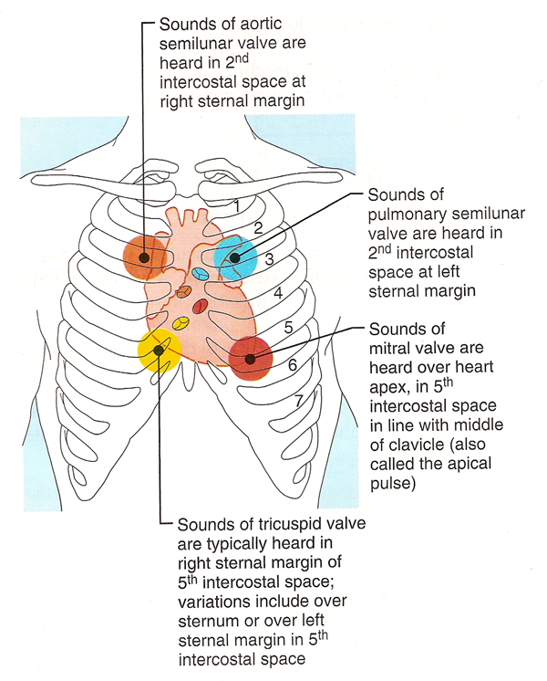
Ascultating Heart Sounds
A P
T B/M

Slide 17
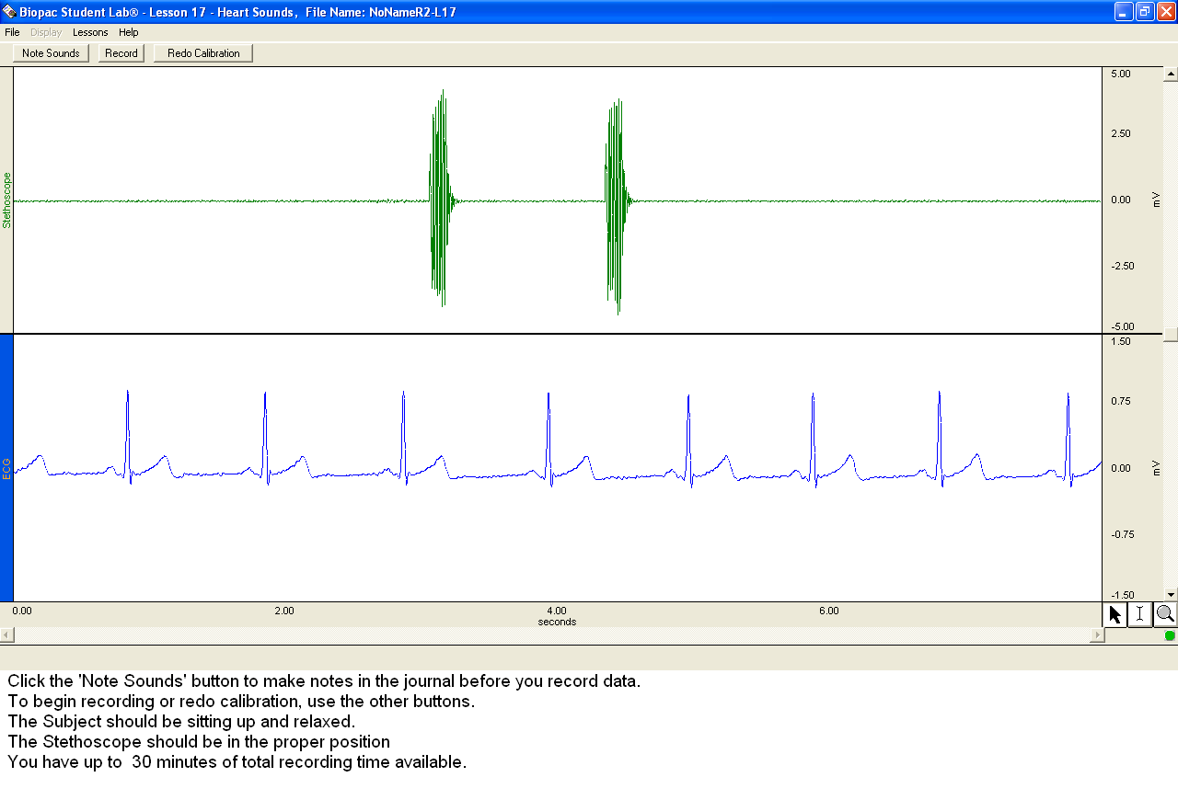
Biopac L017-HS-1 (Heart Sounds)
Begin your data collection
by using the Note Sounds
button. Do not use record
until you have completed
the notation of valve sounds.
Record the sounds on p. 3-23.
Print and label your graph to turn in.

Slide 18
Biopac L017-HS-1 (Heart Sounds)
Choose the greatest deflection up or down
during data analysis
R-wave to 1st heart sound
T-wave to 2nd heart sound
1st 2nd

Slide 19
Settings for data analysis- heart sounds part B
After recording 20 seconds of data, choose suspend. Select Done. We are not following the prompt to do light exercise.
Analyze current data file
Select CH2 as first box and select delta T ; CH1 as second measurement box and delta T.
Zoom in using magnifier until 4-5 cycles are in view. Using I beam to highlight from R to heart sound 1 and then from peak of T to heart sound 2 and record delta T values in Table 2.
Print a representative section and label waves on ECG (channel 2) and heart sounds 1 and 2 on stethoscope recording (channel 1).

Slide 20
What will be due next week:
Pages 3-21 through 3-24
Two labeled printouts, one from each biopac lab
Mastering A and P activity 3 is due by Friday at 11:59 p.m.

