Slide 1
Laboratory 2
The conduction system of the heart and electrocardiography

Slide 2
Lab 2 Activities
Anatomy of the internal conduction pathway of the heart.
Biopac Exercise L05-ECG-1: Normal electrocardiogram (including the names of all waves, intervals, and segments, what they mean, and how they correlate to the parts of the cardiac cycle).

Slide 3
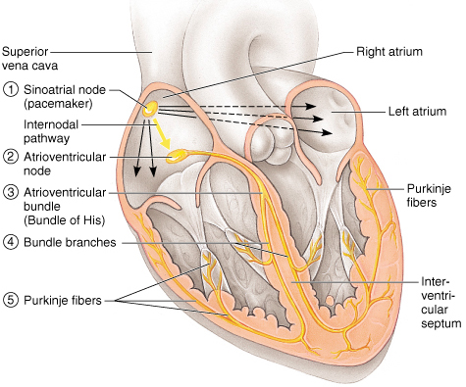
Conduction System and Pacemakers
Autorhythmic cells
Cardiac cells repeatedly fire spontaneous action potentials
Autorhythmic cells: the conduction system
Pacemakers
SA node
origin of cardiac excitation
fires 60-100/min
AV node
conduction system
AV bundle of His
R and L bundle branches
Purkinje fibers
It’s as if the heart had only two motor units: the atria and the ventricles!

Slide 4
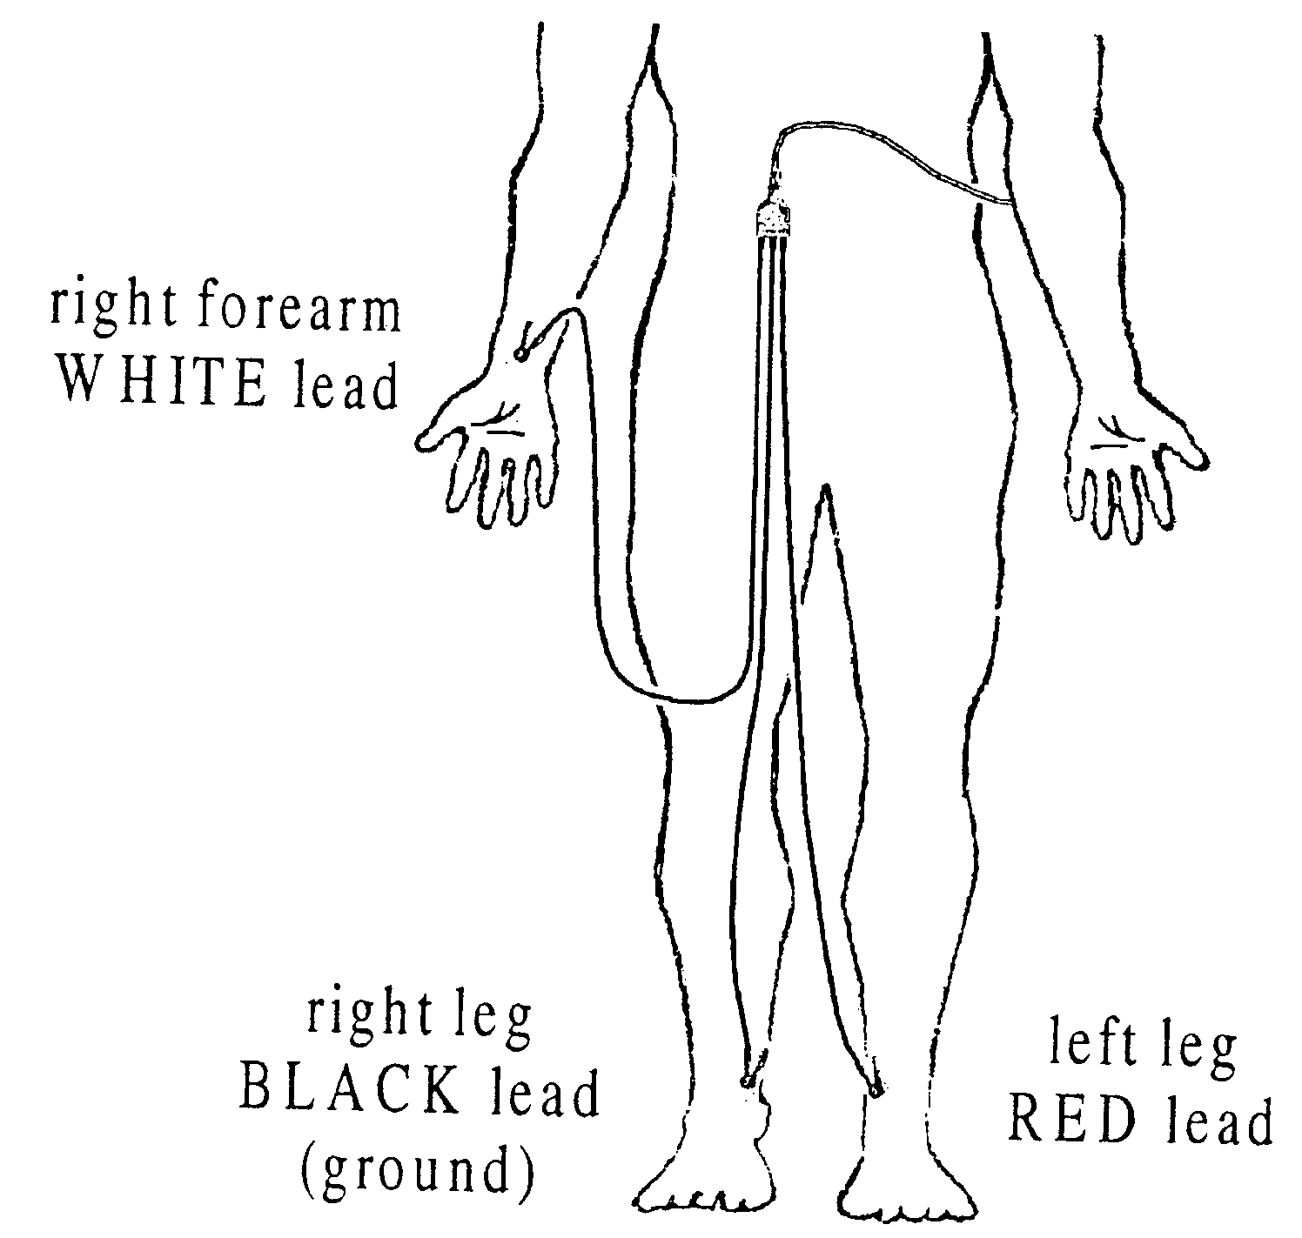
The ECG: Electrode Placement
Caution: Electrode clips are fragile; place cords where they will not be stepped on, in use, or when you are through!

Slide 5
The ECG
Below are illustrated the waves (deflections) of a typical cardiac cycle.
R
P
T
Q
S

Slide 6
The ECG
Waves, intervals and segments of one cardiac cycle are illustrated below.
QRS complex
R
P
T
Q
PR (PQ)
Interval
ST
segment
S
QT interval

Slide 7
BIOPAC NOTES
During calibration:
The subject should be sitting still, hands resting in lap or on knees- click Calibrate
If the beginning of the baseline is decreasing, redo the calibration.
The baseline should be more or less constant (horizontal) during calibration.

Slide 8
BIOPAC NOTES
During data collection (record – suspend – resume)
Treatment 1: Supine the bench top or three chairs or at least with feet elevated in a second chair; arms folded across waist if prone; breathing normally
Click Record , after 20 seconds click Suspend
Treatment 2: Sitting in a chair with arms at sides, hands in lap, feet on the floor and breathing normally
Click Resume , after 20 seconds click Suspend
--Treatment 3: Still seated, click on Resume as subject inhales and exhales deeply for 5 prolonged breath cycles. Recorder must press F4 at start of each inhale and F5 at start of each exhale. After the five breaths, record 5 more seconds then click Suspend
Treatment 4:Exercise vigorously for 1 minute- heart rate should be elevated. As soon as subject is seated click on Resume for 5 minutes.
Click Done. Choose “Record from another subject”, when each person is done then choose “Analyze current data”.
Click “Review Saved Data”- find the “Data files” folder and your data with the ECG tracing.

Slide 9
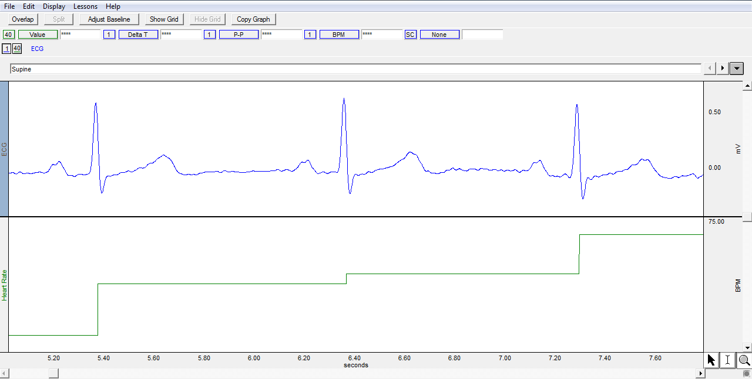
BIOPAC NOTES
Data Analysis
Ensure the boxes at the top are as depicted by the red arrow
Magnify image so that 2-3 cardiac cycles are visible.

Slide 10
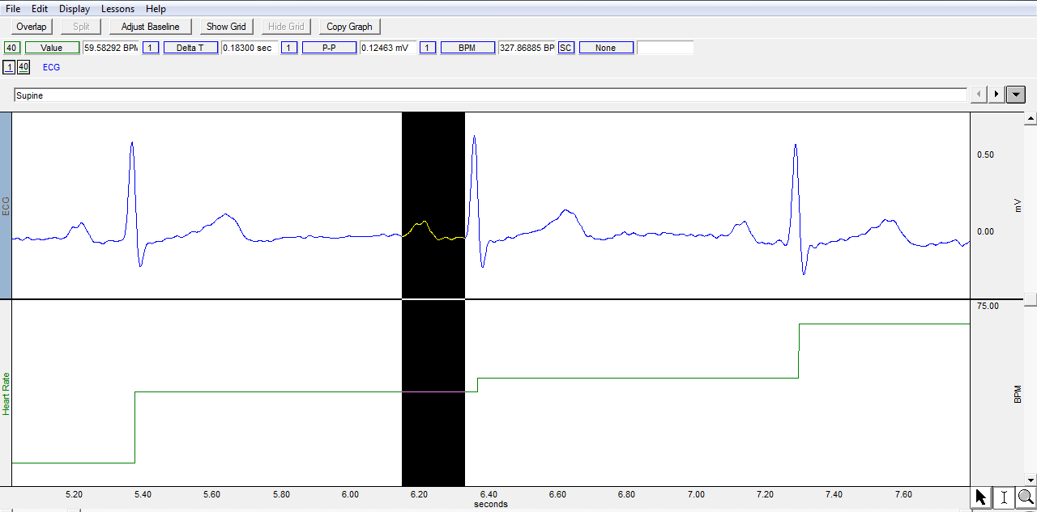
BIOPAC NOTES
Measure how long each event lasted
Delta T: Delta = Change, T = Time
The PR interval (PQ interval) is measured from the start of the P wave (not the top of P) to the start of the Q wave, but we will use Q, which is easier to identify

Slide 11
BIOPAC NOTES
Measure how long each event lasted
Be sure that you analyze and record results of 2 cardiac cycles for each treatment in your lab manual.
Tables 1 and 2, page 2-7
Calculate the average of the 2 cycles!
Do not select cardiac cycles that are right next to each other.
Do your best to identify wave transitions. Be consistent!

Slide 12
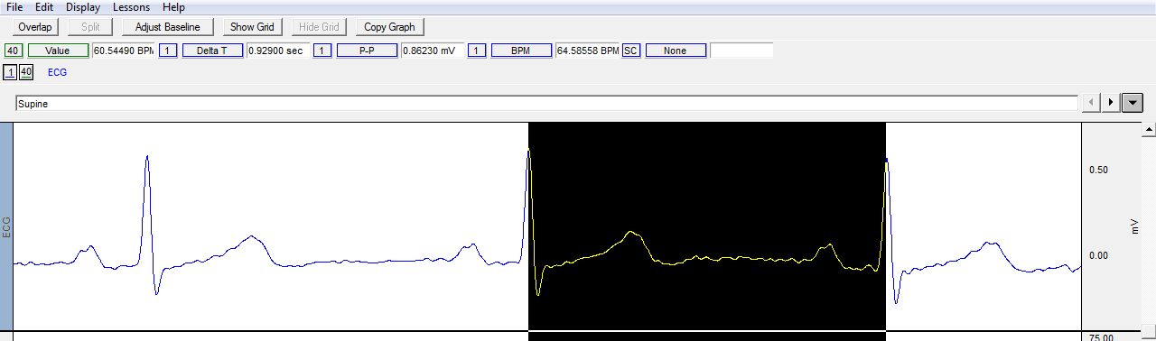
BIOPAC NOTES
Measure the BPM for the same two cardiac cycles for each procedure
Use the I-beam to highlight one cardiac cycle and measure from the top of R to the top of R of the next cycle (R to R) to record the beats per minute rate for each treatment
Record results from 2 cardiac cycles for each treatment segment in Tables 1 and 2.
Calculate the average of the 2 cycles!

Slide 13
BIOPAC NOTES
Cardiac Cycle
Calculate by summing the appropriate intervals.
Rounding
Round your Delta T values for intervals and segments to two decimal places, e.g., 0.16.
Round your BPM values for Heart Rate to one decimal place, e.g., 72.1.

Slide 14
Your Assignment
Print a representative section (2-3 cardic cycles) of your ECG for the first set of treatment data (supine).
Label the waves, intervals, and segments of a typical cardiac cycle on the ECG you print.
Fill in Tables 1 & 2 as you analyze your data on page Lab 2-7 of your lab manual.
Answer the questions on page Lab 2-8.
No on-line homework this week.

Slide 15
BIOPAC NOTES
Your graph should look like this.
Then be sure you label the waves (P, Q-R-S, and T), intervals and segments (PR, ST, and QT) on the graph.

Slide 16
End Lab 2

