Slide 1
HUMAN ANATOMY & PHYSIOLOGY II LAB
BIOL 2021 Syllabus Summary

Slide 2
Course Information
Credit Hours: Biology 2020 (lecture) = 3, Biology 2021 (lab) = 1. You must register for lecture and lab if this is the first time you are taking the course. If you are registering for the evening sections you must register for both the evening lecture and lab sections.
Course Description: A continuation of Biology 2010. Surveys the cardiovascular, lymphatic, immune, respiratory, digestive, excretory, and reproductive systems. Topics include homeostasis, metabolism, water and electrolyte balance, growth and development.

Slide 3
Course Objectives/Goals
1. To learn basic human anatomy and physiology in preparation for careers in health professions.
2. To provide clinical material required for predicting and understanding problems that arise when normal anatomy and physiology fail.
3. To present and identify the concept of health and wellness.
4. To stimulate skills of inquiry and logical thinking.
5. To develop literacy in writing, reading, listening, and arithmetic skills.
6. To understand the scientific method.

Slide 4
Grading
Lab Grade = (Average of weekly lab reports + Mid-term practical + Final practical)/3.
Grading Scale: A > 90%, B > 80%, C > 70%, D > 60%, F < 60%
Make-Up Exams: Advance notice, if possible, and a valid reason must be provided for an official excused absence in order to qualify for a make-up exam.

Slide 5
Computer Assisted Learning
The Human Anatomy and Physiology courses at APSU provide numerous computer-based tools to help students learn the central concepts of this discipline.
Laboratory Powerpoints: Available on Dr. Pitts’s website: www.apsu.edu/biology/pittsg

Slide 6
Computer Assisted Learning
You will submit your weekly lab homework on MasteringAandP.
Students often find additional MasteringAandP resources to be helpful.
A card in your packet containing the individual access code for MasteringAandP is included with your bundled text and lab manual.

Slide 7
Computer Assisted Learning
You use your access code to enroll in the appropriate MasteringAandP (MAP) lecture and lab course and, from then on, use the course ID each time you enter MAP.
Your course ID, ?, is needed to enroll in the correct LABORATORY MAP section (https://www.pearsonmylabandmastering.com).
Go to the study area of MAP to use its resources.

Slide 8
Tutoring
Free tutoring is available for all students for a variety of classes including Anatomy and Physiology in the Academic Support Center, Marks Building - Room 122, Ph. (931) 221-6553. Call to check tutoring schedules.
Some students may also meet eligibility requirements to receive academic assistance from Student Support Services. For more information contact: Student Support Services Program, Ellington, Room 337, (931) 221-6142.

Slide 9
Student Responsibilities
Read the contents of the Lab Manual for the week so you will know what activities are planned for lab before coming to lab.
Dress appropriately.
Pay attention. Make sure your cell phone is on silent.
Use safety precautions.
Maintain a clean and organized work area.
Raise your hand to ask questions.
Use any free time to study for the upcoming practical exams.

Slide 10
Student Responsibilities
Turn in your completed homework on time, either electronically on Mastering A&P or stapled with the sheets in the correct order, and with your name, your instructor’s name, and the day and time of your lab on each page as indicated in the week’s Lab Guide.
Use safety precautions.
Consuming food or drinks in the labs is prohibited.

Slide 11
Student Responsibilities
Dispose of all contaminated or dangerous materials in the appropriate safety disposal containers. The red biohazard containers and the sharps containers (red or clear) around the labs are not for disposal of ordinary trash.
The lab printing facilities are only to print the anatomy and physiology assignments. Printing lecture or lab PowerPoint slides is not allowed in the laboratories.

Slide 12
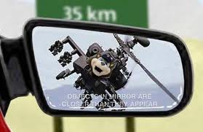
Don’t Lose Your Way
You cannot cram for an A&P exam!
Warning: Exam dates are closer than they appear!

Slide 13
Lab 1
Anatomy of the Heart

Slide 14
Lab 1 Activities
Cardiac muscle slide (#22)
Heart models and diagrams
Dissection of sheep heart
PhysioEx® Frog Cardiovascular Physiology (computer simulation of frog heart modifiers): Exercise 6: Cardiovascular Physiology, activities 1, 2, 4 and 5

Slide 15
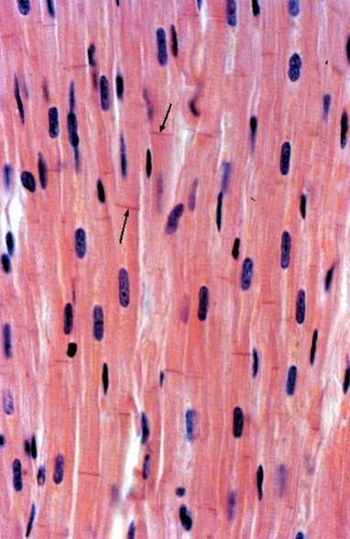
Characteristics of Cardiac Muscle
Forms most of heart wall (myocardium)
Involuntary (unconscious)
Autorhythmicity (contracts without external stimuli)
Fast contraction, non-fatigable
Constant rhythm may be modified by neural and hormonal signals

Slide 16
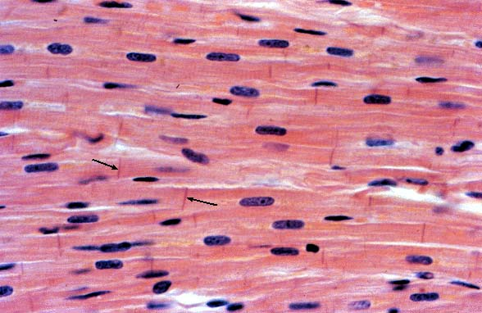
Cardiac Muscle Tissue
Striated
Unicellular
Uninucleate
Branched cells
Intercalated discs

Slide 17
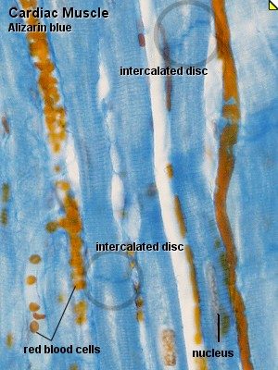
Cardiac Muscle Tissue
Rich blood supply

Slide 18
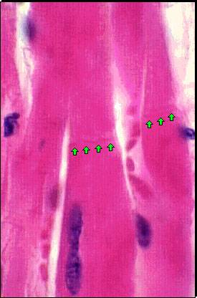
Intercalated Discs
Gap junctions
Electrical synapses
Excitation spreads rapidly
Tight junctions
Help keep blood from entering cardiac tissue
Desmosomes
Hold cardiac cells together to resist tearing during contraction

Slide 19
Physiology of Contraction
Contraction utilizes the Sliding Filament Mechanism
The same mechanism used by skeletal muscles

Slide 20
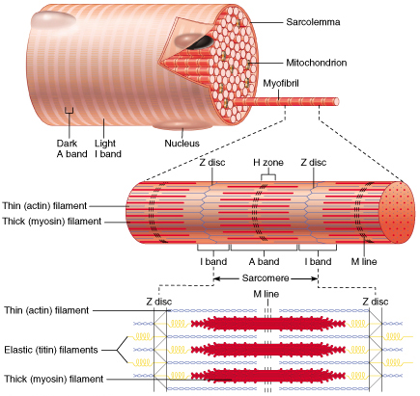
Striations /Sarcomeres
Z discs (lines): the boundary between sarcomeres; proteins anchor the thin filaments
A (anisotropic) band: overlap of thick (myosin) filaments & thin filaments
I (isotropic) band: thin (actin) filaments only
Z line: bisects each I band
H zone: thick filaments only
M line: proteins anchor the adjacent thick filaments

Slide 21
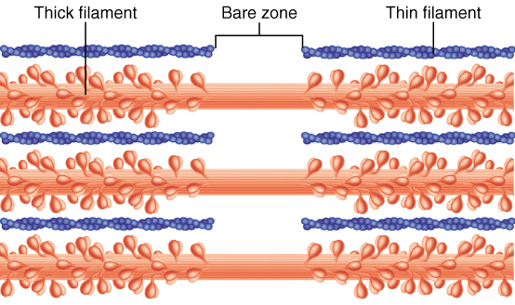
Myofilaments
Thin filaments: actin (plus some tropomyosin & troponin)
Thick filaments: myosin
Elastic filaments: titin (connectin) attaches myosin to the Z discs (very high mol. wt.)

Slide 22
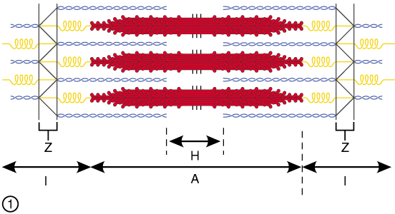
Sarcomeres
Components of the muscle fiber with myofilaments arranged into contractile units
The functional unit of striated muscle contraction
Produce the visible banding pattern (striations)
The myofilaments between two successive z discs

Slide 23
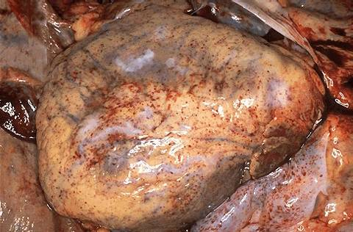
Heart Dissection

Slide 24
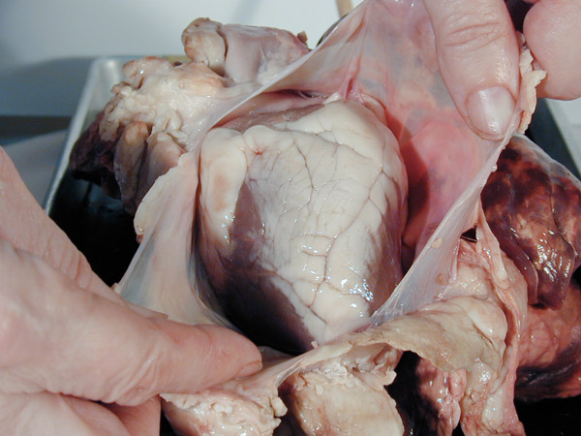
Pericardial Sac

Slide 25
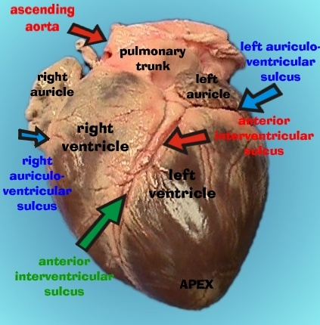
Anterior View of a Pig Heart

Slide 26
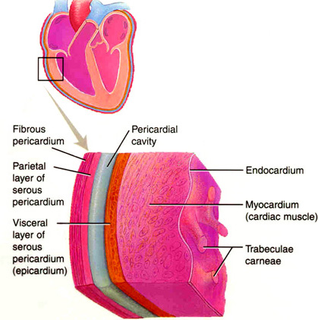

Slide 27
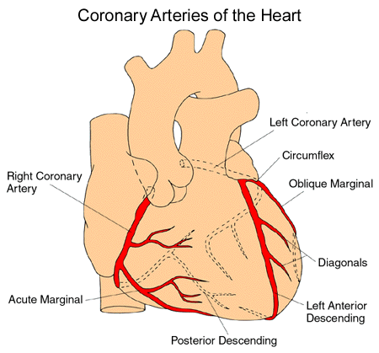
Coronary Arteries

Slide 28
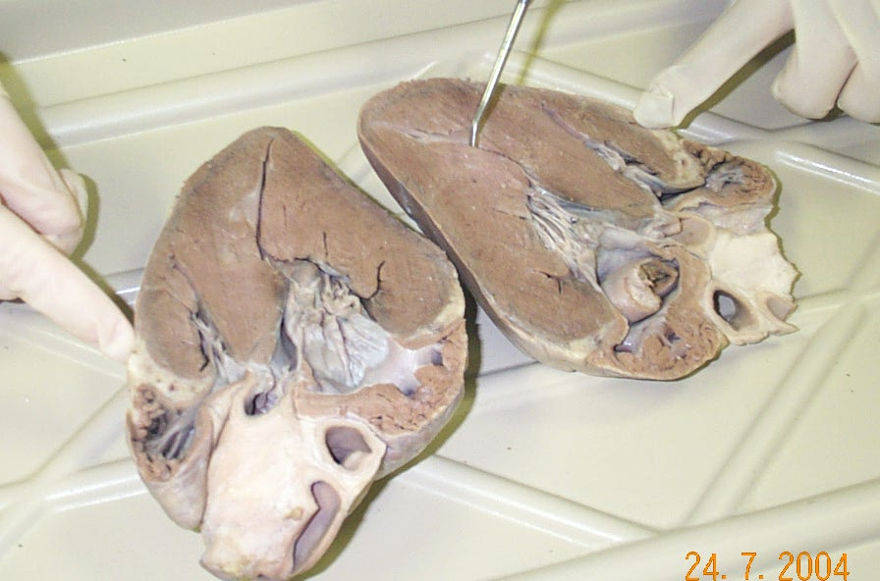
Frontal Section of the Heart

Slide 29
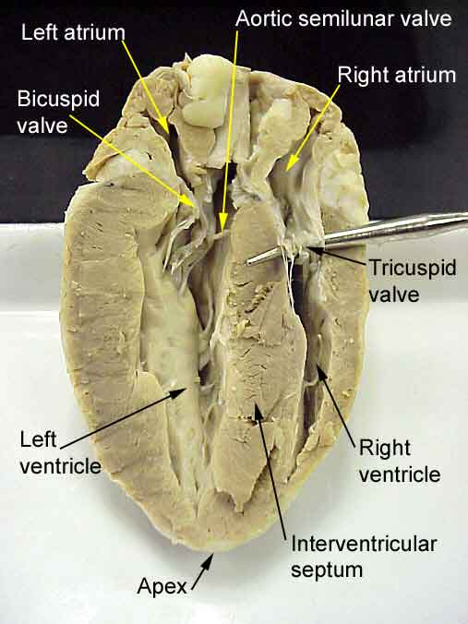
Chambers and Valves

Slide 30
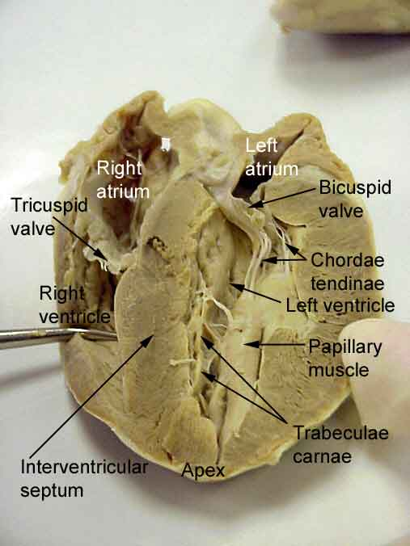
Papillary Muscles and Chordae Tendinae

Slide 31
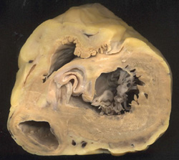
Heart Valves – Transverse Section
Tricuspid
Aortic Semilunar
Bicuspid
Left Ventricle

Slide 32
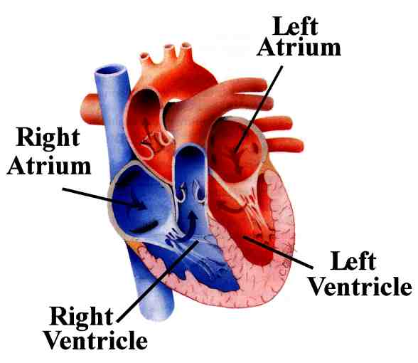
Path of Blood Through the Heart

Slide 33
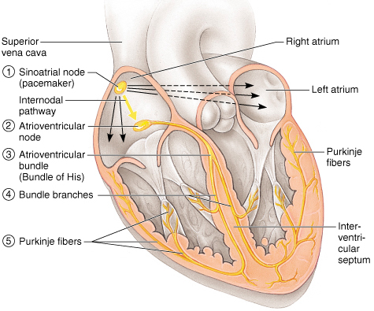
Conduction System and Pacemakers
Autorhythmic cells
cardiac cells repeatedly fire spontaneous action potentials
Autorhythmic cells: the conduction system
pacemakers
SA node
origin of cardiac excitation
fires 60-100/min
AV node
conduction system
AV bundle of His
R and L bundle branches
Purkinje fibers
It’s as if the heart had only two motor units: the atria and the ventricles!

Slide 34
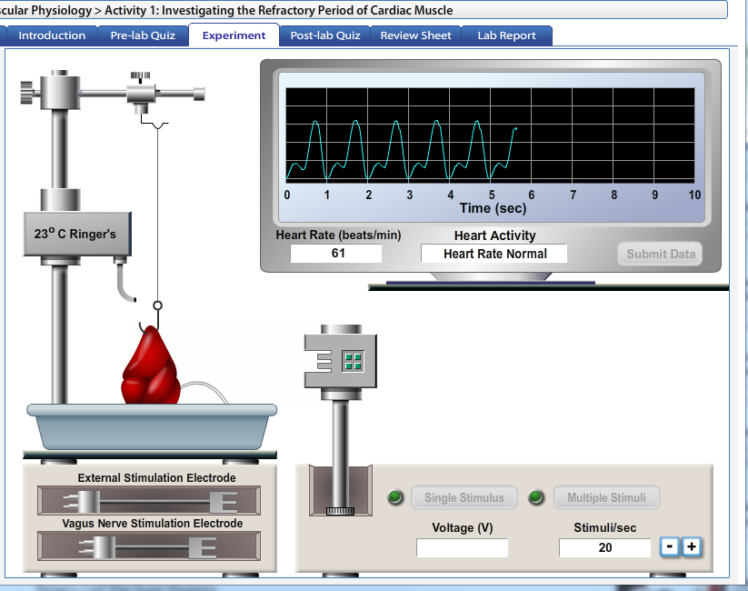
PhysioEx 6
Activities 1 & 2

Slide 35
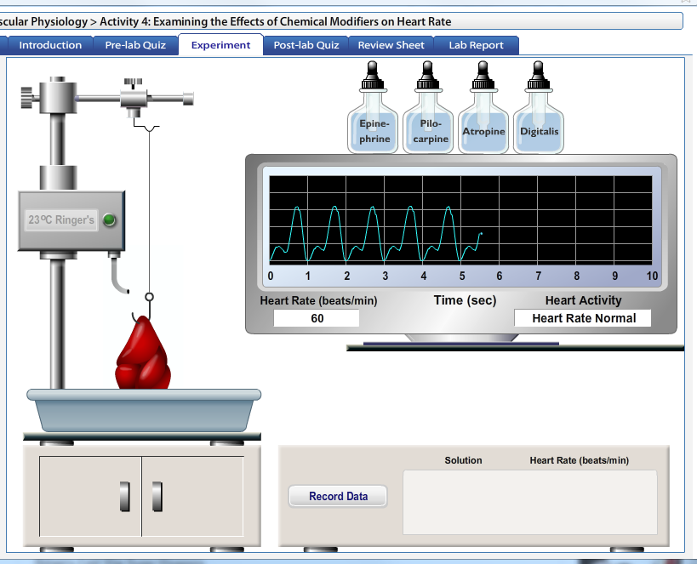
Lab Manual: Activity 3, BUT
PhysioEx 6 Activity 4

Slide 36
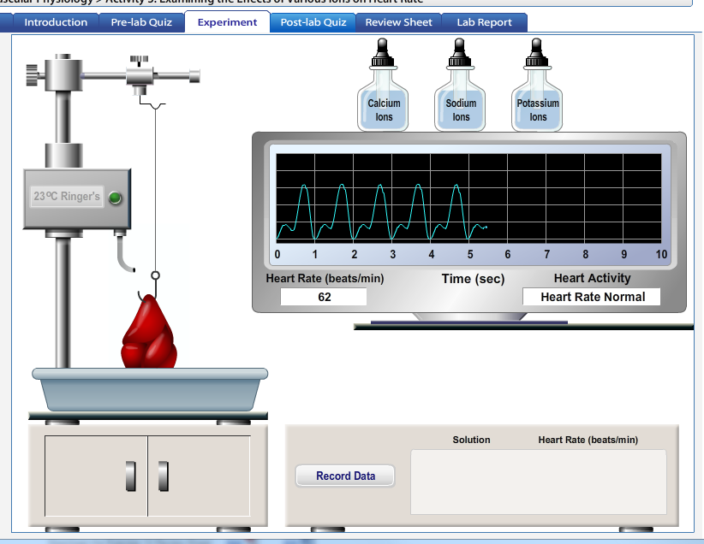
Lab Manual: Activity 4, BUT
PhysioEx 6 Activity 5

Slide 37
Homework to Turn In
Answer questions on tear-out page Lab 1-17 and 1-18 from your manual
Draw a simple sketch of the heart, frontal section, label vessels, valves and chambers, draw arrows for blood flow, and color code for oxygenated and de-oxygenated blood.
Refer to page 1-15 for details if you have questions regarding what to turn in.
This is due at the beginning of lab 2.

Slide 38
MasteringAandP Homework
Use your course ID (?) to enroll in the correct MAP section. https://www.pearsonmylabandmastering.com/northamerica/
Complete Lab Assignment 1 by 11:59 next Friday
There is a 10% per day deduction for late MAP assignments.
The study area of MAP has many resources (such as PAL) that are useful for lecture and lab!

Slide 39
End Lab 1 PPTs

