Slide 1


Slide 2
OFFICE OF DISABILITY SERVICES (ODS) Staff:
Jamie McCrary
David Sanford
Elitha Johnson
Dustie Dyce-Boxx

Slide 3
ODS mission statement:
To ensure access for students with disabilities to ALL curricular and co-curricular opportunities offered at APSU.

Slide 4
Defining disability-
The ADA defines a disability as an individual who:
Has a physical or mental impairment that substantially limits one or more major life activities to include major bodily functions - OR
Has a record of such impairment

Slide 5
Disability identity:
Visible vs. non–visible disability
Permanent vs. temporary disability

Slide 6
Laws/Policies That Protect Persons With Disabilities In Post Secondary Education
ADA
ADAA(2008)
Section 504 of The Rehabilitation Act of 1973
Title II And Title III
OCR
APSU Policy 6:004

Slide 7
College disability population:
College students with a disability – 25-30%
National average of students that disclose their disability – 19%
APSU students who have disclosed their disability – 8%

Slide 8
Accommodations vs. accessibility:
Accommodations - are built on a specific person’s disability needs.
Accessibility - access for everyone.

Slide 9
Types of accommodations: (not limited to)
Extended Testing Time (Example1.5)
Minimal Distraction Testing Area
Note-Taker Services
Use of Assistive Technology
Preferred Seating
Adjustable Seats/desks
Copy of Power Points

Slide 10
how students receive accommodations
Identify to the ODS office
Complete student application online
Complete intake meeting with Director/Associate Director
Request accommodations each semester via accommodation portal
Receive Accommodation Letters Via Email
Encourage the Scheduling Of student/teacher conference

Slide 11
Faculty Accommodation Letter video
Faculty Accommodation Letter(youtube)
Disability Services Training Tutorials
Disability Services Training Tutorials (website)

Slide 12
Example Of Accommodation Letter
John Doe- Fall 2020 -PSY1010
Mr. Doe is registered with the Office of Disability Services. The information provided has been prepared through consultation with our office. This information should be considered confidential. The accommodations as listed are among those identified in the Rehabilitation Act 1973, Section 504 and the Americans with Disabilities Act ADA which address the issue of non-discrimination of students with disabilities in post-secondary settings. The accommodations listed are not retroactive but become effective as of 18-JUL-17. The following accommodations are required:
1. Alternative Formats
o Accessible Textbooks
2. Alternative Testing
o Extra Time 1.50x
o Periodic Breaks
o Test Minimal Distraction Room
o Uses assistive technology
o Word Bank
3. EQUIPMENT
o Note Taking Software
4. INSTRUCTIONAL ACCOMMODATIONS
o Consideration for Attendance
Student may miss class due to disability; ODS will contact faculty to discuss whether flexibility in class attendance policy is appropriate.
o Extend time in class assign
o Short Breaks
o Uses Assistive Technology
5. Notetaking Services
o Notetaking
Students testing at ODS must have a testing agreement from their instructor.
Instructors, please fill out Alternative Testing Form by clicking the link https://teton.accessiblelearning.com/APSU/ContractInstructor.aspx?ID=3004&CID=82295&Key=fHopvnGX

Slide 13
It is recommended (not required) that student and instructor have a conference to discuss the approved accommodations. This can be done in person, on the phone, or via email. Once the conference is completed, please forward the information to DisabilityServices@apsu.edu.
In person – Student or Instructor may deliver a signed copy of the conference form to ODS.
On the phone – Send an email to ODS stating you have conferenced with the student. Please CC: the student in the email. The student may also email ODS and CC: the instructor.
Email – Forward the final email to ODS.

Slide 14
Students may not use all accommodations requested. It is at the student’s discretion on what accommodations he/she will utilize.
EX 1.) Student may be approved for minimal distraction testing location but does not feel that it is needed for every test.
EX 2.) Student may be approved for CART services but he/she may decide to use a recorder or a note taker in lieu of, if approved.

Slide 15
Testing At ODS
All tests are stored in a secure location. Test are automatically shredded
Testing rooms are monitored by proctors and video camera. Instructors may request video from ODS for any reason.
Only instructor approved material will be allowed in the testing room. No cell phones or other electronic devices are allowed in the testing room, unless pre-approved.
Test should be delivered to ODS 24 hours prior to the scheduled test.

Slide 16

Assistive Technology
Assistive technology (AT) is any item, piece of equipment, software program, or product system that is used to increase, maintain, or improve the functional capabilities of persons with disabilities. AT can be computer software: screen readers and communication programs or devices

Slide 17

Alternative formats
Alternative formats include audio, braille, electronic or large print versions of standard print such as educational material, textbooks, information leaflets and test.

Slide 18
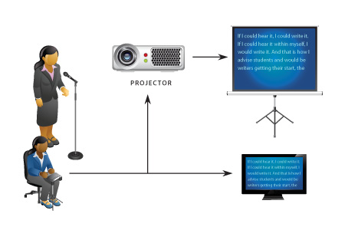
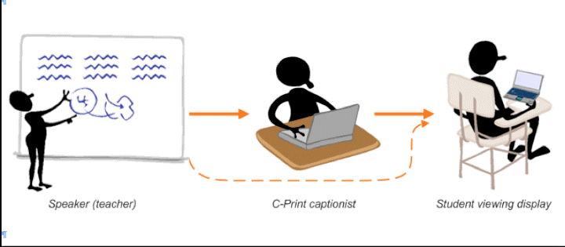
CART
Communication access real-time translation (CART), also called open captioning or real-time stenography, or simply real-time captioning,

Slide 19
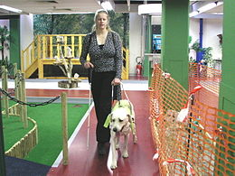
Assistance Animals
ODS assess if animal is an assistant animal
Differences between Assistant animal and Therapy Animal
Assistance Animals in the classroom
APSU follows HUD policies/procedures
Animals on Campus Policy 3:007

Slide 20

Other Programs at APSU
Full Spectrum Learning
TRIO
Academic Support Center
Adult and Non- traditional Students (ANTS)
Military Student Center
Health/Counseling Services
Student Conduct/Case Managment
Tuition Reduction Program

Slide 21

Together WE CAN MAKE A DIFFERENCE

