Slide 1
Lab 9
The Kidney

Slide 2
Lab 9: The Kidney
Dialysis experiment results and tests for NaCl and albumin (start dialysis first)
Kidney dissection
Urinalysis
Interpret dipstick with the help of a chart
Normal and abnormal constituents of urine
Urinary sediment (pictures +/or slides)
Histology
Kidney #62, Ureter #62, and Bladder #10
PhysioEx 41B Renal Physiology --The Function of the Nephron
Models
Urinary system
Kidney (including nephron and glomerulus models)

Slide 3
Dialysis and Kidney Dissection
For each group of 4 students:
Have two students set up the dialysis experiment
Have the other two students start the kidney dissection

Slide 4
Dialysis of Albumin and NaCl
Add albumin & NaCl using separate pipettes
Tie bag
Incubate for one hour
Test beaker water using biuret reagent for protein and silver nitrate for Cl⁻ ions

Slide 5
Kidney section

Slide 6
Kidney Dissection
Make a frontal section and observe visible regions
Save kidneys in a glove; mark with group names

Slide 7
A Human Kidney

Slide 8
The Nephron: Functional Unit of the Kidney

Slide 9
Three Physiological Processes
In the Nephron: 1) glomerular filtration, 2) tubular reabsorption , and 3) tubular secretion
These three processes cooperate to achieve the various functions of the kidney
Different sites → different primary functions

Slide 10
Cortex – low power

Slide 11
Cortex – with Glomerular Corpuscles

Slide 12
Glomerular Filtration Membrane Diagram

Slide 13
Glomerular Filtration Membrane

Slide 14
Cortex-Medulla Transition Zone

Slide 15
Renal Medulla – Base of Pyramid

Slide 16
Ureter Histology (retroperitoneal)

Slide 17
Urinary Bladder

Slide 18
Transitional Epithelium

Slide 19
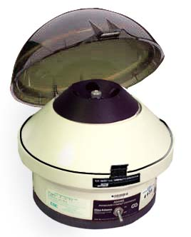
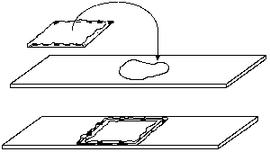
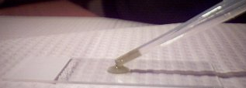
Urinalysis

Slide 20
Calcium Oxalate Crystals

Slide 21
RBCs – Some Crenated

Slide 22
WBCs & Bacteria (Rods)

Slide 23
Yeast

Slide 24
Squamous Epithelial Cells from the Urethra

Slide 25
Spermatozoan

Slide 26
PhysioEx Exercise 9
Activity 1

Slide 27
PhysioEx Exercise 9
Activity 1

Slide 28
PhysioEx Exercise 9
Activity 2

Slide 29
Exercise 9. Renal Physiology
The Function of the Nephron: Computer Simulation
Activity 1- The effect of arteriole radius on glomerular filtration. Page 9-18 Table 3
Activity 2- The effect of blood pressure on glomerular filtration. Page 9-18 Table 4
Below the data tables (or on the back of the page) construct and properly label six graphs using the data from each table.
You can use plotting software, e.g., Excel, if you like.

Slide 30
Please Leave the Lab Areas Clean
Gloves and tissue scraps to biohazard bucket
Dissecting trays & instruments washed and replaced
Urines flushed down the sink with plenty of water
Urine centrifuge tubes washed, rinsed, and disinfected; then returned to their racks to dry.
Urine cups, dipsticks, & paper towels in regular trash
Used microscope slide cover slips in sharps containers
Plain microscope slides washed and returned to microscope slide boxes
Test tubes washed and returned to racks to dry
Disinfect lab table and sink surfaces

Slide 31
Turn in: Pages 9-17/9-18 6 graphs Complete MAP 9 End Lab 10

Slide 32
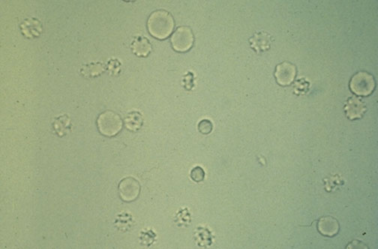
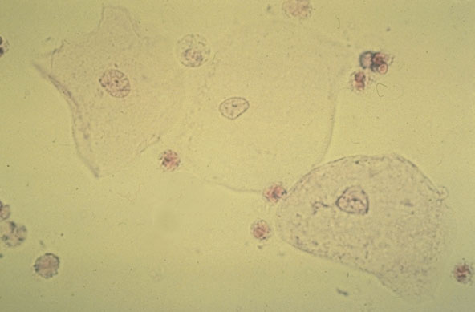
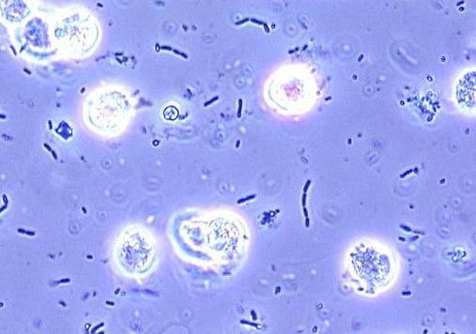
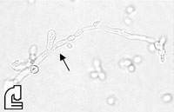
Red Blood Cells
Squamous Cells
Calcium Oxalate Crystals
White Blood Cells & Bacteria
Yeast

